Slide 1
HERMES
Strategic Education
&
Awareness Campaign
2022 - 2023

Slide 2
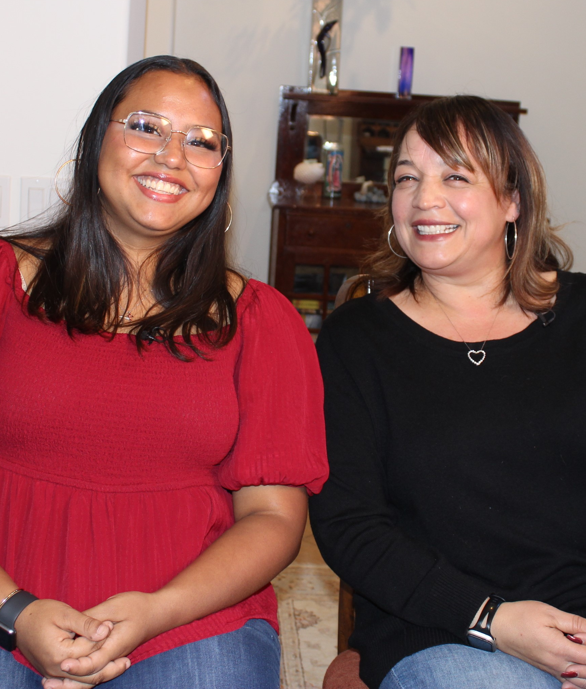
INTRODUCTION
The County of Ventura Human Services Agency, Children and Family Services (CFS) vision is to offer support, hope and opportunity to families and children in need. It is through this vision that Consortium Media developed this strategic education and awareness campaign for Strengthening VC Families.
Each program has a unique function that offers important resources to Ventura County families in need, ranging from business support including discounts, mentorship, and jobs; family and faith recruitment support including ongoing requests for safe and loving homes for children and older youth in care; social worker education to dispel public concerns; and awareness education to protect vulnerable children and youth in Ventura County.

Slide 3
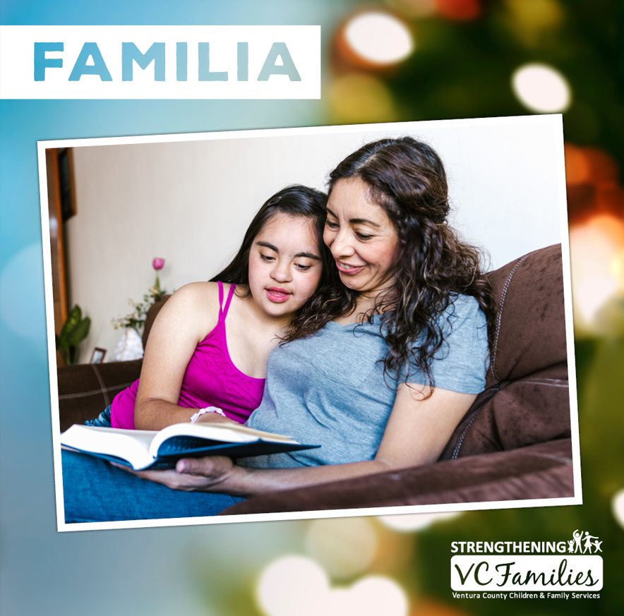
LA FAMILIA CREATIVE
Census (children removed from parents) is very high in many areas where poverty lurks. In Southern California, Latino families struggle with poverty due to several reasons, they may be new to the country, (often involved in the farming industry due to working on farms in Mexico or other areas) their work may be affected by weather, the ebb and flow of crops, illnesses or other reasons, and they and their children and youth may struggle as a result.
The Familia Campaign was designed to break down barriers and create a comfort level with families asking for help and support as well as stepping up to help children and families that may be separated for an interim time. In Ventura County, California, families are supported when they are in difficulty as well as reunified as soon as it is safe.

Slide 4
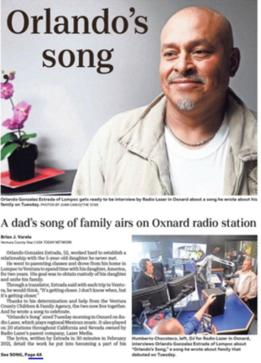
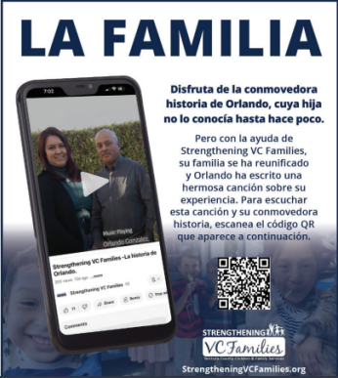
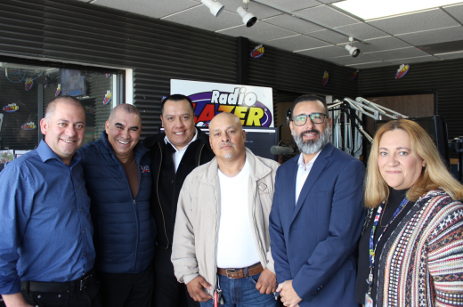
The story of Orlando’s Song gave Strengthening VC Families exposure from a large Spanish language broadcast network.
Orlando, a father, who had reunified with his daughter, wrote a song of joy about reunifiying with his daughter.
Consortium Media worked with Lazer Media’s Radio Lazer Network of 20 stations throughout California and Reno, Nevada to air “Orlando’s Song” in early March 2023. Listen here.
Radio advertising, digital marketing and a PR campaign happened concurrently and were extremely successful.

Slide 5
EBLAST 1
FAITH IN MOTION
Faith in Motion outreach was developed to target Ventura County’s faith communities. These populations have a high level of participation in providing out-of-home care. This campaign targets both faith leaders and the local faith communities who are asked to provide loving resource homes for local children or youth in need.

Slide 6
EBLAST #2 TO RELIGIOUS LEADERS IN VENTURA COUNTY
Greetings Friends,
I've recently had the opportunity to do some work with the Strengthening VC Families program from Ventura Human Services Agency, Children and Family Services (CFS), in their Faith in Motion campaign; I believe that this campaign has the potential to make a massive impact on the lives of Ventura children and families, but we need your help to make this happen.
Faith in Motion (FIM) is a unique collaboration between CFS and Ventura faith communities. Strengthening VC Families is inviting faith communities who care about vulnerable children in out-of-home foster care to join their work in restoring families and providing renewed hope for these children.
In past years, my wife and I were resource parents for children who needed out-of-home care, and our church currently supports many resource parents, including the amazing Shayley who you will meet in the video below.
Not only can it be rewarding to provide love, care, and stability to children or older youth in need and watch them grow and thrive, but it is essential to do so; as faith ministries, it is our duty to protect and invest in the youth in our community.
I recognize that some people may not be in a position to become resource parents, but there are many ways that our faith community can help - some of which are outlined in the video below.
During this special season, I was hoping you might share this video with your congregation during a service and/or send it by email.
Please also forward this to your Ventura County pastors. I greatly appreciate your help in this paramount work.
Blessings,
Pastor Jim Crews

Slide 7
FAITH IN MOTION CREATIVE
Digital
Postcards
Posters

Slide 8
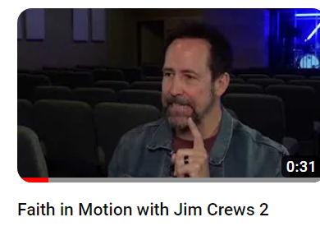
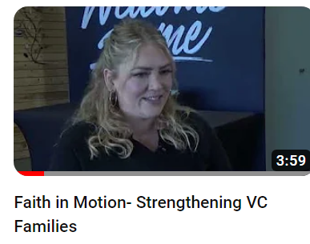
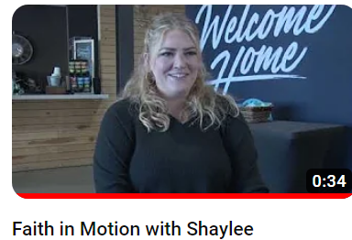
FAITH IN MOTION VIDEOS
Interviewees included former foster parent and current Pastor Jim Crews who spoke to both church leaders and to congregations about the need for resources homes within the community; Shalyee a foster parent who is currently fostering multiple children discussing her experience; and Jaci Johnson from County of Ventura, Children & Family Services

Slide 9
PERMANENCY
CREATIVE
Family and youth services are focussed on sharing that every child deserves permanency, and every family deserves to stay together whenever it is safe

Slide 10
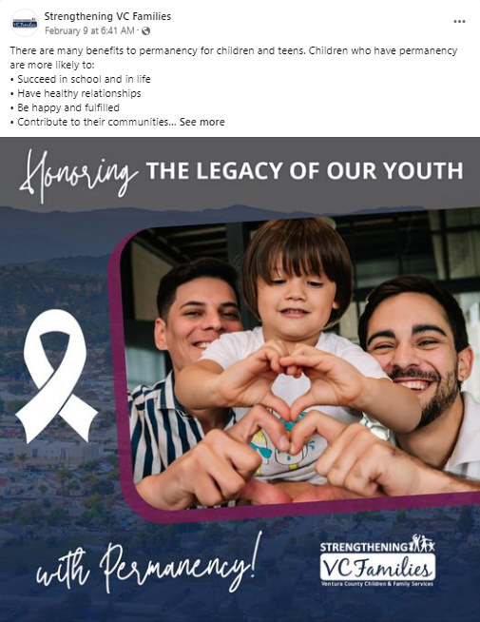
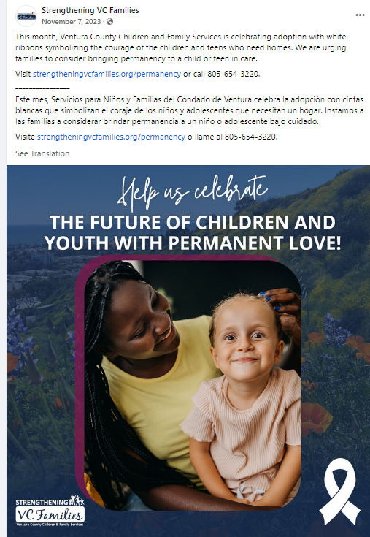
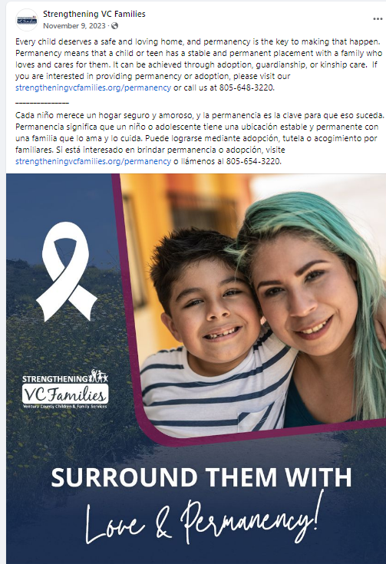
PERMANENCY SOCIAL & RADIO SPOTS
11/16 - 11/30
Radio – Spot 1
Radio – Spot 2
Radio – Spot 3

Slide 11
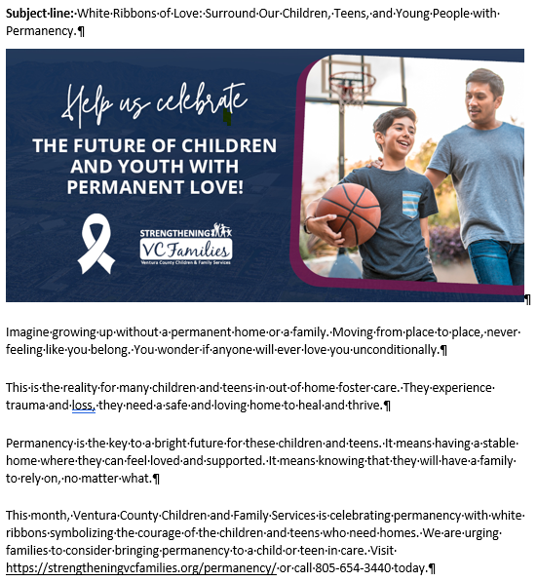
PERMANENCY E-BLAST
11/16 - 11/30

Slide 12
BUSINESSES WITH HEART CREATIVE
Businesses With Heart: This outreach targets Ventura County businesses who work with CFS to provide a range of supports to resource parents and to families in need. Some offer discount on products or services; mentor an older youth in business; or donate to community parents.

Slide 13
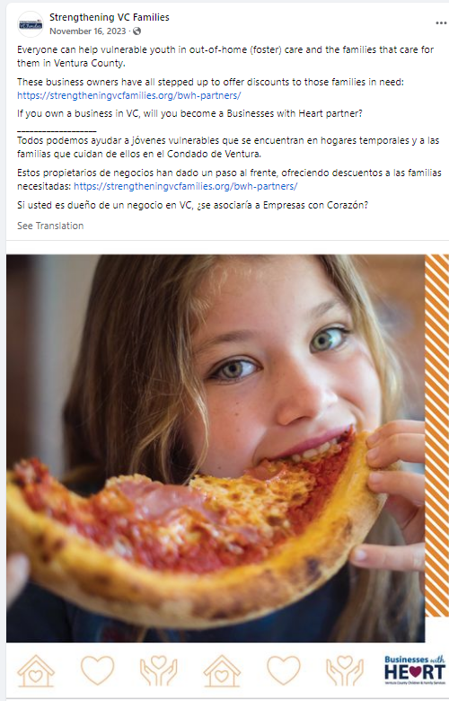
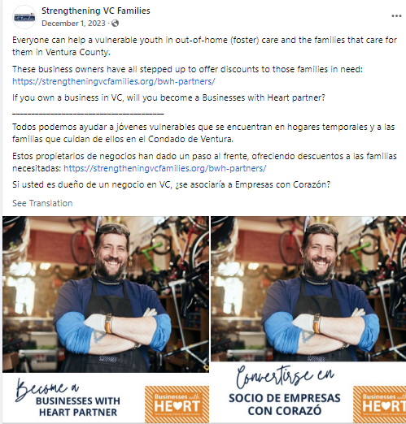
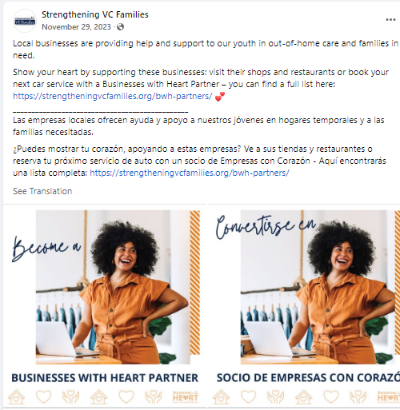
BUSINESSES WITH HEART SOCIAL AND RADIO
11/1 - 11/30

Slide 14
TAY OLDER YOUTH CREATIVE

Slide 15
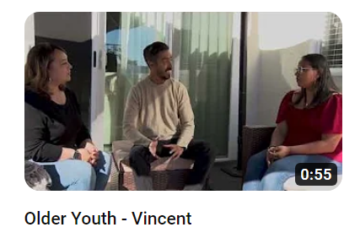
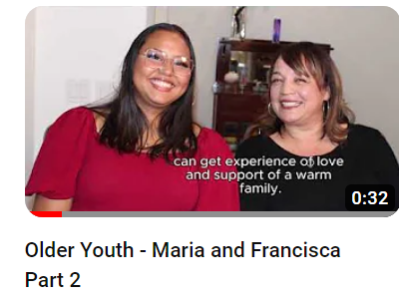
OLDER YOUTH VIDEOS

Slide 16
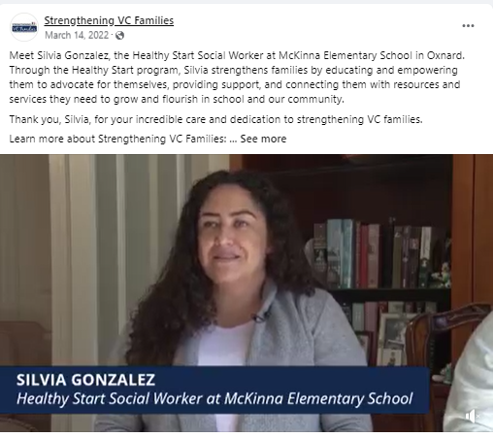
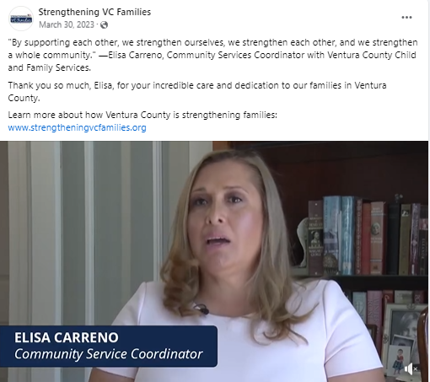
SOCAIL WORKER MONTH
To dispel the myths that social workers just remove children from parents, we raised the profile of this population – humanizing them, to create understanding and empathy within our community.
In March, we celebrate these social workers who have selflessly dedicated their careers to supporting families and ensuring the safety and well-being of all children and youth in Ventura County.
Click to play videos

Slide 17
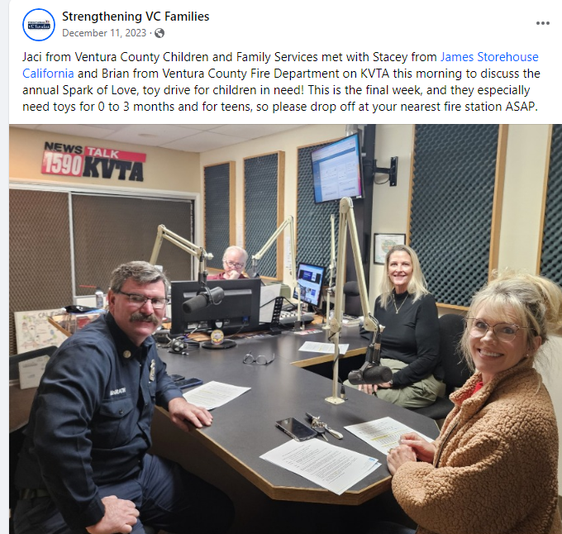
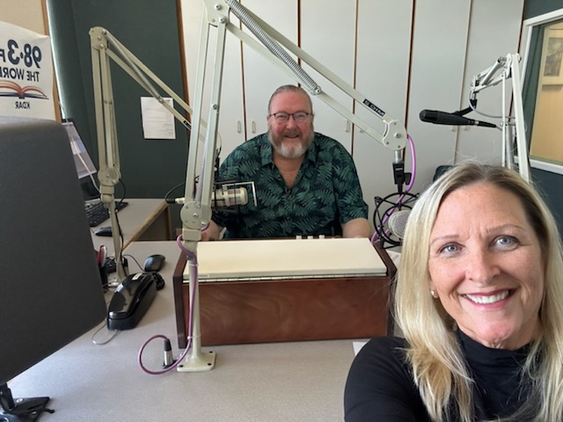
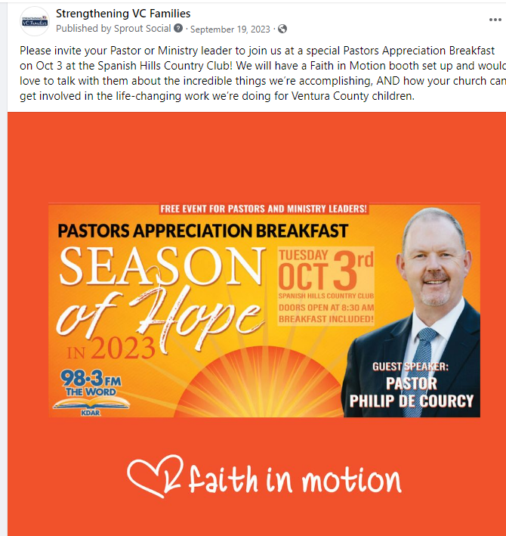
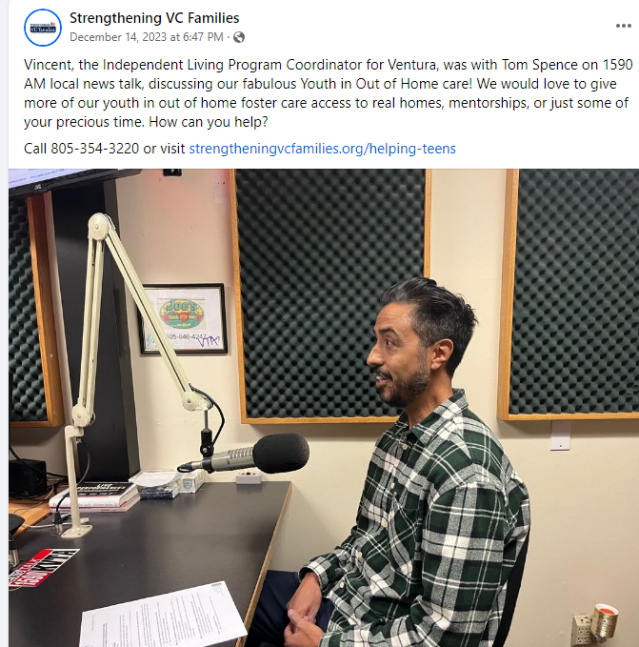
RADIO HIGHLIGHTS
Businesses With Heart
MP3 https://www.dropbox.com/scl/fi/icyerbmzxzayayifsth2f/VC-Children-and-Family-Services-final-111623-Businesses-with-Heart.mp3?rlkey=2tetksl4gi5t8lfs9ldl031ps&dl=0
La Familia
MP3 https://www.dropbox.com/scl/fi/svy4ophumvsklot6mc7s8/consort-hsa_0105-24_FIN.mp3?rlkey=adc2rjatunne3w3jwwxdevbo4&dl=0
MP3 https://www.dropbox.com/scl/fi/3ditnn6pj6vok0gzihww6/HSA_CC-Int-10-02-23_FINAL.mp3?rlkey=ww6ewzjnt52ssineoqlyw9vo3&dl=0
MP3 https://www.dropbox.com/scl/fi/sf6crurg7vum2qu9xc7de/HSAC-1004-23.mp3?rlkey=tbayivofjptxs1o93elpuihxc&dl=0
La Familia
MP3 https://www.dropbox.com/scl/fi/sly7nk2mommcf24e55n43/SVCF-Access-Resources-1.mp3?rlkey=km9at8vnwjcw3dcfrb3dnxkde&dl=0
MP3 https://www.dropbox.com/scl/fi/rg9ze2lny7xwzlbw3h9nf/SVCF-La-Familia-1.mp3?rlkey=ni1xvpfgrjhf1mj7jepp0n237&dl=0
Shelter Homes
MP3 https://www.dropbox.com/scl/fi/6d3cgjd58sgq2jf2jmhku/MIXTECO-COUNTY-OF-VENTURA-NEEDS-EMERGENCY-SHELTER-HOMES-1.mp3?rlkey=nu74lu6xyp1v6jk6uoe5fj9r2&dl=0
MP3 https://www.dropbox.com/scl/fi/q1y8prnj6nbx3da2revwz/MIXTECO-COUNTY-OF-VENTURA-NEEDS-EMERGENCY-SHELTER-HOMES-2.mp3?rlkey=ej0rzlg9hl1uuvo6rybod9tq4&dl=0
TAY
MP3 https://www.dropbox.com/scl/fi/1m0mcrhu5zxp1tlz8qne0/Foster-Care-final-120423.mp3?rlkey=2tt3wc4bx14yhkd86wz763wd6&dl=0

Slide 18
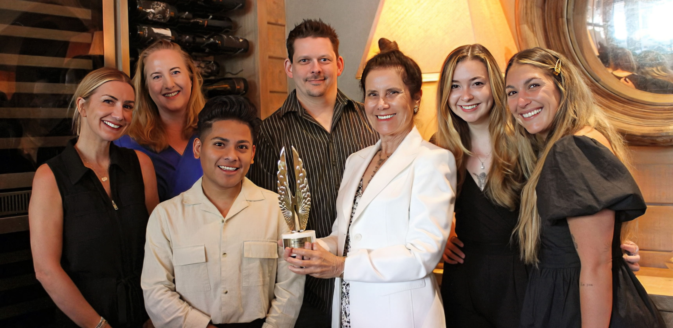
THANK YOU!
Our 30 years of passionate, award-winning brand and rebrand development through education and awareness gives us a unique and powerful pathway to help brands excel.
Visit consortium-media.com or email dbw@consortium-media.com

