Slide 1


Sizing the AI Economy
Thought Leadership Platform for Uniphore
April 2023

Slide 2
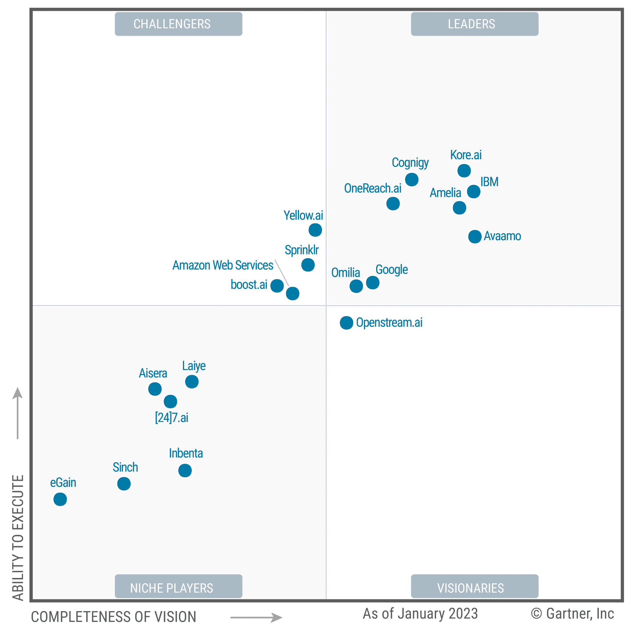
Assignment
Uniphore competes in the bruising “conversational AI” space against
many mega brands. Gartner’s magic quadrant for conversational AI included
19 companies and that’s only a sampling
of its competitors.
The company seeks a thought leadership platform to take the high ground and differentiate. Equally important, this can’t be a short-term event. It must sustain a regular drumbeat of visibility over the long term, which then builds the Uniphore brand and delivers air cover for sales.
2

Slide 3
No Single Topic Currently Commands Attention Quite Like AI
Thanks to the introduction of ChatGPT,
the profile of AI transcends the tech sector. Heck, the insurance salesperson
in Omaha now understands AI’s potential impact on business. The chart to the right depicts the number of articles with either [AI] or [artificial intelligence] in the headline (Source: Factiva). You can see
the number of hits in Q1 of 2023 already
far exceeds the entire total of 2022.
Crazy!
2019
2020
2021
2022
2023 Q1
3

Slide 4
How Can Uniphore Ride This AI Wave of Interest?
By being the company that quantifies the AI economy.
Toward this end, we will dive
into sizing the AI economy as a thought leadership platform.
4

Slide 5
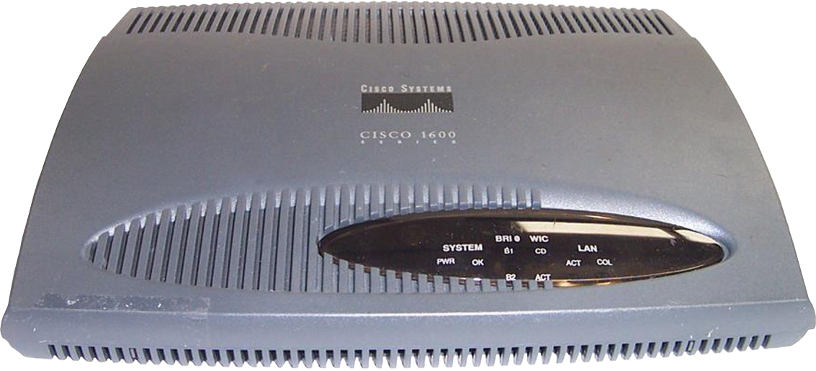
OK, Let’s Rewind the Tape
to Cisco Sizing the Internet’s Impact on the Economy
Stage Setting
Cisco, known for its switches
and routers, recognized an opportunity to take the high ground as a leading driver of
the internet.
5

Slide 6
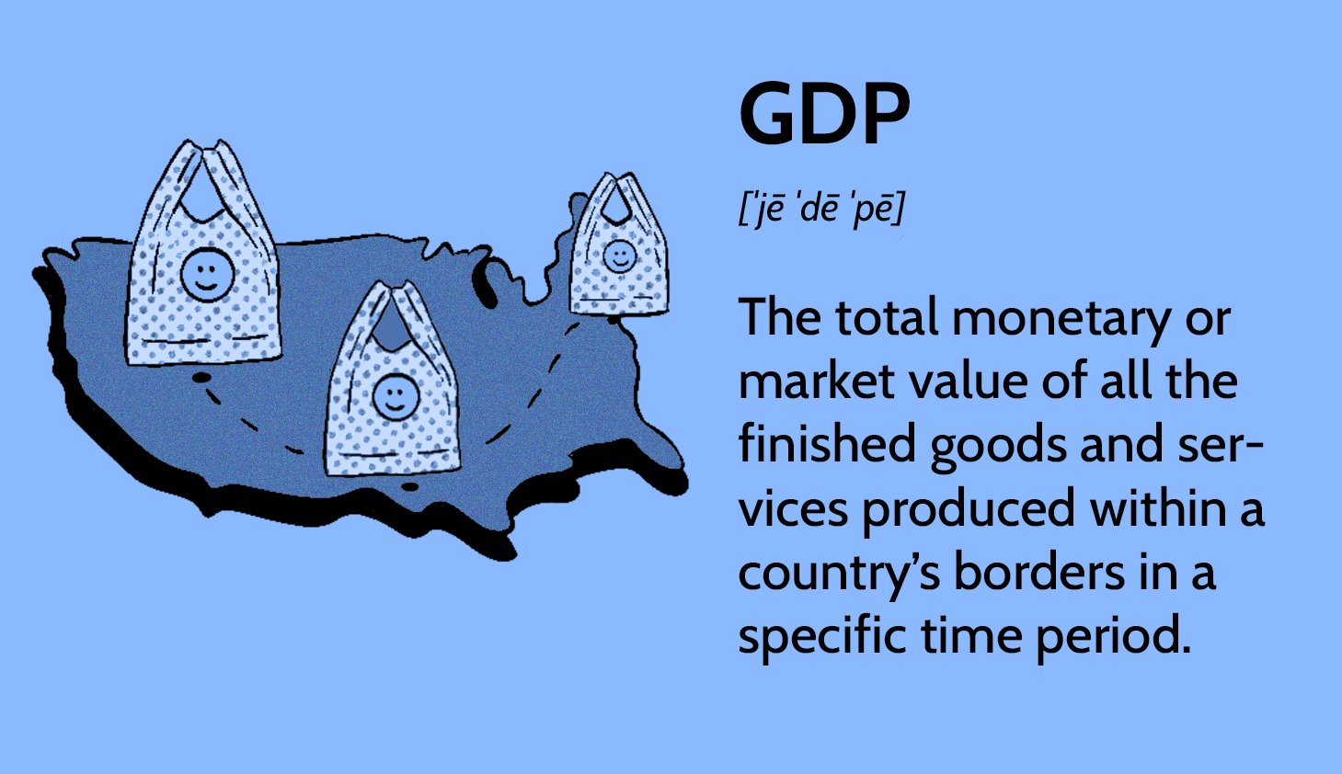
OK, Let’s Rewind the Tape
to Cisco Sizing the Internet’s Impact on the Economy
Cisco was striving to differentiate from Lucent and commodity hardware for networking.
The company engaged the University of Texas at Austin to conduct research on how the internet grew the U.S. economy.
  Two data points anchored the study:
  job creation and an increase in GDP
  The study ran from 1998 to 2000
6

Slide 7


Cisco Sizing the Internet’s Impact on the Economy
These numbers capture how Cisco gained separation from Lucent (source: Factiva).
0
1996
1997
1998
1999
2000
7

Slide 8

Cisco Sizing the Internet’s Impact on the Economy
CEO John Chambers adopted the study as
a speaking pulpit.
“
John Chambers could charm butter off toast.
Speaking to a sold-out audience at a Churchill Club’s dinner held Tuesday evening at the Santa Clara Marriott, the down-home CEO of Cisco Systems (CSCO) once again spread the gospel of the Internet, saying that the “New Economy is the Internet economy,” and as such, the Internet will change everything.
— From the Red Herring (Feb. 17, 1999)
8

Slide 9
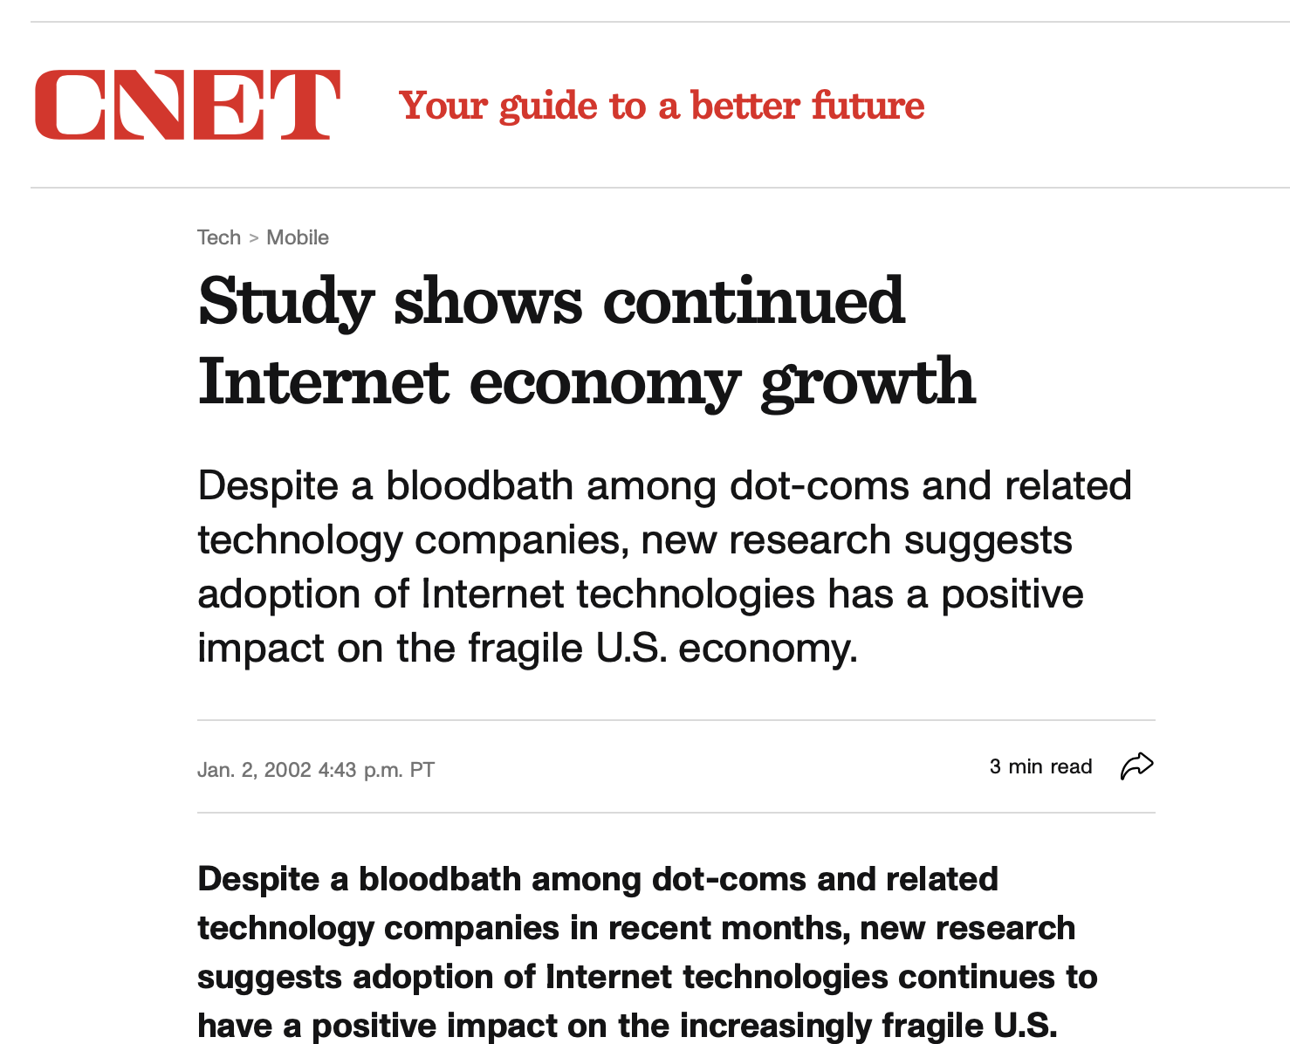
Cisco Sizing the Internet’s Impact on the Economy
Even after
the dot-com meltdown, the media continued
to reference Cisco
and the study.
9

Slide 10
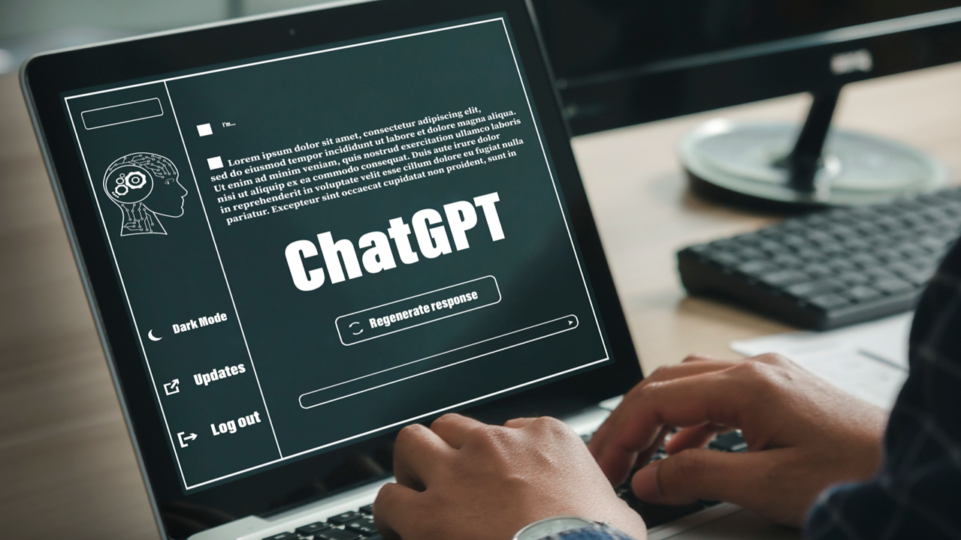
How Do Journalists Write About the Economic Impact of AI?
Of course, we had to start by asking ChatGPT the question,
“What is the economic impact
of artificial intelligence on the economy?”
What is the economic impact of artificial intelligence on the economy?
10
10

Slide 11
ChatGPT’s Answer
“Artificial intelligence (AI) has the potential to transform many industries and have a significant impact on the economy. Here are some ways in which AI can affect the economy:
Increased productivity: AI can automate many tasks, reducing the need for human labor and increasing productivity. This can lead to cost savings and higher profits for businesses.
New job opportunities: While AI may eliminate
some jobs, it can also create new job opportunities, particularly in fields related to AI development and maintenance.
Improved decision-making: AI can help businesses make better decisions by providing insights and predictions based on data analysis.
Increased efficiency: AI can optimize processes
and reduce waste, leading to increased efficiency
and lower costs.
Improved customer experience: AI can be
used to provide personalized recommendations
and improve customer service, leading to
increased customer satisfaction and loyalty.
Disruption of traditional industries: AI has the potential to disrupt traditional industries, such as transportation and healthcare, leading to significant changes in the economy.
Overall, the economic impact of AI will depend on how it is developed, adopted and regulated. While AI has the potential to bring many benefits, it is important to consider the potential risks and work to mitigate them.”
What is the economic impact of artificial intelligence on the economy?
11
11

Slide 12

We Refined the Ask:
“Quantify the impact of artificial intelligence on the economy”
No One Appears to Have Cracked the Code
“In conclusion, while the economic impact of AI is difficult to quantify precisely, it is clear that AI has the potential to bring both benefits and risks to the economy. Careful planning, regulation and investment are needed to maximize the benefits and mitigate the risks of AI.”
12
12

Slide 13
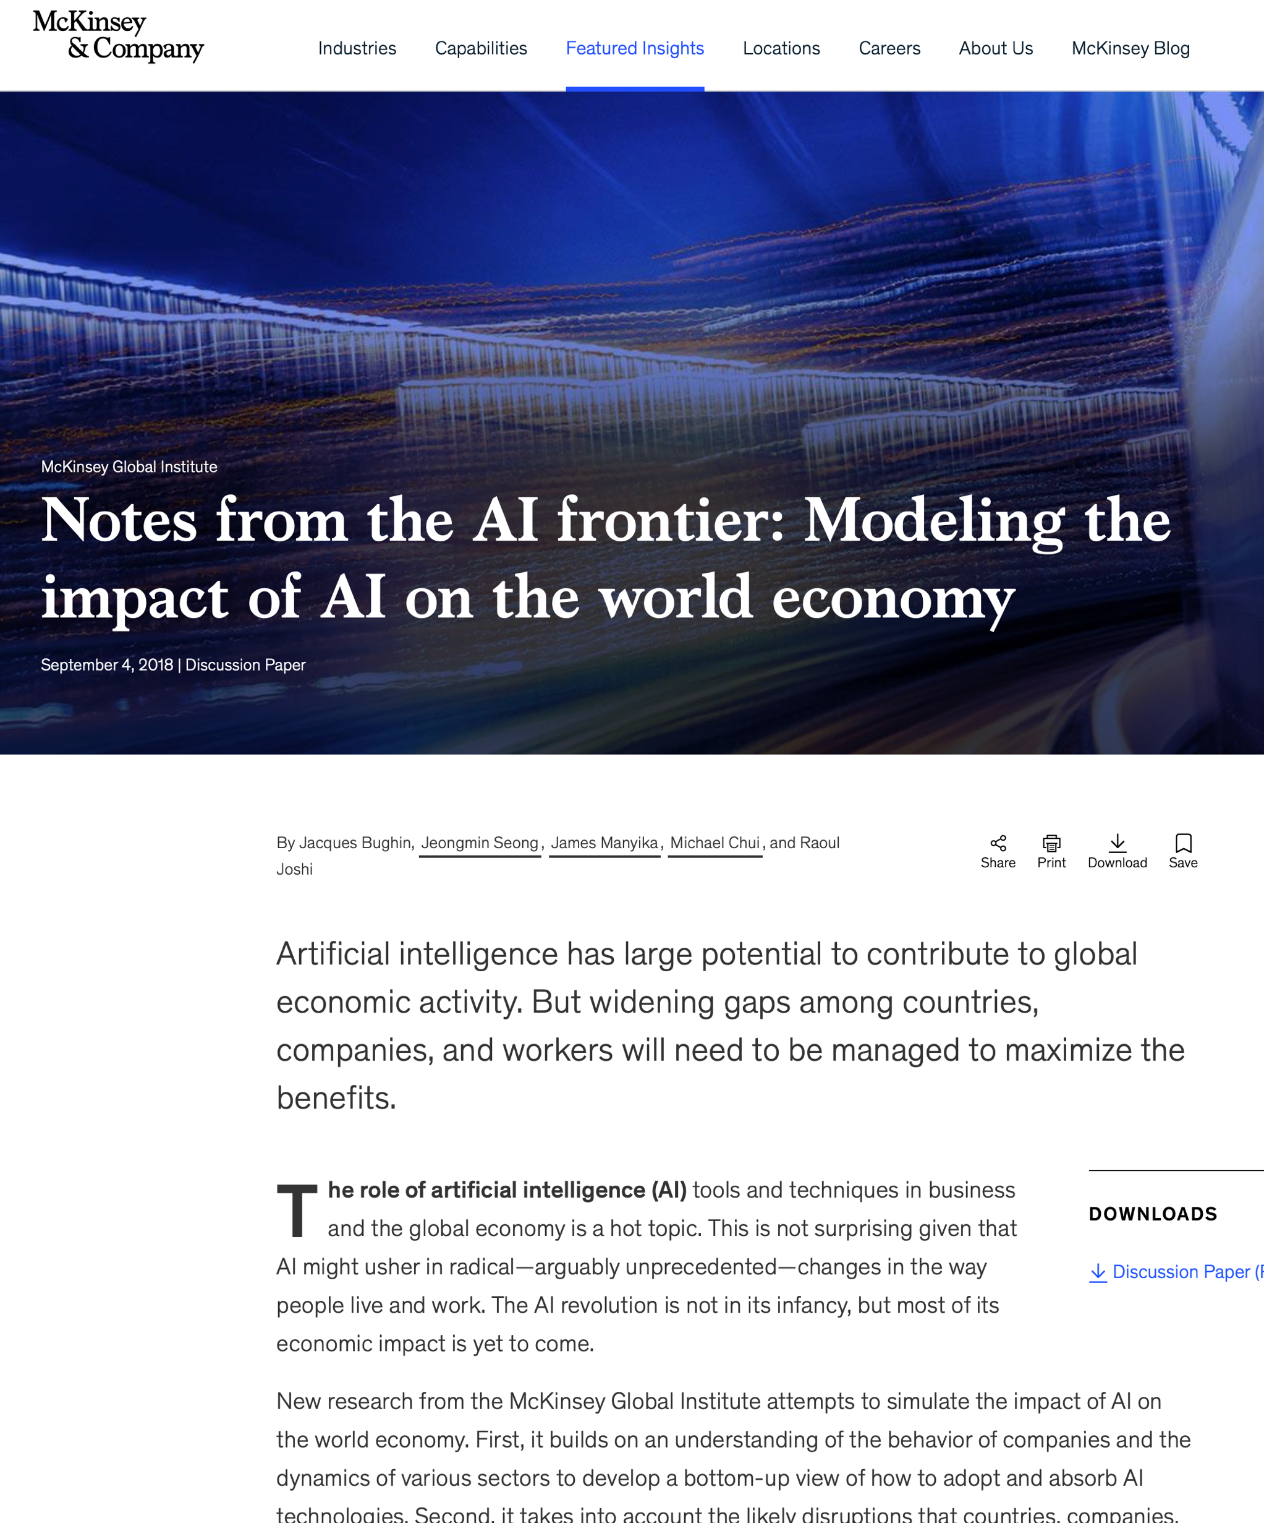

Raking the Online Sand on the “AI Economy” Turned Up a McKinsey Paper (Sept. 2018)
Includes two macro data points:
  AI has the potential to deliver additional global economic activity of around $13 trillion by 2030, or about 16% higher cumulative GDP compared with today. This amounts to 1.2% additional GDP growth per year.
  Up to 800M workers could lose their jobs to AI and automation by 2030.
13
13

Slide 14
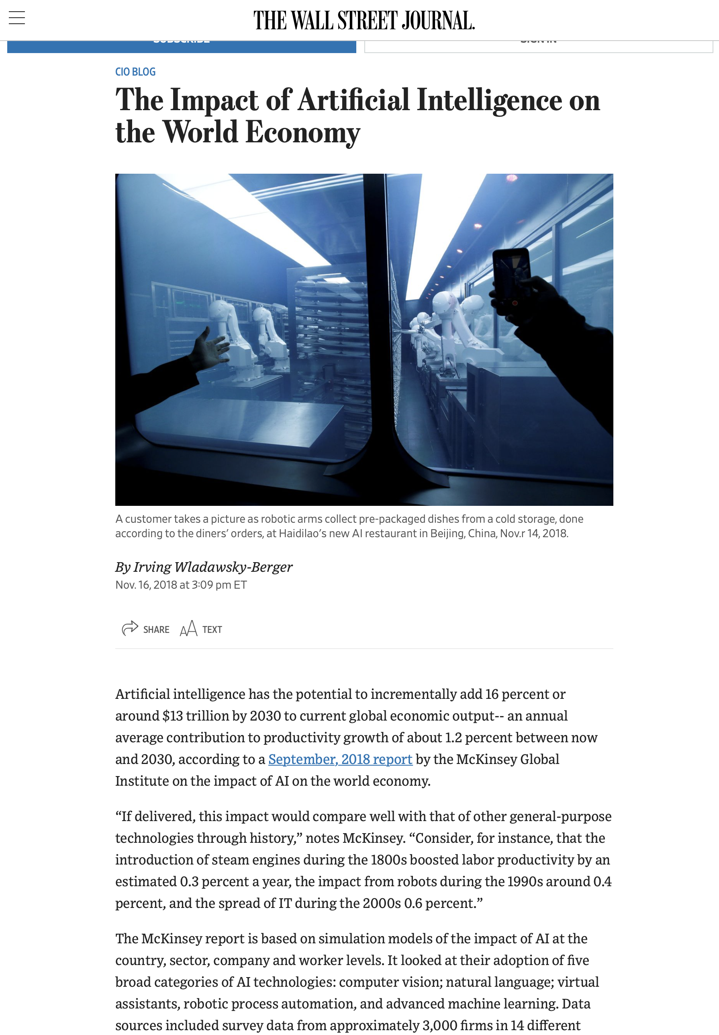
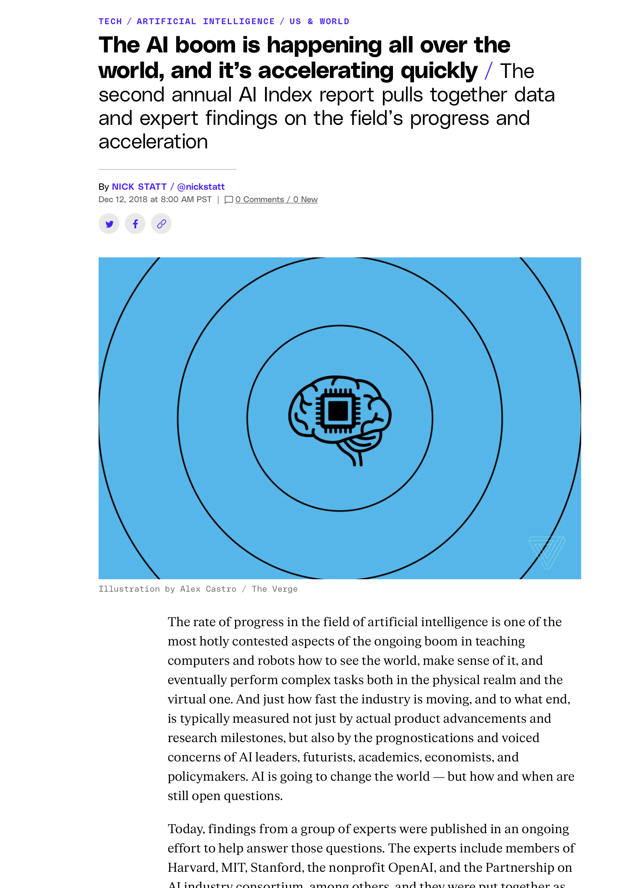

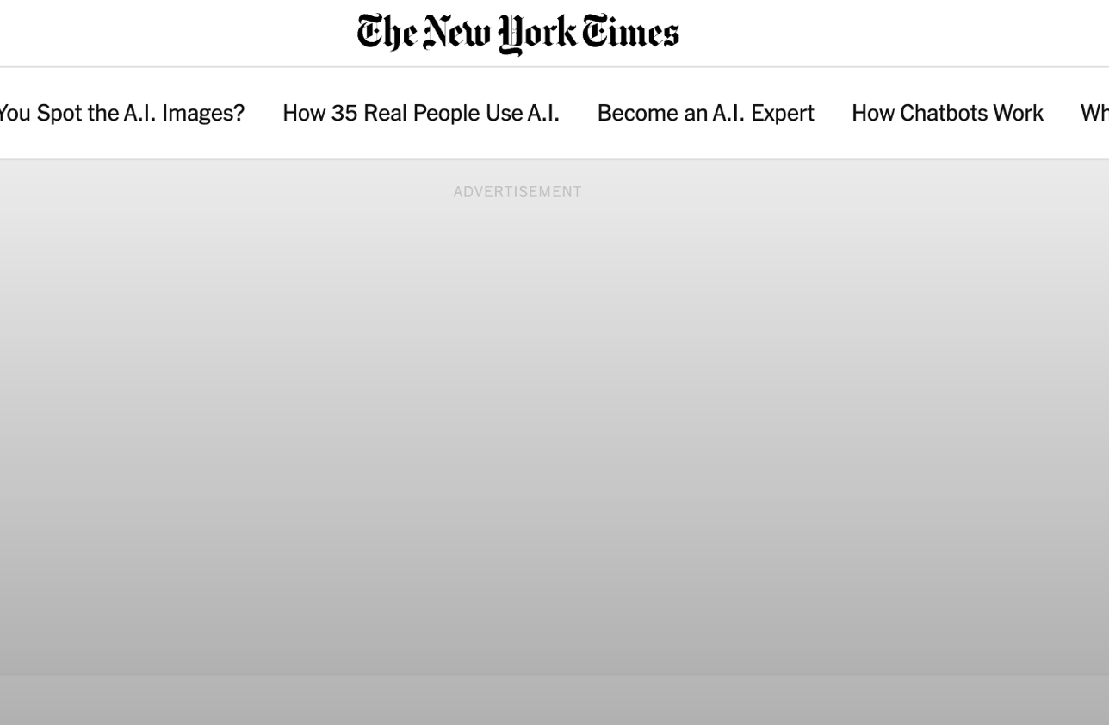
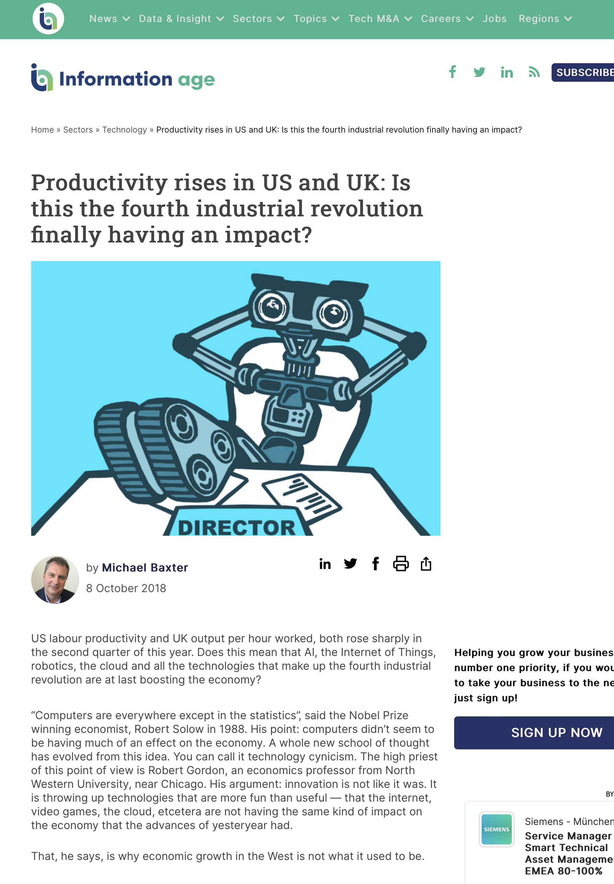
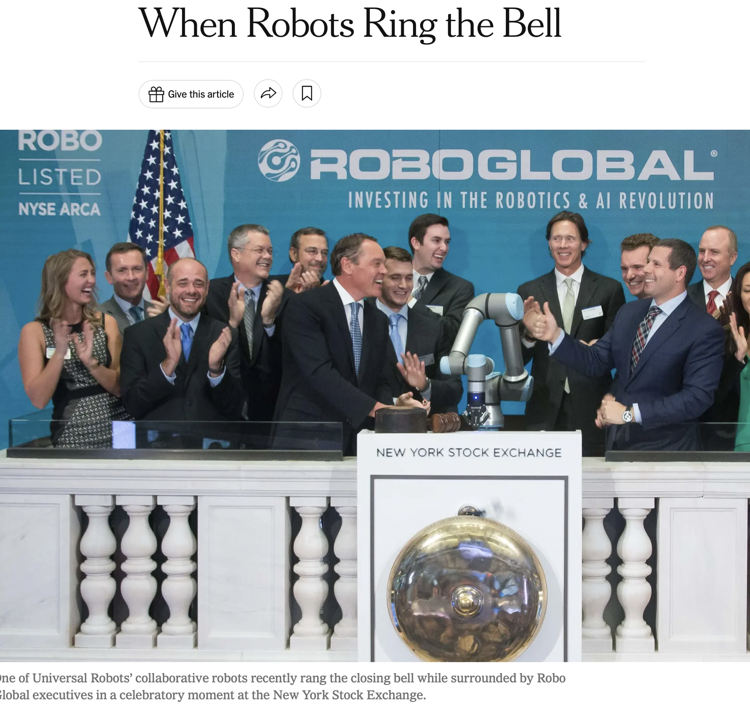
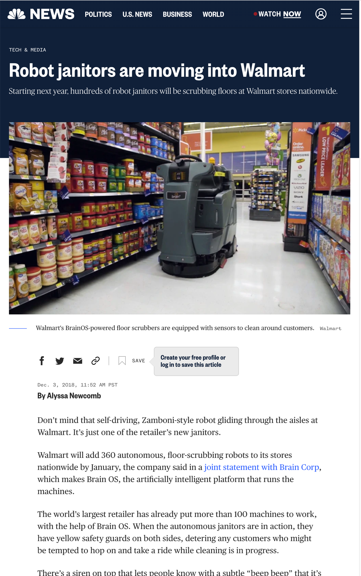
Journalists Covered the McKinsey Data Points:
Job Displacement Dominates the Storyline
14

Slide 15

The McKinsey study takes a
“blue-sky” look at AI’s place in the economy rather than truly sizing
AI’s impact on the economy.
15

Slide 16
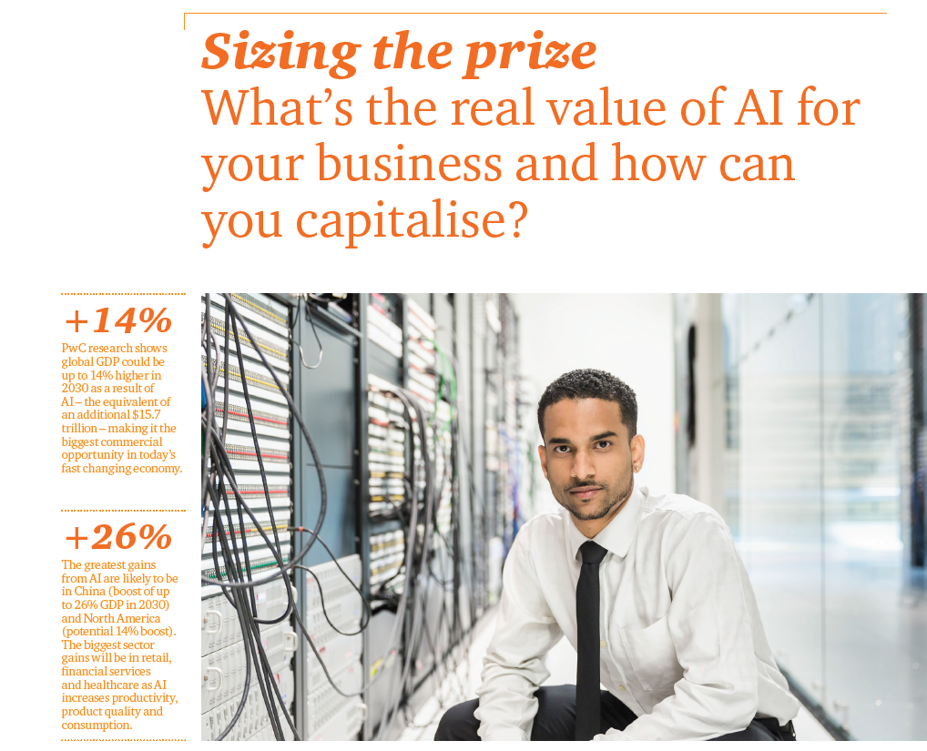
PwC Also Generated a Report on the
AI Economy (2017), Another “Blue-Sky” Approach
Journalists Periodically Reference (even though the data is old)
2017
16
16

Slide 17
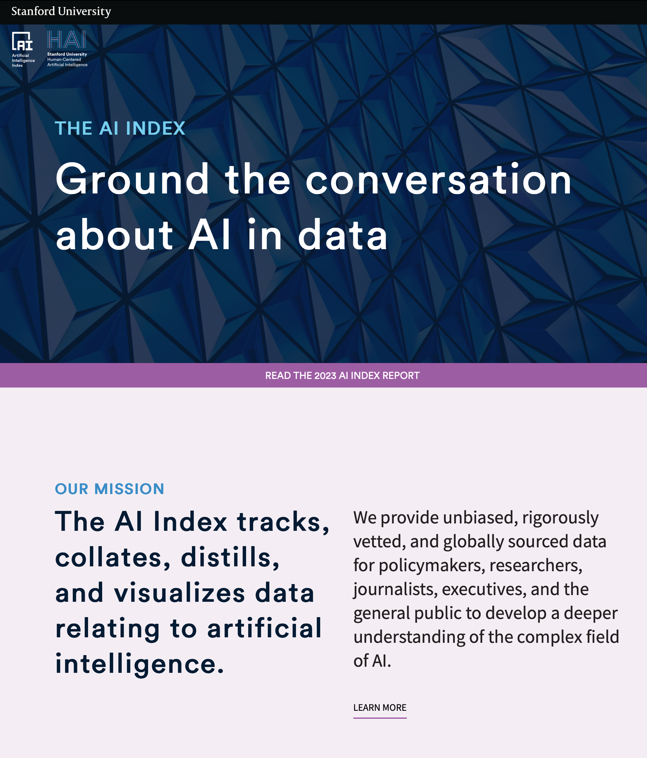
Stanford Has Created the AI Index, Which Drills Down Into AI-Related Issues as Opposed to Economic Impact
17
17

Slide 18
More Recently, Goldman Sachs Took a Stab at Framing the AI Economy
18
18

Slide 19
More Recently, Goldman Sachs Took a Stab at Framing the AI Economy
Focused on generative AI:
  Riff off the ChatGPT phenomenon
Highlighted job displacement:
  Makes the point that history shows
  when automation eliminates jobs, they’re typically offset by the creation of new jobs. Yet, the study doesn’t quantify AI’s impact on job creation.
19
19

Slide 20
More Recently, Goldman Sachs Took a Stab at Framing the AI Economy
Estimated generative AI could raise U.S. labor productivity growth to just under 1.5% over a 10-year period.
  A relatively easy dart to throw
  without putting a timeline to it.
Much more difficult to research where we are today, the velocity of change and where will we be in 12 months.
20
20

Slide 21
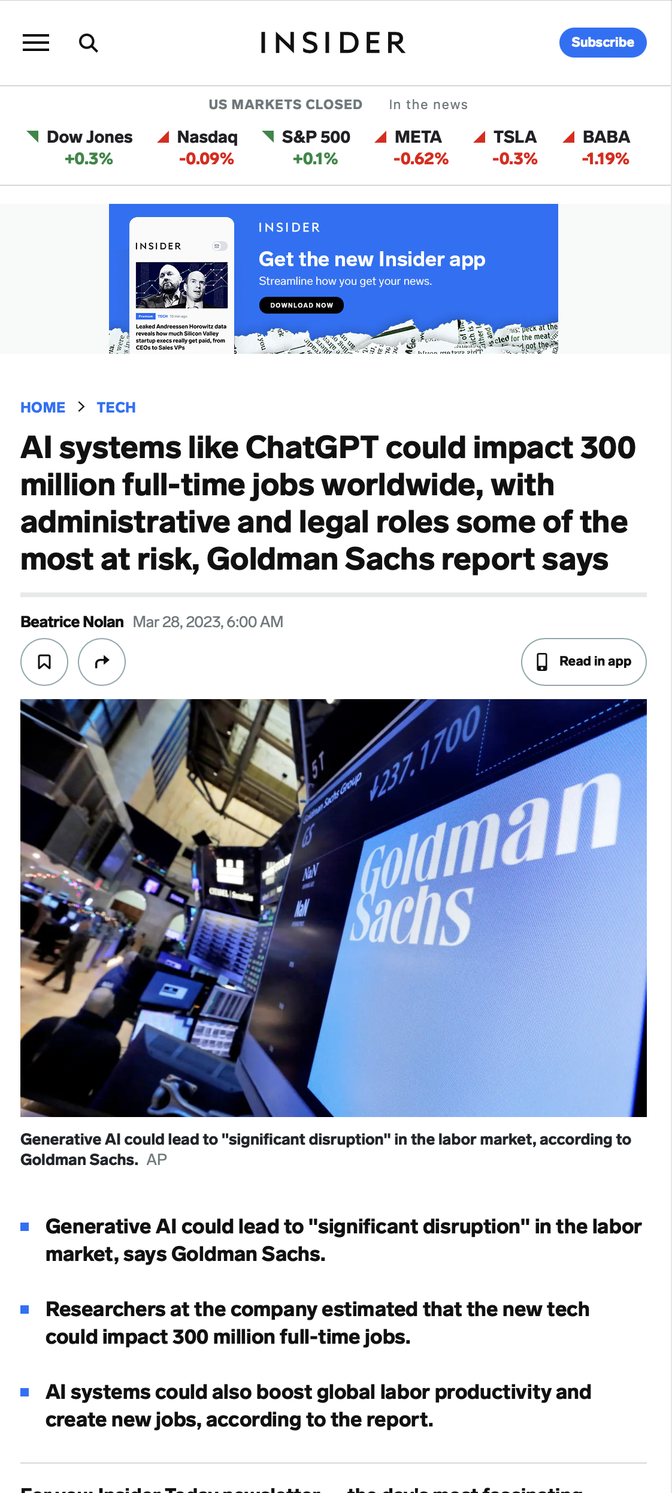
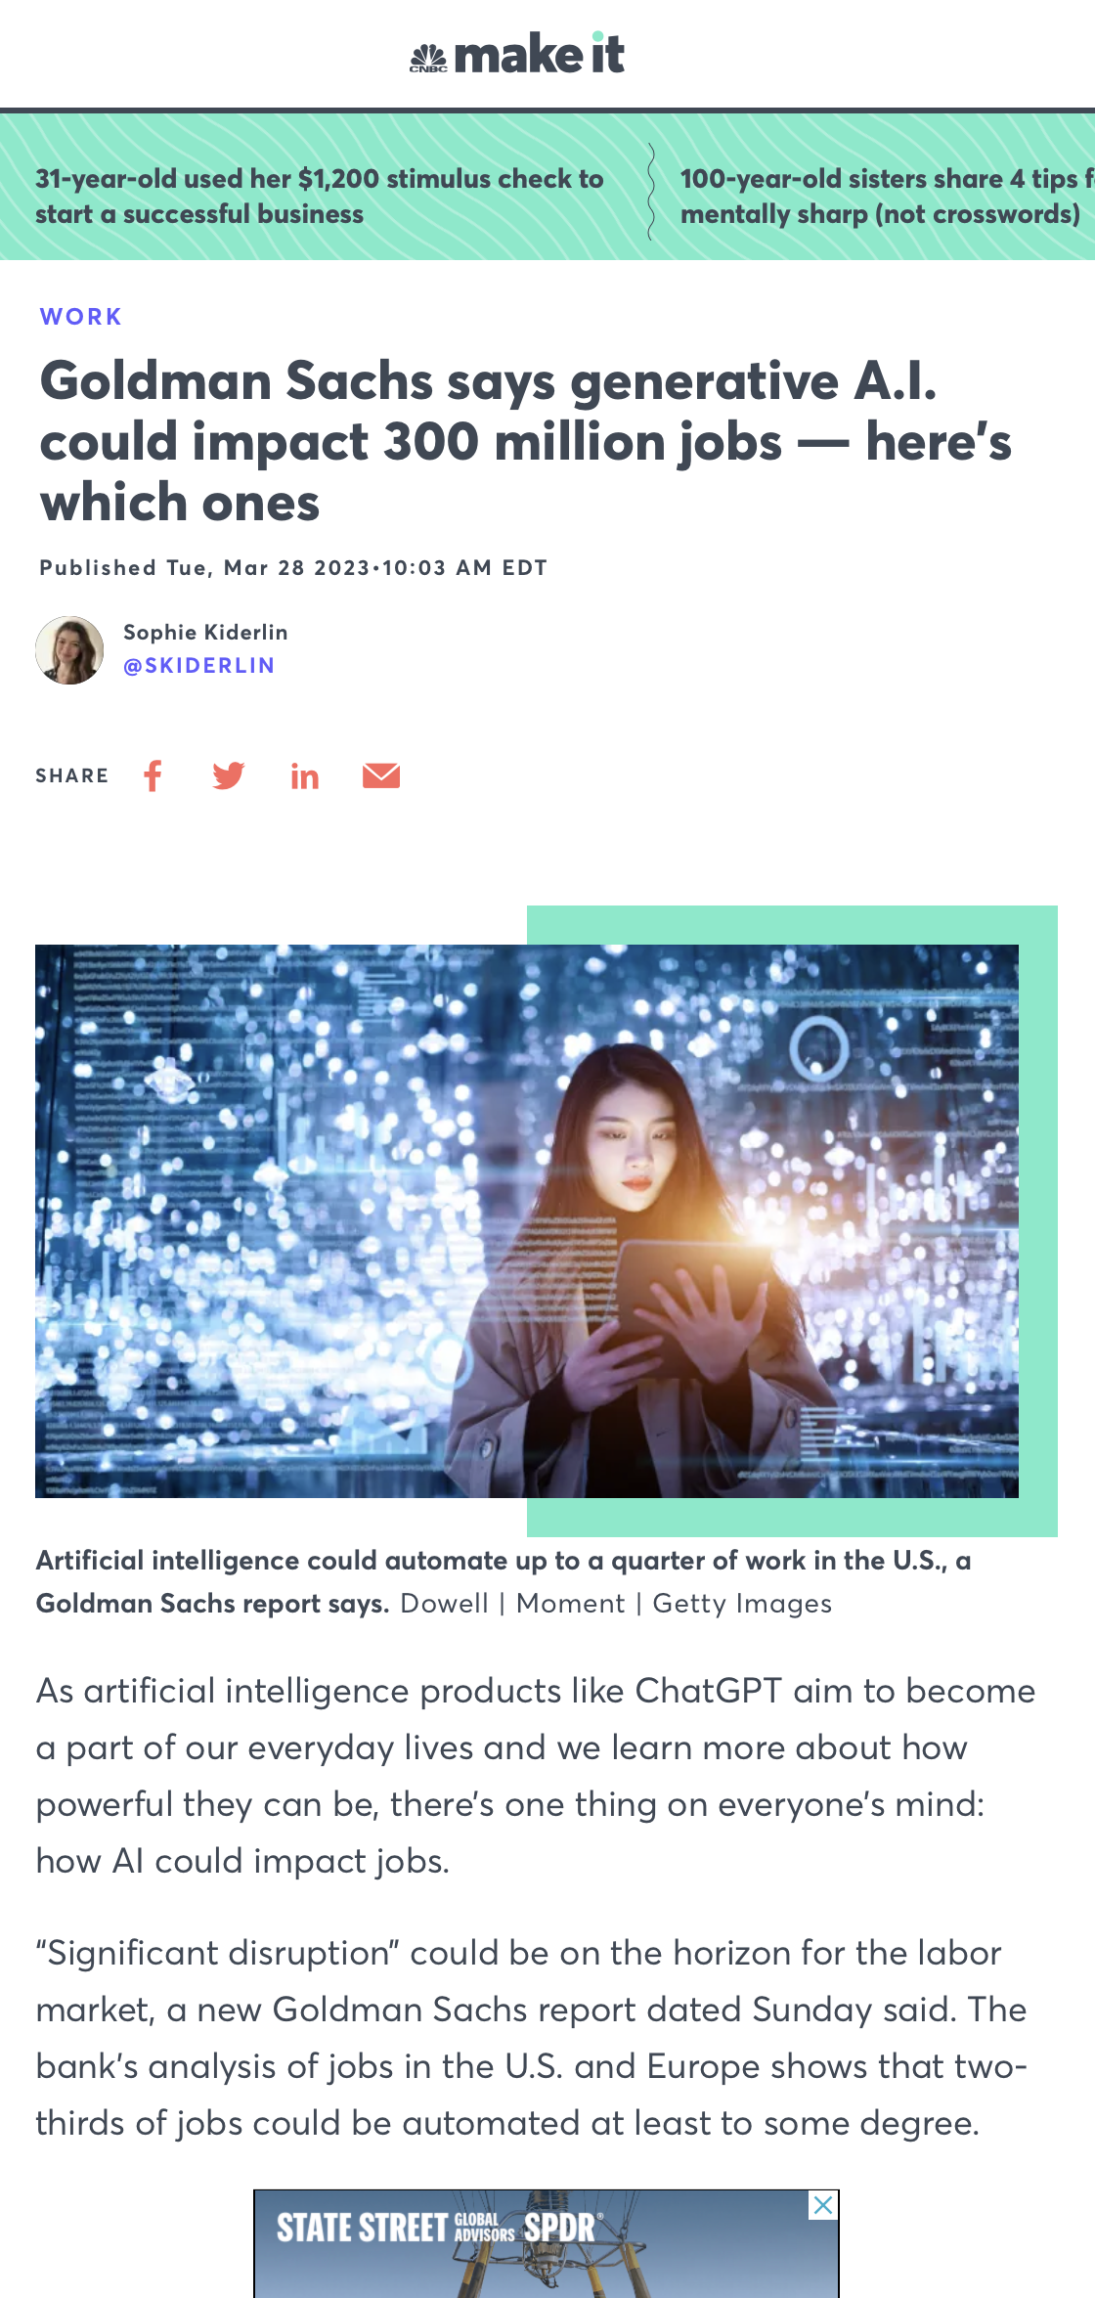
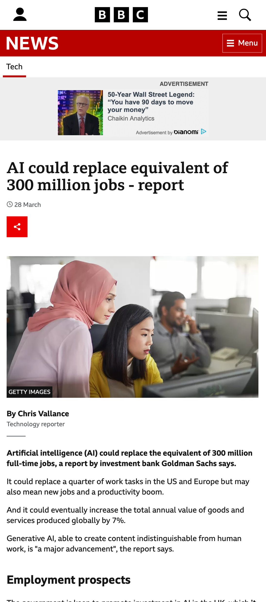
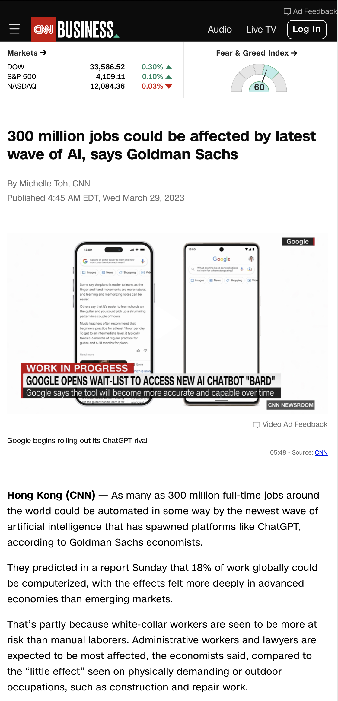
Still, the Media Widely Reported on the Goldman Sachs AI Study
Again, Emphasizing the Job-loss Narrative

Slide 22

The opportunity is there for a company to put a stake in the ground in quantifying the value creation from AI .
22

Slide 23
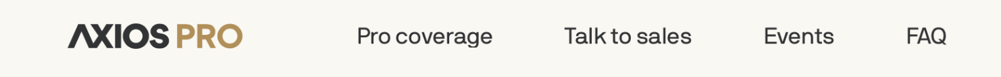

Opens the Door
to Educate Government
“We believe AI may represent the most consequential technology advancement of our lifetime. There is enormous interest in the opportunity ahead. And responsibilities for those of us who develop this technology. We’re using this time to educate, be curious and learn.”
23

Slide 24
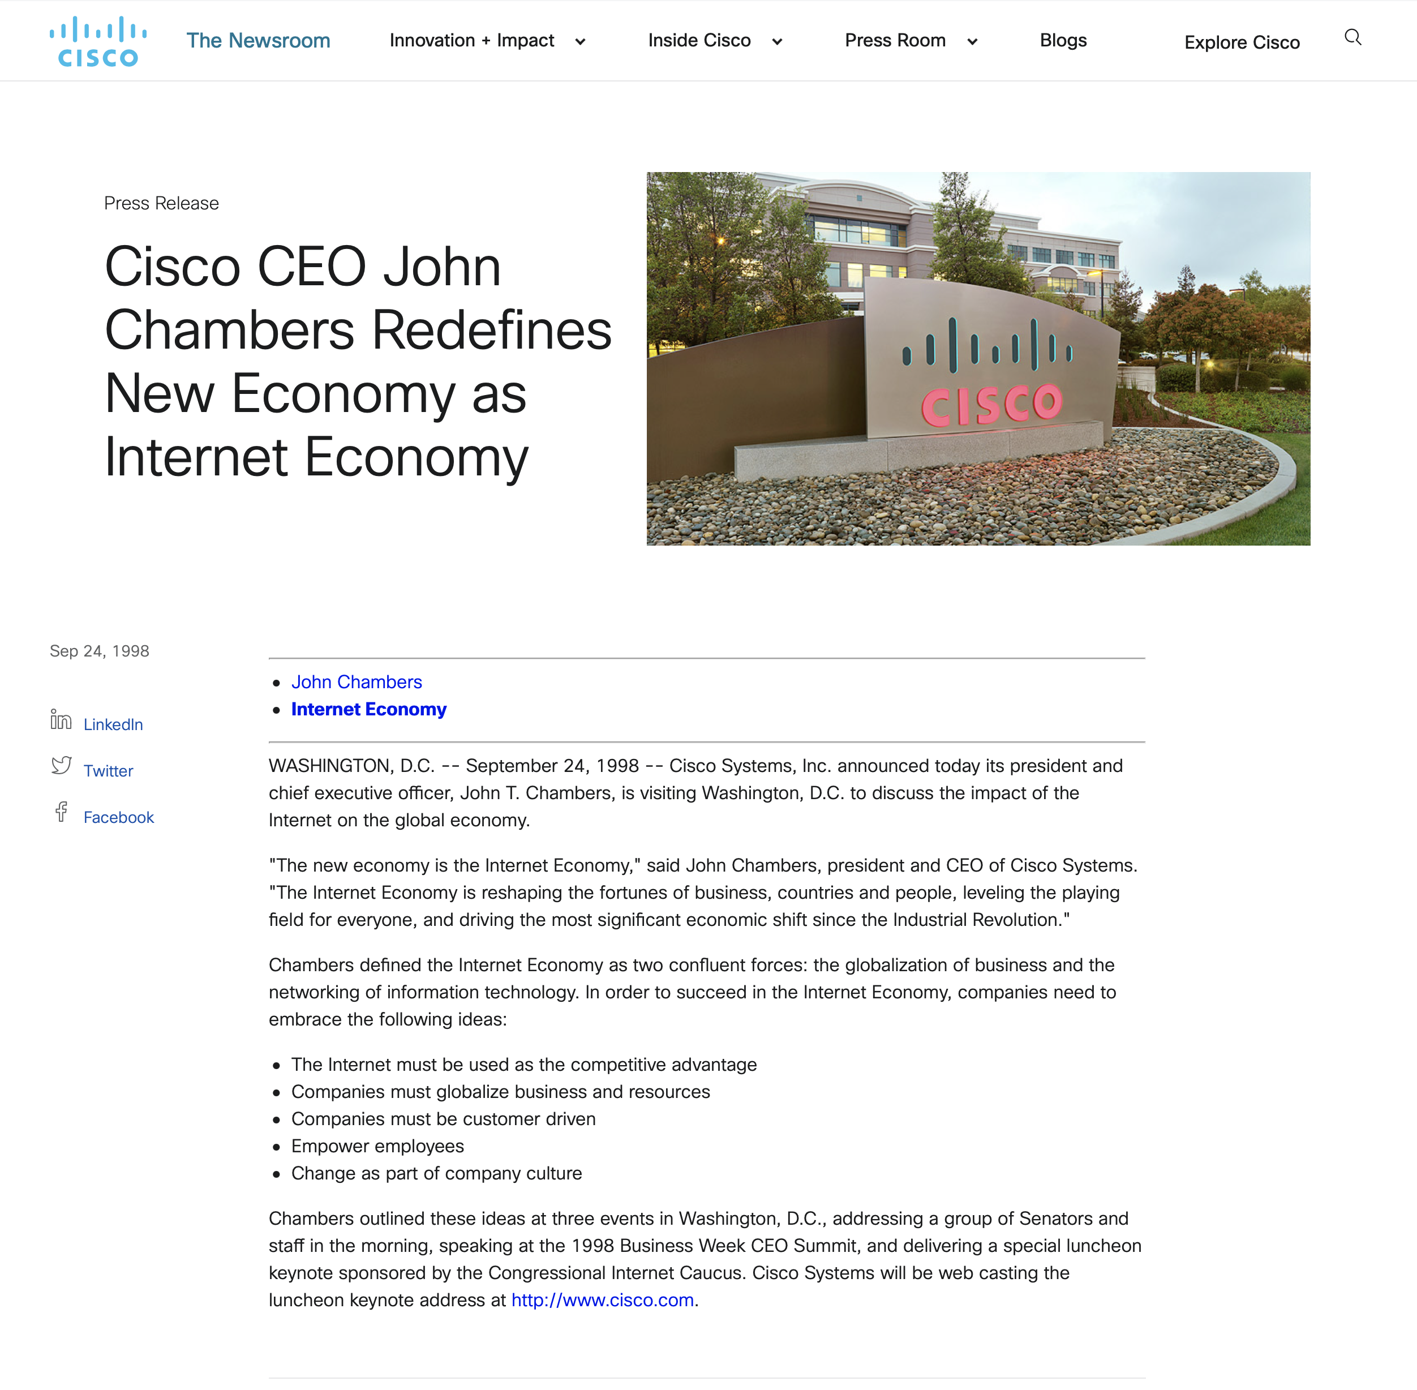
Opens the Door
to Educate Government
BTW, Cisco/Chambers leveraged the internet economy to penetrate
the D.C. ecosystem.
24

Slide 25
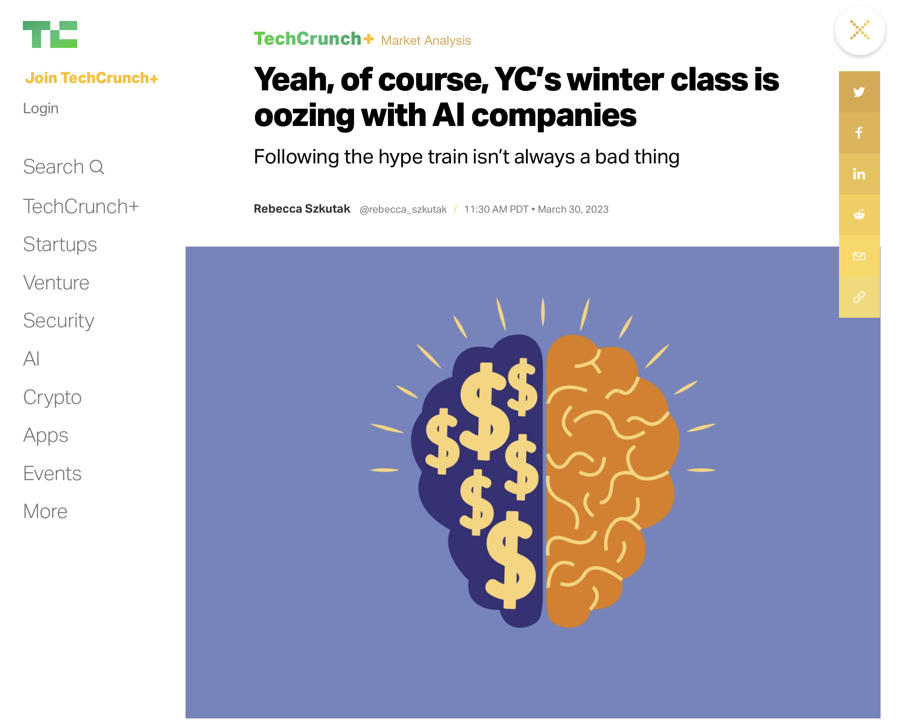
What Variables Do Today’s Journalists
Use to Frame the AI Economy?
Lean Heavily into
the Startup Scene
How much venture funding is going
to AI startups?
  $5.B since 2022, up from $1.5B
  in 2020 (Source: Pitchbook)
Number of AI startups
Number of AI startups acquired
by other companies
25

Slide 26
What Variables Do Today’s Journalists
Use to Frame the AI Economy?
Robotics, Job Loss and Economic
Number of robotics deployed
Predictions that AI will replace workers:
  Blue collar
  White Collar
Increased worker productivity and increased
GDP (again looking out many years)
26

Slide 27
What Variables Do Today’s Journalists
Use to Frame the AI Economy?
Other AI Indicators Correlated to the Economy
Number of classified ads for AI talent
Supply of AI talent can’t keep pace with demand
Number of AI Ph.D. grads
27

Slide 28
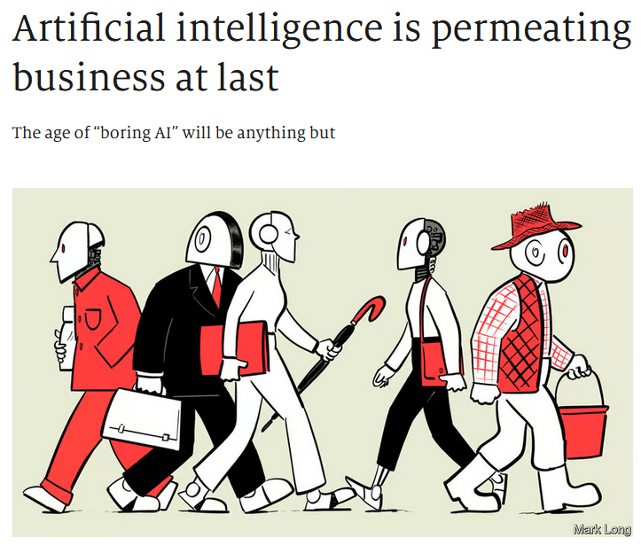
What Variables Do Today’s Journalists
Use to Frame the AI Economy?
Many Stories Strive to Tease Out
the Humanity via Anecdotes
  “When in September Hurricane Ian forced Walmart to shut a large distribution hub, halting the flow of goods to supermarkets in Florida, the retailer used a new AI-powered simulation of its supply chain to reroute deliveries from other hubs and predict how demand for goods would change after the storm.”
            — From “Artificial intelligence
            is Permeating Business at Last”
            (The Economist, Dec 6, 2022)
28

Slide 29
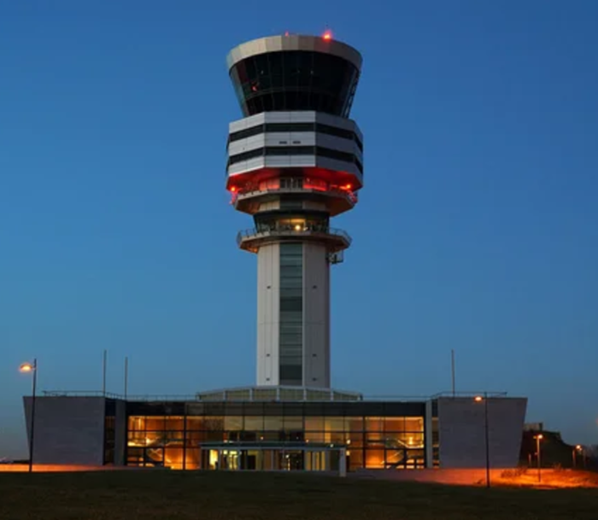
Many Stories Strive to Tease out
the Humanity via Anecdotes
Alaska Airlines Deploys AI
for Flight Routing (Fortune, July 27, 2021)
Today, airplanes in the U.S. don’t fly a straight-line path between takeoff and
landing. Instead, they zig-zag in the general direction of their destination,
dog-legging between a series of navigational waypoints. These waypoints
form what are essentially highways in the sky. But there are many different
possible routes between waypoints and it is up to the dispatchers to
determine which of these skyways the plane will travel to reach its destination.
To do this, the dispatchers take into account weather and wind forecasts,
as well as military and other airspace restrictions, and sometimes reports of turbulence provided
by pilots who have already flown that same route earlier in the day. Finding this information often requires the dispatcher to flip back and forth between a dozen different government, private weather forecasting, airport and internal airline databases.
29

Slide 30

Many Stories Strive to Tease out
the Humanity via Anecdotes
And Here’s Another One, Again from The Economist
on the Intersection of AI and Agriculture
The machines are coming for your crops — at least in a few fields in America. This autumn, John Deere, a tractor-maker, shipped its first fleet of fully self-driving machines to farmers. The tilling tractors are equipped with six cameras, which use artificial intelligence (AI) to recognize obstacles and maneuver out of the way. Julian Sanchez, who runs the firm’s emerging technology unit, estimates that about half the vehicles John Deere sells have some AI capabilities. That includes systems that use onboard cameras to detect weeds among the crops and then spray herbicides and combine harvesters that automatically alter their own setting to waste as little grain as possible.
30

Slide 31
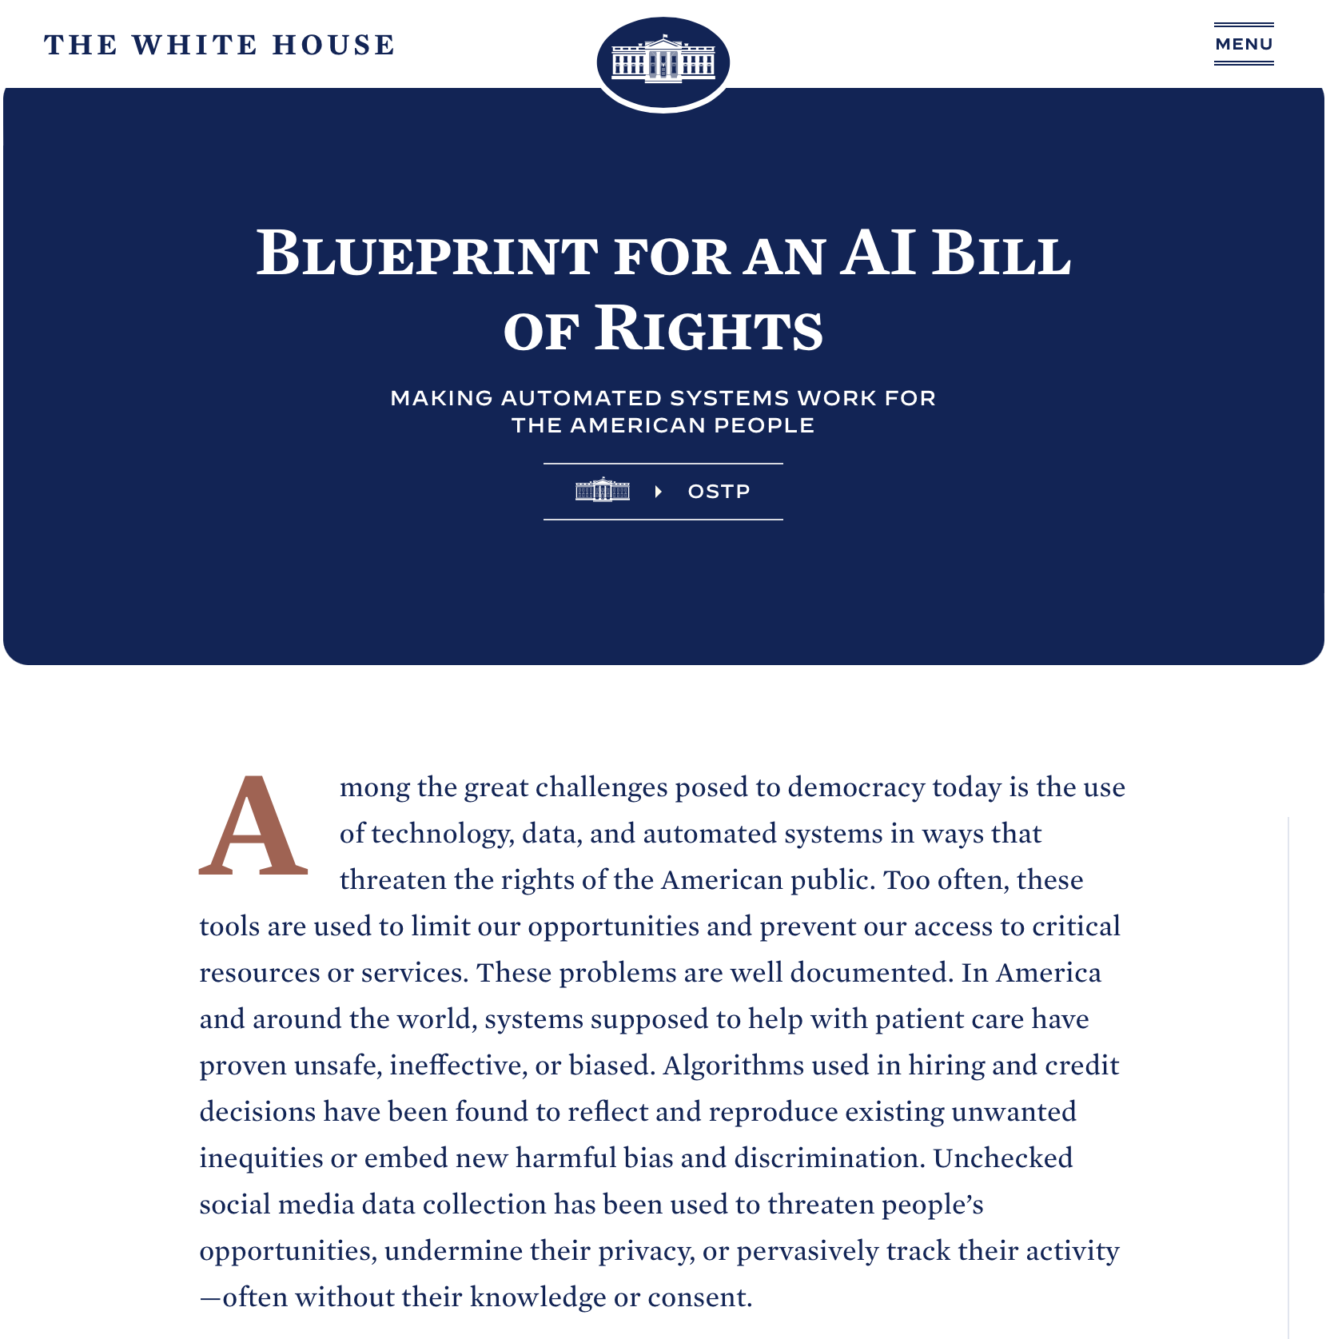
Making Sense of AI (not just the AI economy)
Everyone is trying to figure out how AI will impact society. The White House released what it called the “AI Bill of Rights” last October as the path for responsible AI.
Here’s the reality. No one knows how this will play out in the coming years.
By sizing the AI economy, Uniphore gains the street cred to not only talk about issues but also have a seat at the table to shape issues. Organizations like the Office of Science and Technology Policy (OSTP), not just journalists, will seek your opinions.

Slide 32
Closing Comments
We are excited about the possibilities (needless to say).
There’s no question in our minds that with the right execution, the AI economy study would take the Uniphore brand to another level, as well as increase the valuation of the company.
Calculating the ROI needs to take into account Uniphore’s association with the AI economy, which will go on for years.
  How long can we expect journalists, government officials and other pundits to talk about the impact of AI on the economy? A good seven to 10 years seems like a conservative projection.
We look forward to your feedback.

Slide 33


