Slide 1
CAPC Clinical Training Landing Page
2024 MarCom Awards Creative Assets

Slide 2
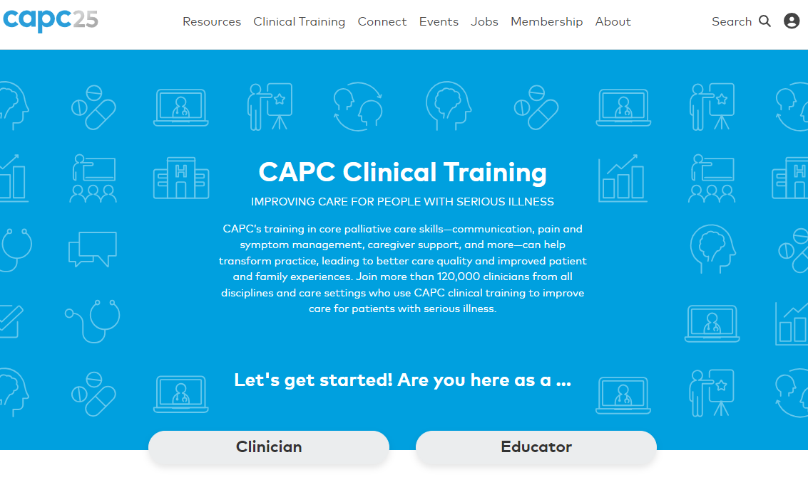
New Design

Slide 3
New Design

Slide 4
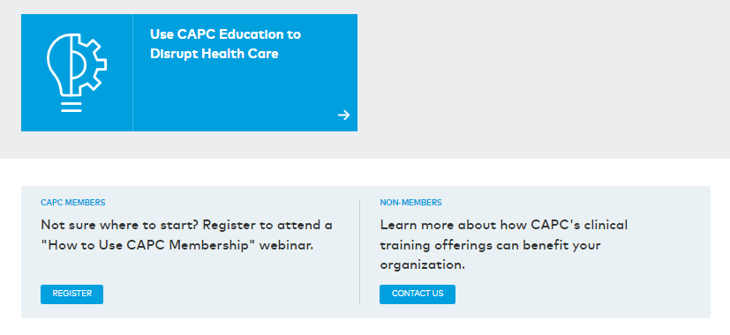
New Design

Slide 5
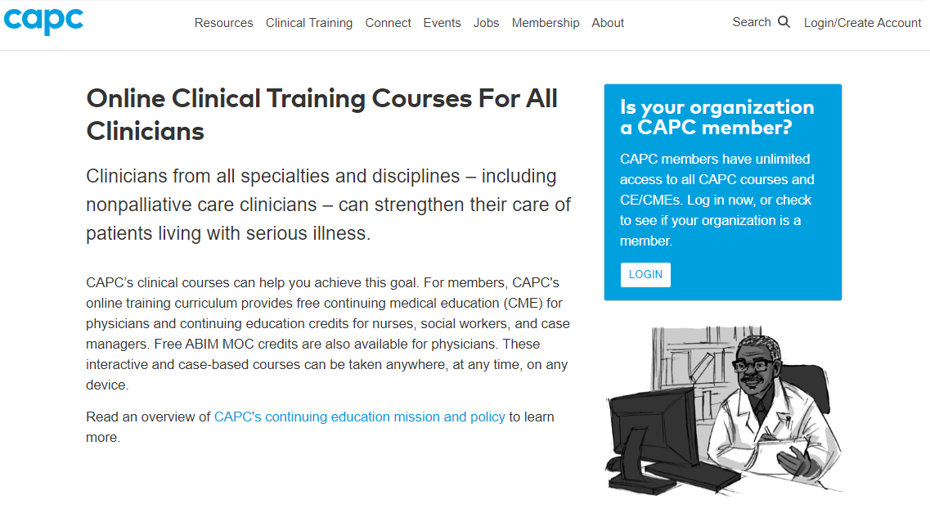
Previous Design

Slide 6
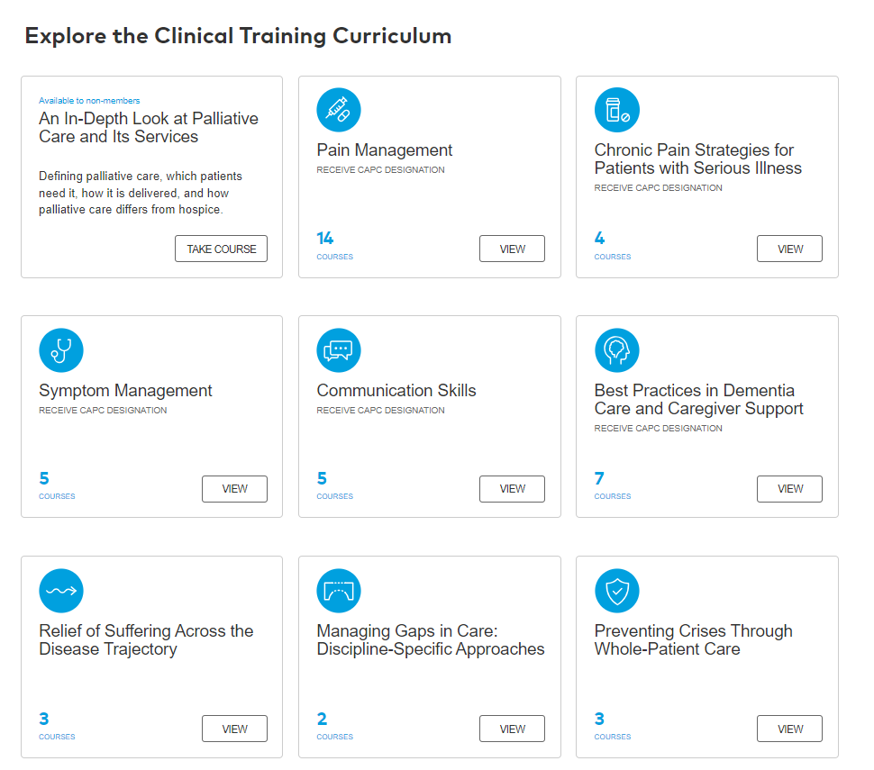
Previous Design

Slide 7
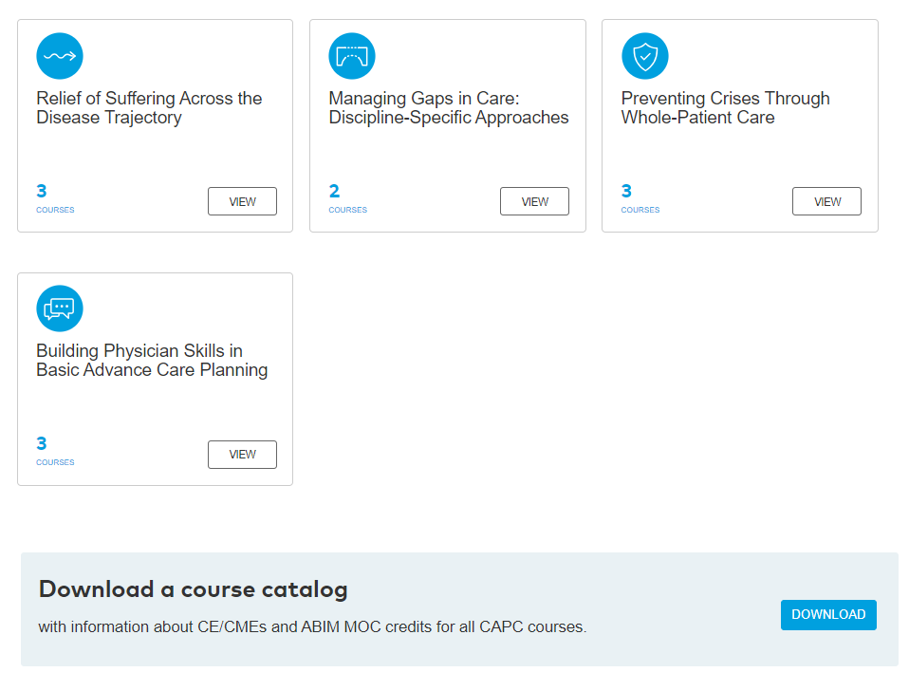
Previous Design

