Slide 1
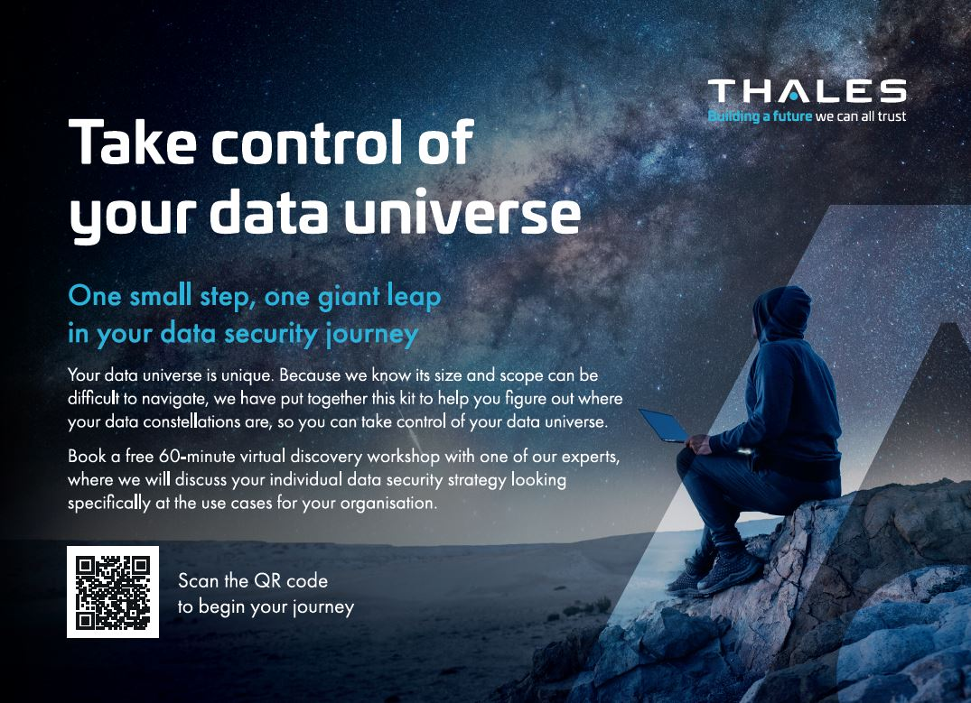
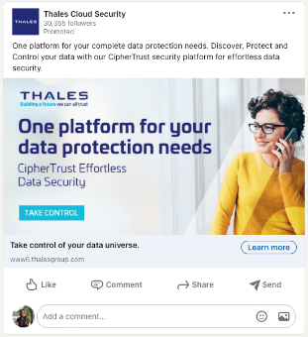
CipherTrust Always-On Campaign
Take control of your data universe
Marketing promotion campaign to target the fortune 1000 accounts globally using digital marketing. Tactics included ABM & Linkedin Ads, Content Syndication, Nurture email series, Direct Mail offer, virtual ABM events to drive Thales awareness and engagement throughout the audience.
Results
2165 accounts targeted
2.8M+ impressions
50% of accounts clicked
739 new accounts on-site
78% accounts "lifted" (increased engagement in the timeframe of the campaign)
408 accounts transitioning to the MQA stage (marketing qualified accounts)
CipherTrust pipeline increased by 26% YoY
https://www6.thalesgroup.com/yourdatauniverse

