Slide 1
Public Outreach Program for Workforce Development in Ventura County
by Consortium Media
All campaigns included robust organic social campaigns on FB, IG & LI and carefully curated copywriting and creative married with a balanced media plan, using digital and traditional channels, to target specific community groups and businesses.
Campaigns were in English/Spanish (and Mixteco on radio). Reaching high-census, low-income areas with diverse populations.
JOB CONNECT
VENTURA COUNTY WORKS
SKILLUP
HOMELESS OUTREACH
HIGH ROADS CONSTRUCTION CAREERS (HRCC)
DISABILITY EMPLOYMENT WORKS (DEWORKS)
Each campaign relates to a separate grant/fund but with recognizable Workforce Development Board of Ventura County branding.

Slide 2
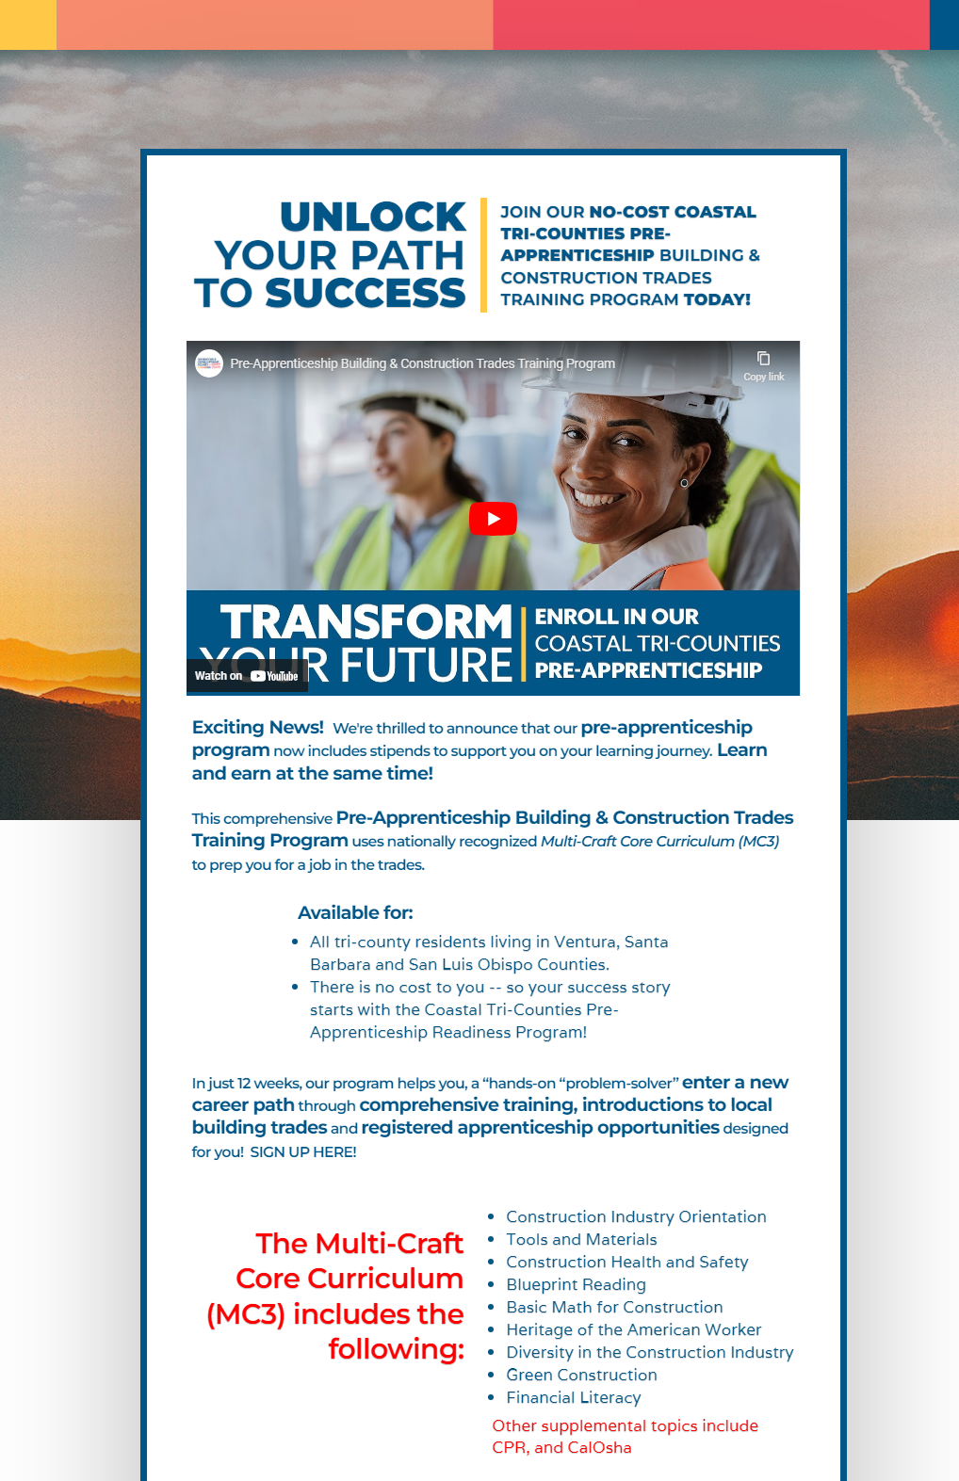
High Roads Construction Careers - HRCC
Landing Page - https://www.tricountyhrcc.org/
Web and Social Media Graphics

Slide 3
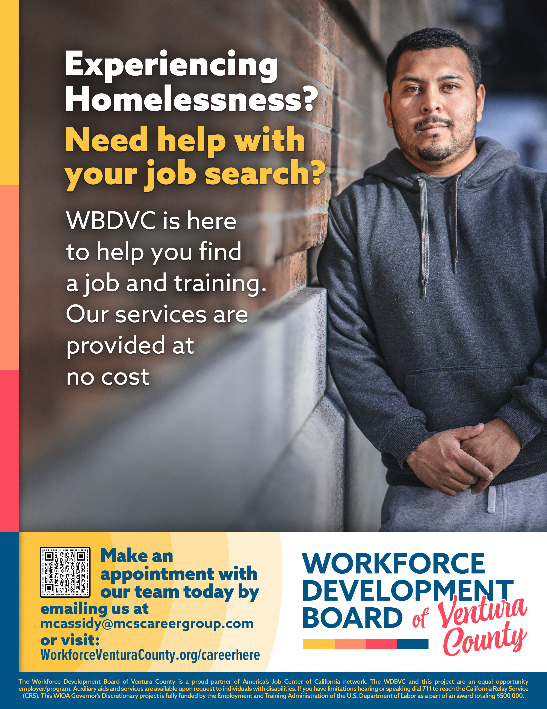
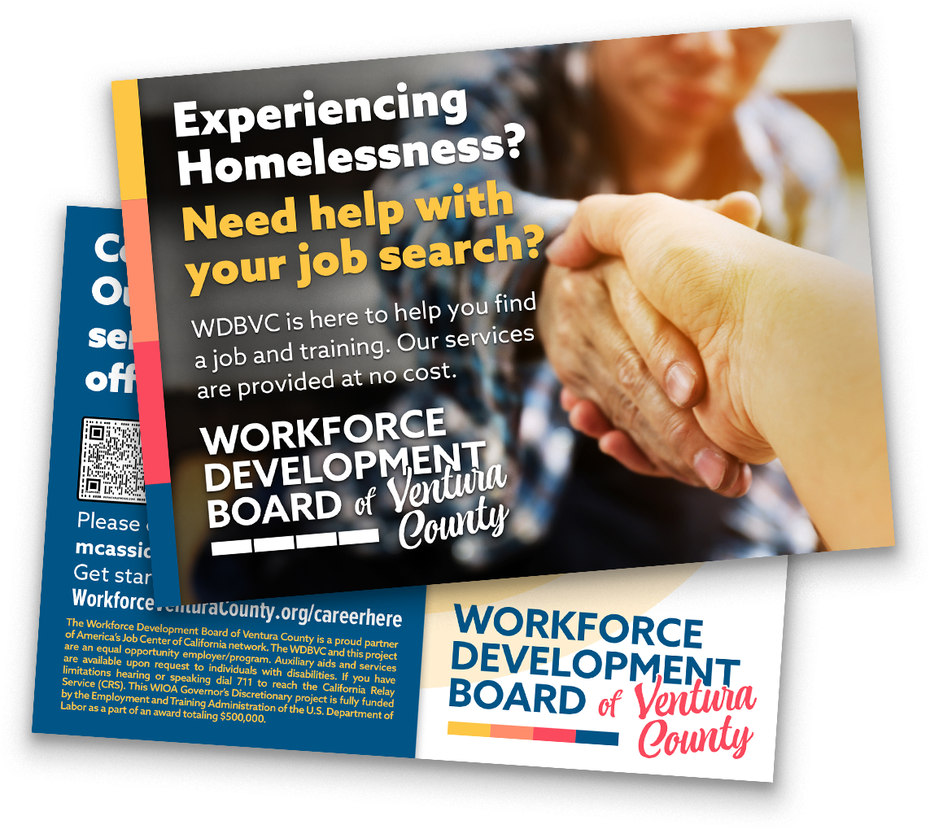
Homeless Outreach
Poster
Postcard

Slide 4
Job Connect
Landing Page - https://www.jobconnectvc.org/
Banner Ads

Slide 5
Ventura County Works
Postcard
Email blast

Slide 6
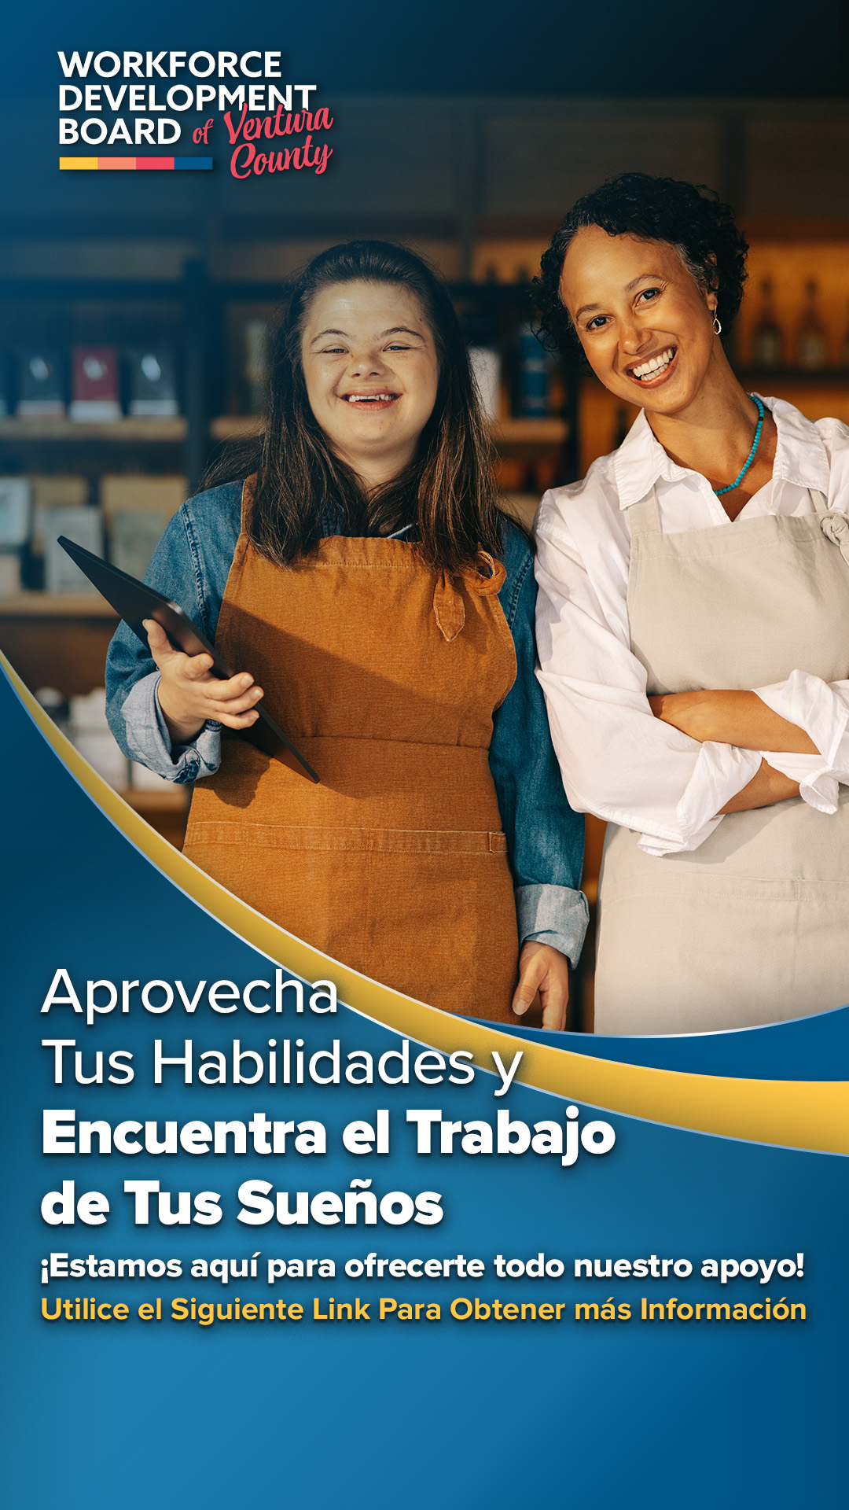
DeWORKS
Email blast
Banner Ads

Slide 7
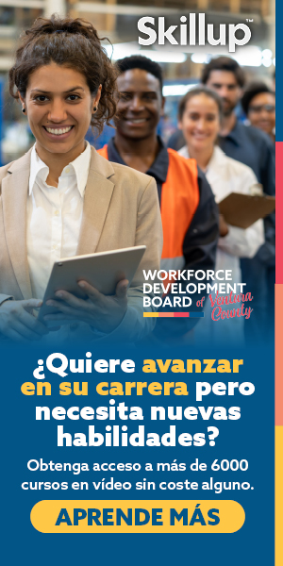
Skillup
Web and social media graphics
Banner Ads

Slide 8
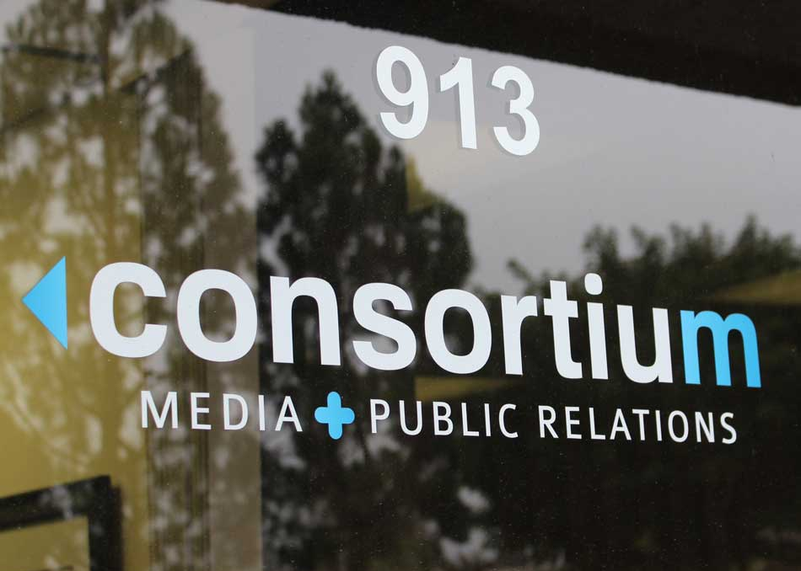
THANK YOU!
Our skilled team and 33 years of passionate, award-winning brand and public outreach campaigns have provided us with a unique and powerful wealth of experience to help brands excel.
Visit consortium-media.com or email dbw@consortium-media.com

