Slide 1
Outsourced Social Media Management USA Rugby 7s Collegiate Championships

Slide 2
Aspire Marketing Impact: USA Rugby 7s Collegiate Championships
Massive engagement increases during the event
Links to Social Media Channels @Rugby7CC:
Weekend Twitter Overview (May 13-15):
165K+ Impressions
7.2% Eng. Rate
Followers: +225 (~100% Growth)
70K Profile Visits
Weekend Instagram Overview (May 13-15):
630K+ Impressions
Followers: +555 (~40% Growth)
48K+ Accounts Reached
22K+ Profile Visits
~1,700 Website Visits

Slide 3
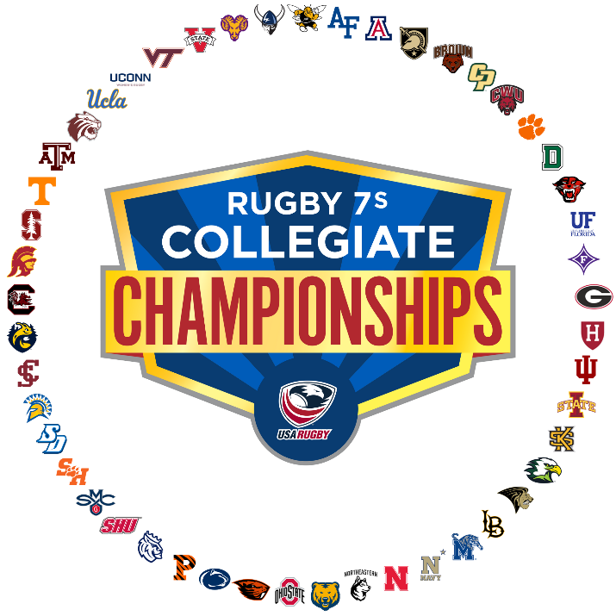
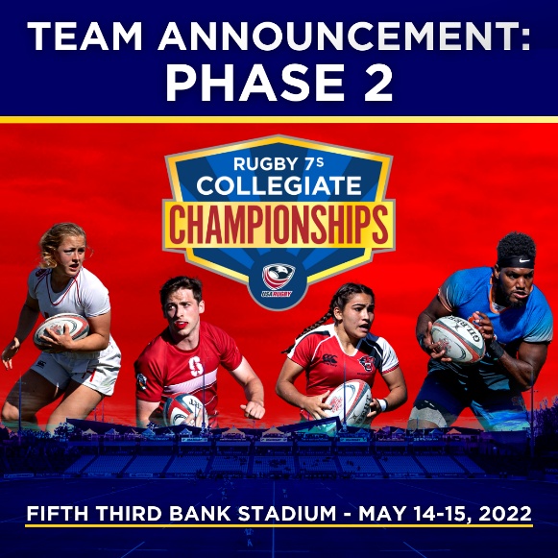
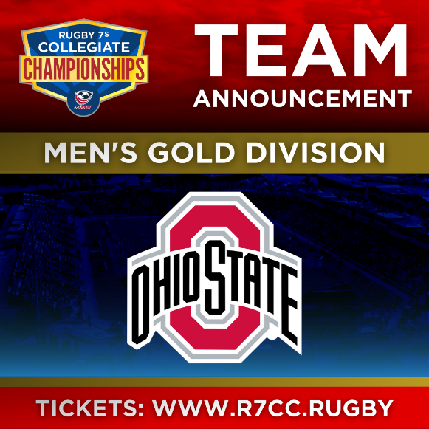
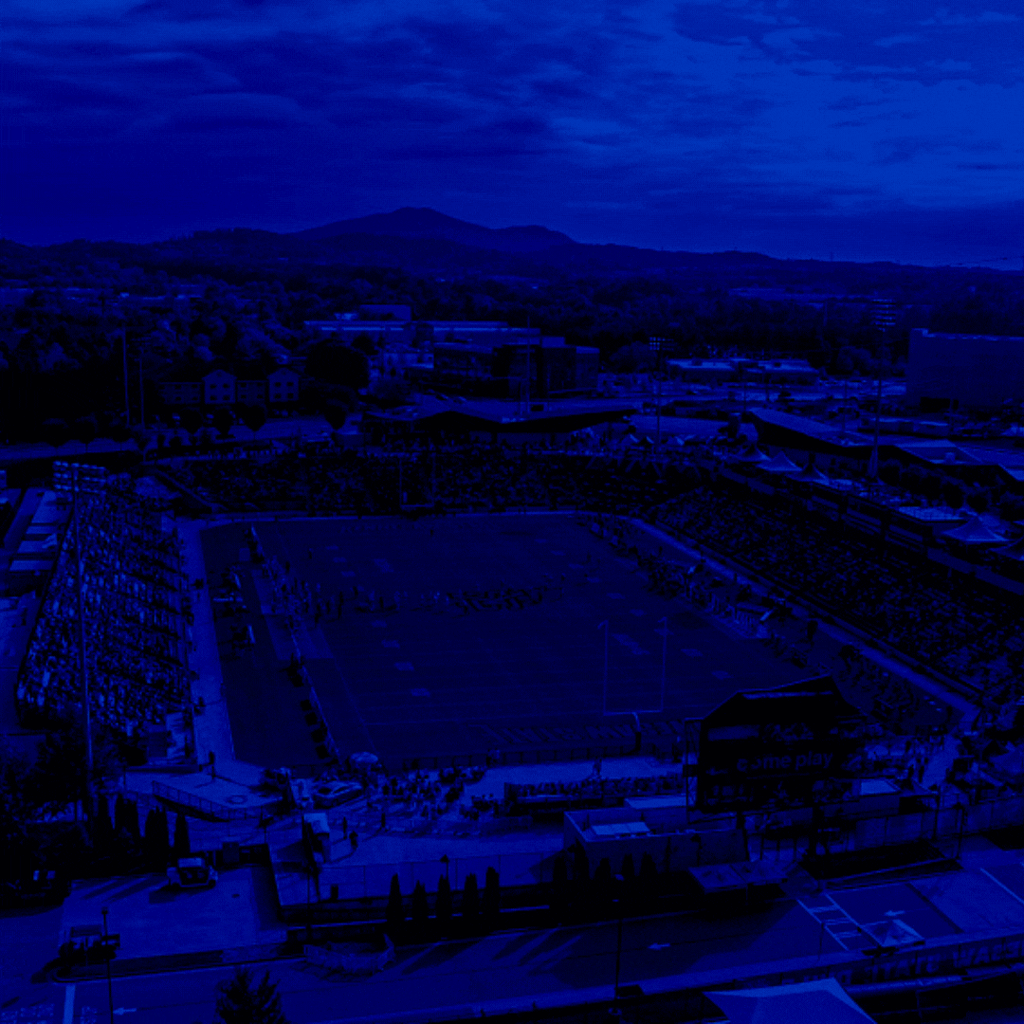
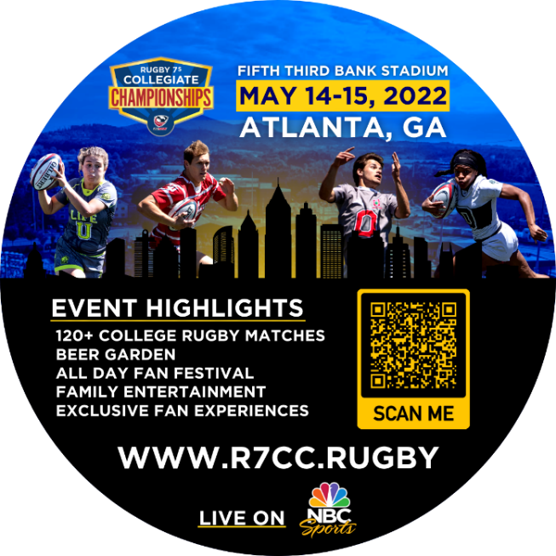
Aspire Marketing Impact: USA Rugby 7s Collegiate Championships
Sample projects and graphics created for the event
Full Project List:
81 unique social graphics
9 Email Templates
4 Press Releases
Club Social Outreach
Sponsorship Decks
Info Session Flyer
Banner Ads
Info Session YouTube Video
Ticket Flyer Handouts
Tickets On Sale Graphic
Billboard Ad Creative
Coaster Marketing
Group Tickets Flyer
Luxury Suite Flyer
High School Team Flyer
Volunteer Flyer
FEVO Flash Sale Graphic
Website Mapping
Marketing Contests

