Slide 1
MIPS Rebrand Hermes Award Submission

Slide 2
Our Approach
MIPS hired Tanis Communications to rebrand the company, including a new vision, corporate positioning, messages for each of their key markets: automotive, cloud data center and embedded, a new logo and visual ID, and a website redesign.
In a landscape characterized by fierce competition and rapid technological advancements, especially with the rise of AI, our client recognized the need for a strategic rebrand to establish a distinctive identity and capture market share effectively.
Our approach included the following:
1. Competitive audit. We started with a comprehensive competitive audit, delving into the strategies, strengths, weaknesses, messages and visual ID for the key players. We reviewed all external facing marketing, including websites, social media, webinars, videos, and analyzed industry and company press coverage. We gained valuable insights into market trends, competitor positioning and emerging opportunities, laying a solid foundation for the brand framework.
2. In-depth stakeholder interviews. We conducted in-depth interviews with the leadership team. These interviews unearthed valuable insights into perceptions, aspirations, and expectations, empowering us to craft a brand narrative that would resonate with all stakeholders. We made sure the rebranding efforts aligned with the business strategy and goals.
3. Unique value proposition. Armed with a profound understanding of the competitive landscape and stakeholder insights, we crafted a new brand framework and value proposition that would set our client apart in the industry. The key essence of the rebrand was focusing on customers’ needs to have open and flexible compute for emerging opportunities in AI, cloud data centers, automotive and embedded markets. Companies are frustrated with competitors forcing them into vendor lock-in, with no flexibility and speed to accelerate compute solutions. Through iterative ideation and refinement, we distilled the essence of their brand through a compelling narrative, encapsulating their distinct strengths and value proposition. The new vision: freedom to accelerate compute in automotive, data centers and embedded markets with the tagline: freedom to innovate compute.

Slide 3
Logo Redesign
The new logo we designed embodies a dynamic Vanguard Bird, symbolizing freedom and forward-thinking. MIPS is at the forefront of progress and innovation, and our Vanguard Bird leads the way, breaks barriers, and symbolizes our cutting edge of technology. Its wings not only evoke movement and speed but also signify the precise processing of data.
These elements collectively represent the unrestricted acceleration and the ability to overcome obstacles swiftly, while also emphasizing adaptability and innovation.
The logo encapsulates the ethos of progress and forward momentum, reflecting an agile, innovative, and transformative approach.
With a refined identity, a resonant value proposition, and a strategic roadmap for execution, our client is now poised to seize new opportunities, foster deeper connections with customers and drive sustainable growth in an increasingly competitive landscape.
Play video here.

Slide 4
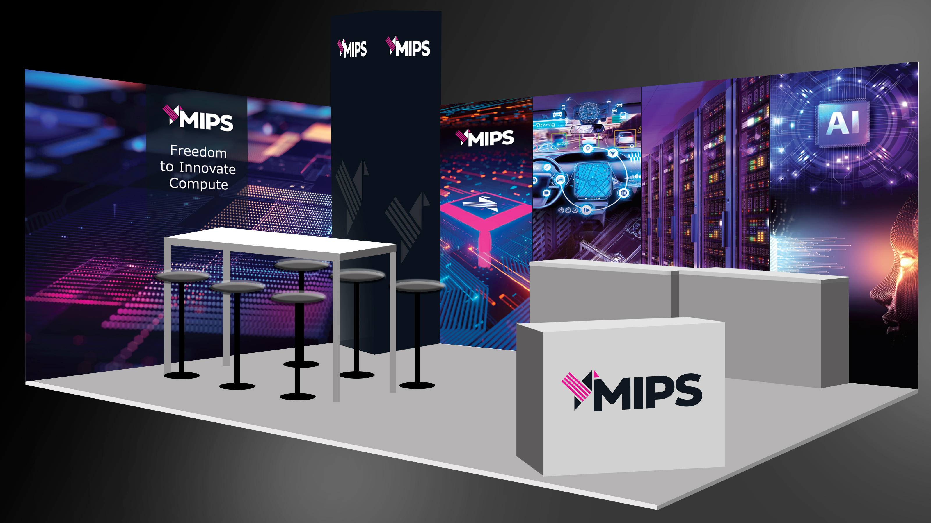
MIPS EMBEDDED WORLD 3D VIEW

Slide 5
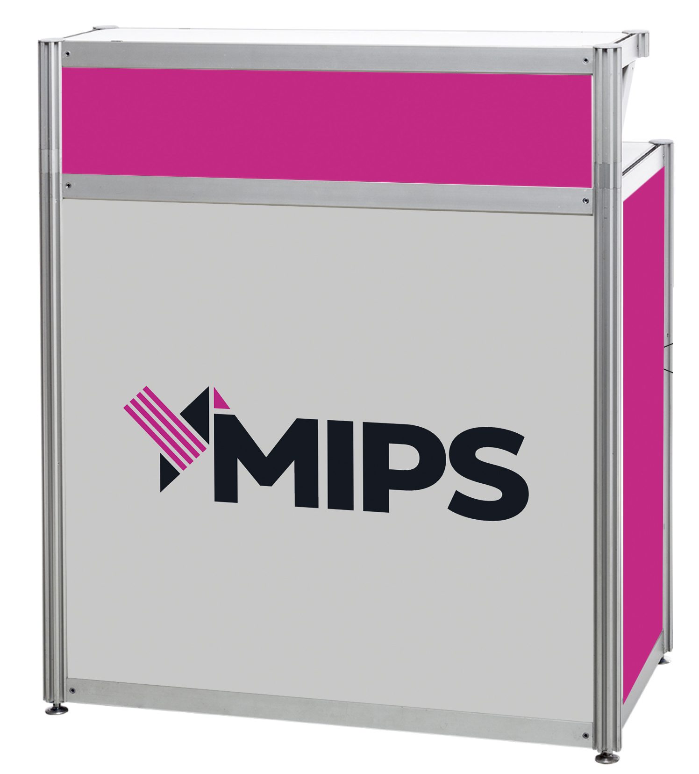
KIOSK

Slide 6
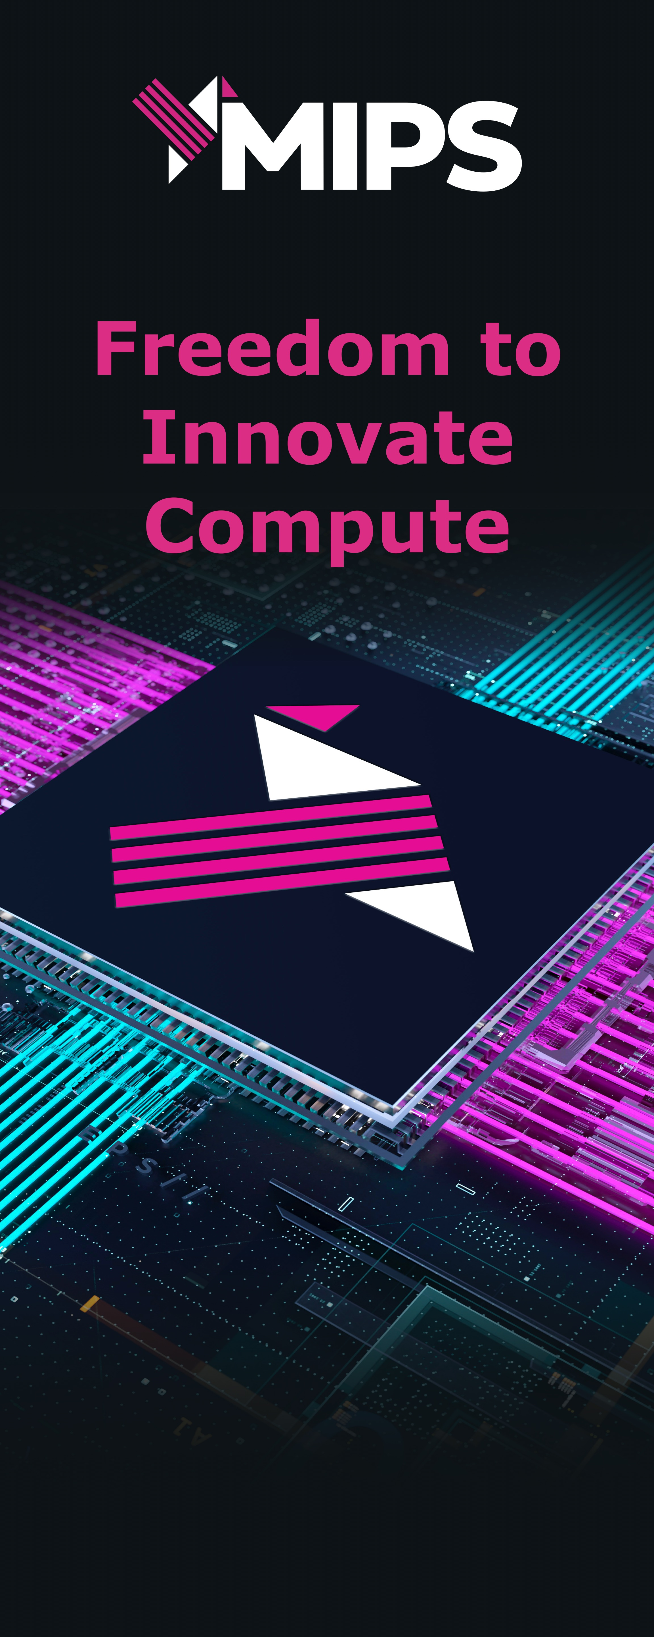
Retractable Banner Artwork

Slide 7
Social Media Banners

Slide 8
Links
The redesigned web site can be viewed here. https://mips.com/
Blog that summarizes the rebrand and positioning: https://mips.com/news/mips-launches-new-strategic-focus-and-rebrand-the-freedom-to-innovate-compute/

