Slide 1
Making Synopsys Discoverable in the Digital Media Era
Expanding Reach Through SEO + Compelling Content
Notes:
Make yellow rectangle wider

Slide 2
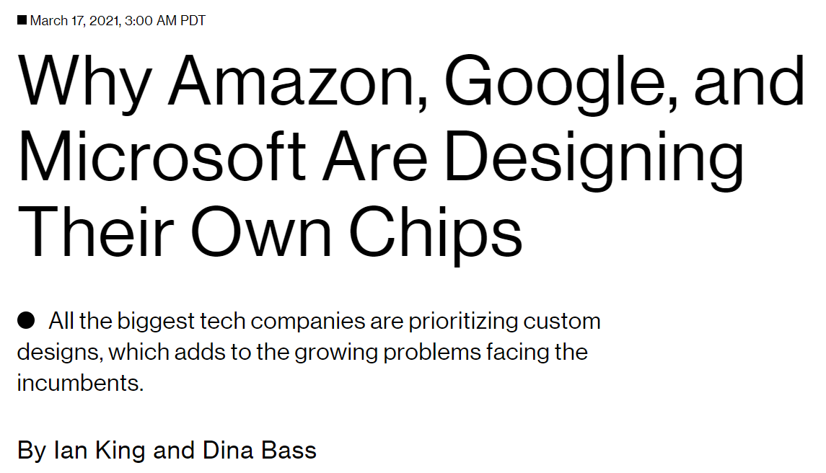
Setting the Scene
As more non-chip companies entered the business of chip design, such as Apple, Amazon, and Facebook, Synopsys wanted to expand its public profile beyond the usual chipmaking suspects.
Although highly regarded within the EDA/chip design community, they needed more exposure to reach the tech giants who continued to strike out on their own.
Synopsys’ discoverability problem was especially bad online. Searches would turn up outdated or incorrect information — if they even showed up among their competitors at all.
To grab the attention of people outside the EDA bubble, we helped Synopsys renovate and optimize their corporate blog for better search engine optimization (SEO).

Slide 3
The Assignment
Synopsys’ corporate blog, New Horizons in Chip Design (formerly From Silicon to Software), hadn’t been touched in over a year.
The small collection of blog posts published before we took over hadn’t broken through to the searching public, averaging just over 200 monthly page views.
In order to make inroads with the growing range of companies starting to design their own silicon, the blog desperately needed an infusion of fresh content and strategic SEO to help Synopsys organically reach a larger audience beyond the usual chip design companies.

Slide 4
Not Settling for Success
Our tactics worked, successfully resurrecting Synopsys’ corporate blog from the dead. Compelling content and a comprehensive refresh of the blog’s SEO fundamentals jump-started growth.
However, we knew our audience was primarily made up of people already familiar with Synopsys. One year in, the blog derived much of its traffic from social media and internal word of mouth.
To build on our initial success, we dug deeper, jumping ahead of the pack with more timely topics and squeezing every drop of SEO “juice” out of each blog post both on-page and behind the scenes.
June 2021 Traffic Page Views
43.9% Social Networks
24.5% Natural Search
17.3% Direct
5.1% Referring Domains
4.7% Display
1.8% Email
The blog saw 6,570 page views in June 2021, after one year of work.

Slide 5
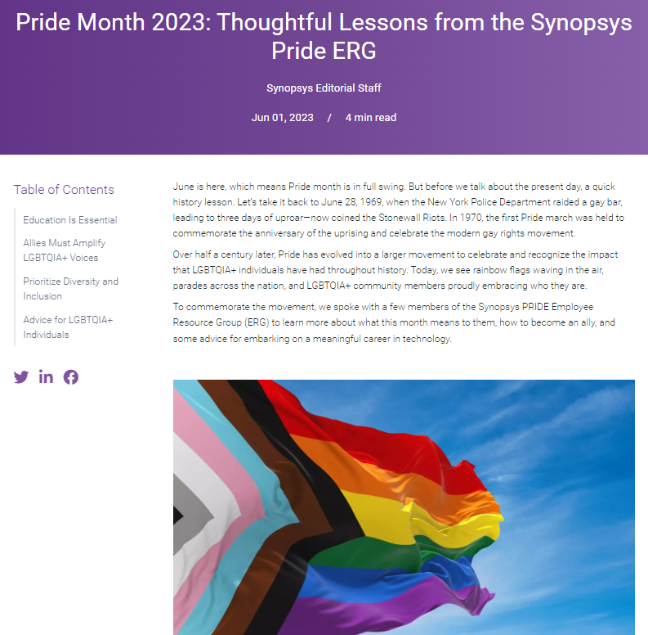
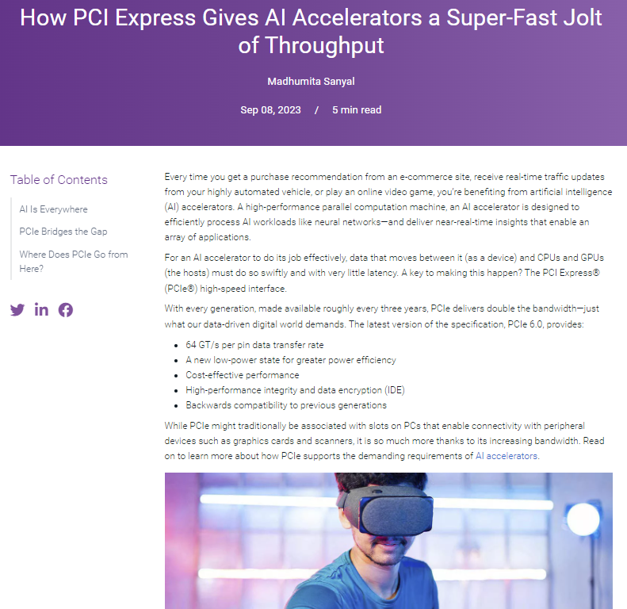
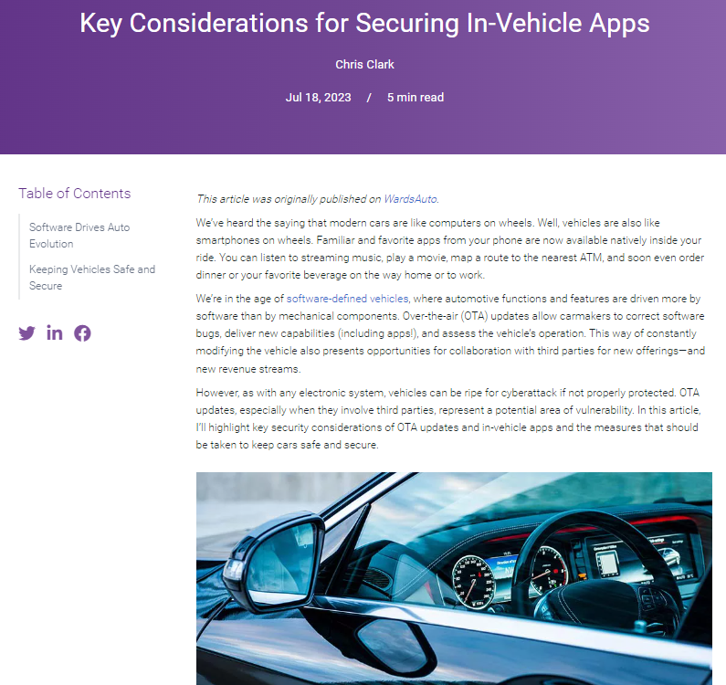
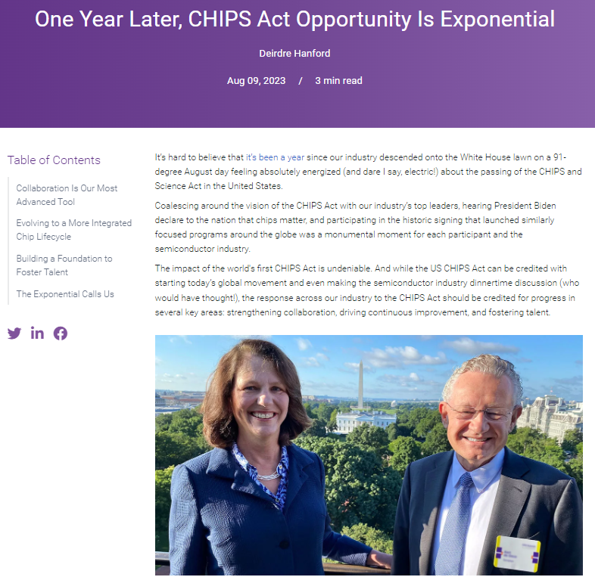
Addressing Critical Topics
We hosted sourcing sessions with Synopsys’ SMEs to find relevant, eye-catching blog topics, uncovering important emerging issues in the semiconductor industry.
We took a journalistic approach to each blog post, with the core goal of educating the reader rather than “selling” Synopsys.
Google’s algorithm favors long-form, one-stop-shop content. We focused on developing complete, multi-part stories, including links to other resources and relevant articles (just like journalists do).

Slide 6
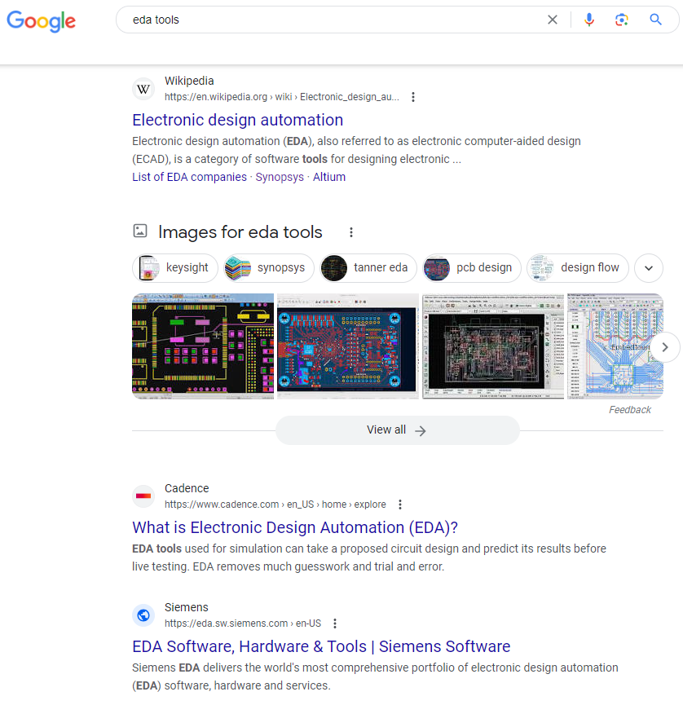
SEO & Organic Search Performance
Our first round of organic search optimizations to the blog set a strong foundation and drove initial traffic growth. However, the blog still struggled to hit the first page for anything beyond niche, hyper-specific topics searched primarily by the type of people already familiar with Synopsys.
Knowing SEO is a long-term strategy, we doubled down on bespoke keyword research for each blog post to fuel unique on-page optimizations.
In the summer of 2023, we also helped migrate Synopsys’ corporate blog from WordPress to Adobe Experience Manager. This move, facilitated in parallel with a refresh of on-page SEO, improved the blog’s performance against Google’s all-important Core Web Vitals.

Slide 7
On-Page Optimizations
On top of AEM’s improvements to loading speed and user experience, we continued our laser focus on on-page SEO:
Researching key search terms and establishing a taxonomy
Feathering keywords into blog post copy
Constructing URL slugs with relevant search terms
Optimizing headers (H1, H2, H3) using high-value keywords
Creating custom meta title and description tags for each post
Updating image alt text for both SEO and accessibility
Applying Schema.org markup so content could be included in Google’s rich results at the top of SERPs
Implementing internal link structures referring to each other, signaling to Google how corporate website content and blog posts interrelate, and underlining the keyword relevance of content on both sides

Slide 8
Goals? Achieved.
Blog Traffic Results
Blog Traffic Results
In December 2022, Synopsys’ blog saw:
6,806 unique visitors
9,938 page views
Compare that to December 2023:
21,851 unique visitors
32,651 page views
The infusion of fresh content and on-page + technical SEO made an indelible impact. Organic search accounted for the majority of the blog’s traffic growth through 2023.
December 2023 Traffic Page Views
56.6% Natural Search
16.4% Social Networks
13.5% Direct
6.3% Referring Domains
4.3% Display
0.4% Email

Slide 9
Blog Visitors & Page Views
Last 13 Months
AEM Migration

Slide 10
Organic Search Rankings
In December 2022, the blog ranked in the top 100 Google results for 973 search terms in the United States.
As of December 2023, the blog ranks in the top 100 Google results for 2,882 search terms in the United States, most of which are unbranded terms that make a particularly strong impact on awareness and organic search traffic volume.
The blog also ranks in the top 10 for 250 keywords, meaning Synopsys’ blog is on the first page of the Google results. This includes a couple dozen #1 overall rankings across multiple topics and product areas, including:
Counterfeit chips
Fake chip
AMS verification
Reset domain crossing
SoCs cars
Multi die
Co-packaged optics
OTA security

Slide 11
Quality, Not Just Quantity
In addition to leading the way in traffic growth, organic search sets a higher standard for quality of traffic, or how engaged blog visitors are:
Average Bounce Rate (Lower Is Better)
Organic Search: 69%
Social Networks: 90.8%
Referrals: 80%
Average Time on Site (Higher Is Better)
Organic Search: 2:38
Social Networks: 1:09
Referrals: 1:21
Our work on Synopsys’ blog exposes them to a new, broader audience that stays on the blog and reads high-quality content about Synopsys’ technologies and partnerships.
Every customer, journalist, or potential employee’s journey starts online; our renovation of Synopsys’ digital footprint means no missed opportunities as these stakeholders meet and get to know Synopsys.

Slide 12
©2024 The Hoffman Agency

