Slide 1




Parexel is one of the largest clinical research organizations in the world, helping their clients accelerate life-changing medicine to market. Since 2007, Saltwater has been their digital partner for web development, SEO, conversion rate optimization, PPC, and more — and in 2023, we undertook our biggest challenge (and success) yet: a complete reimagining of their website.

Slide 2
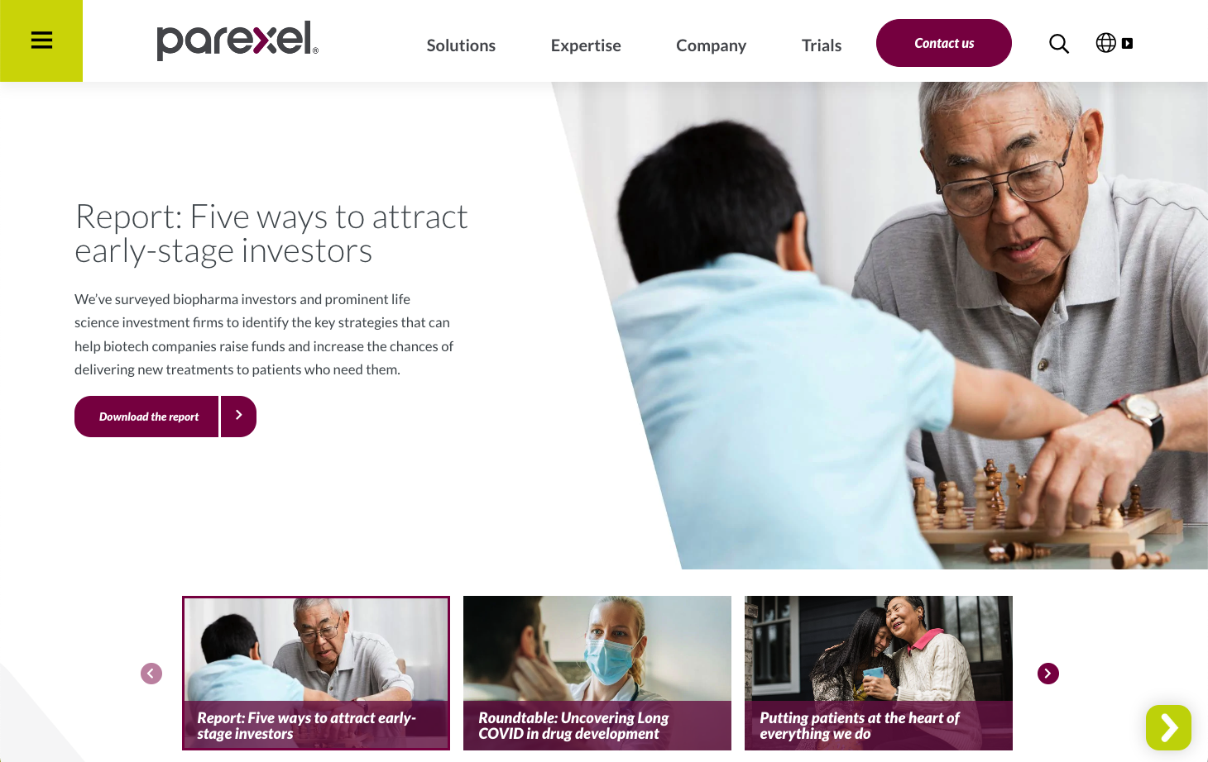
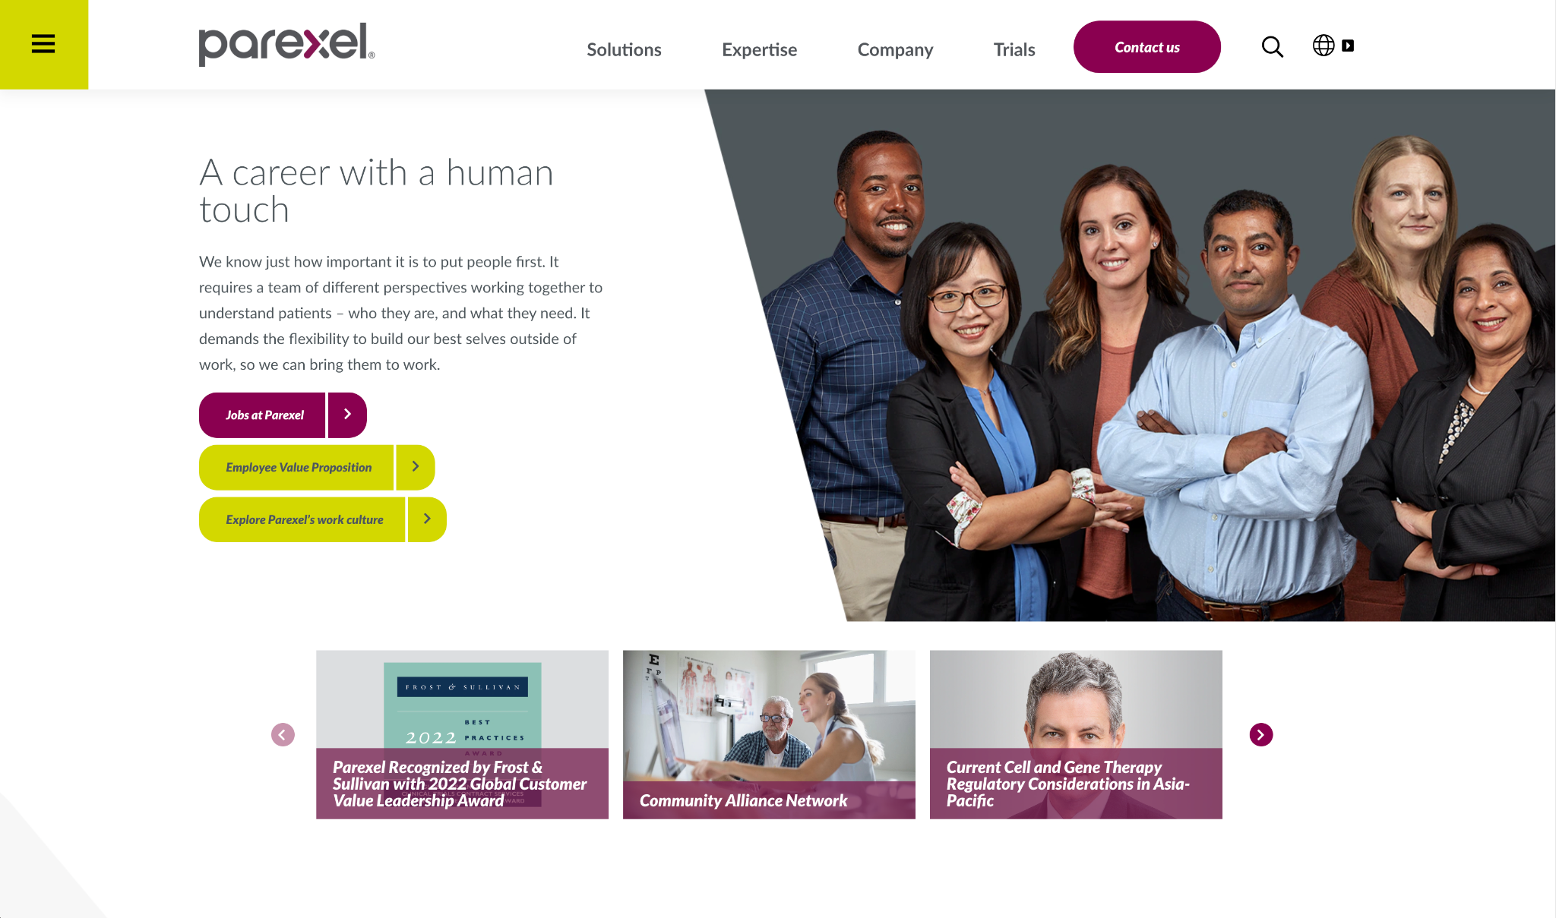
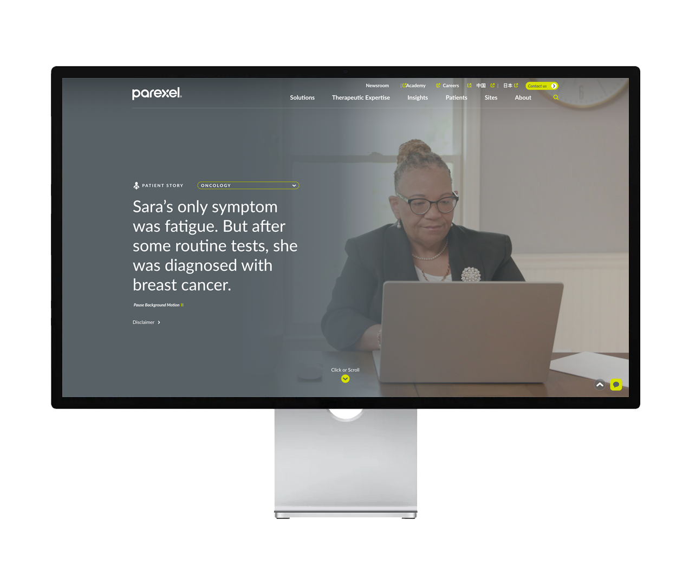
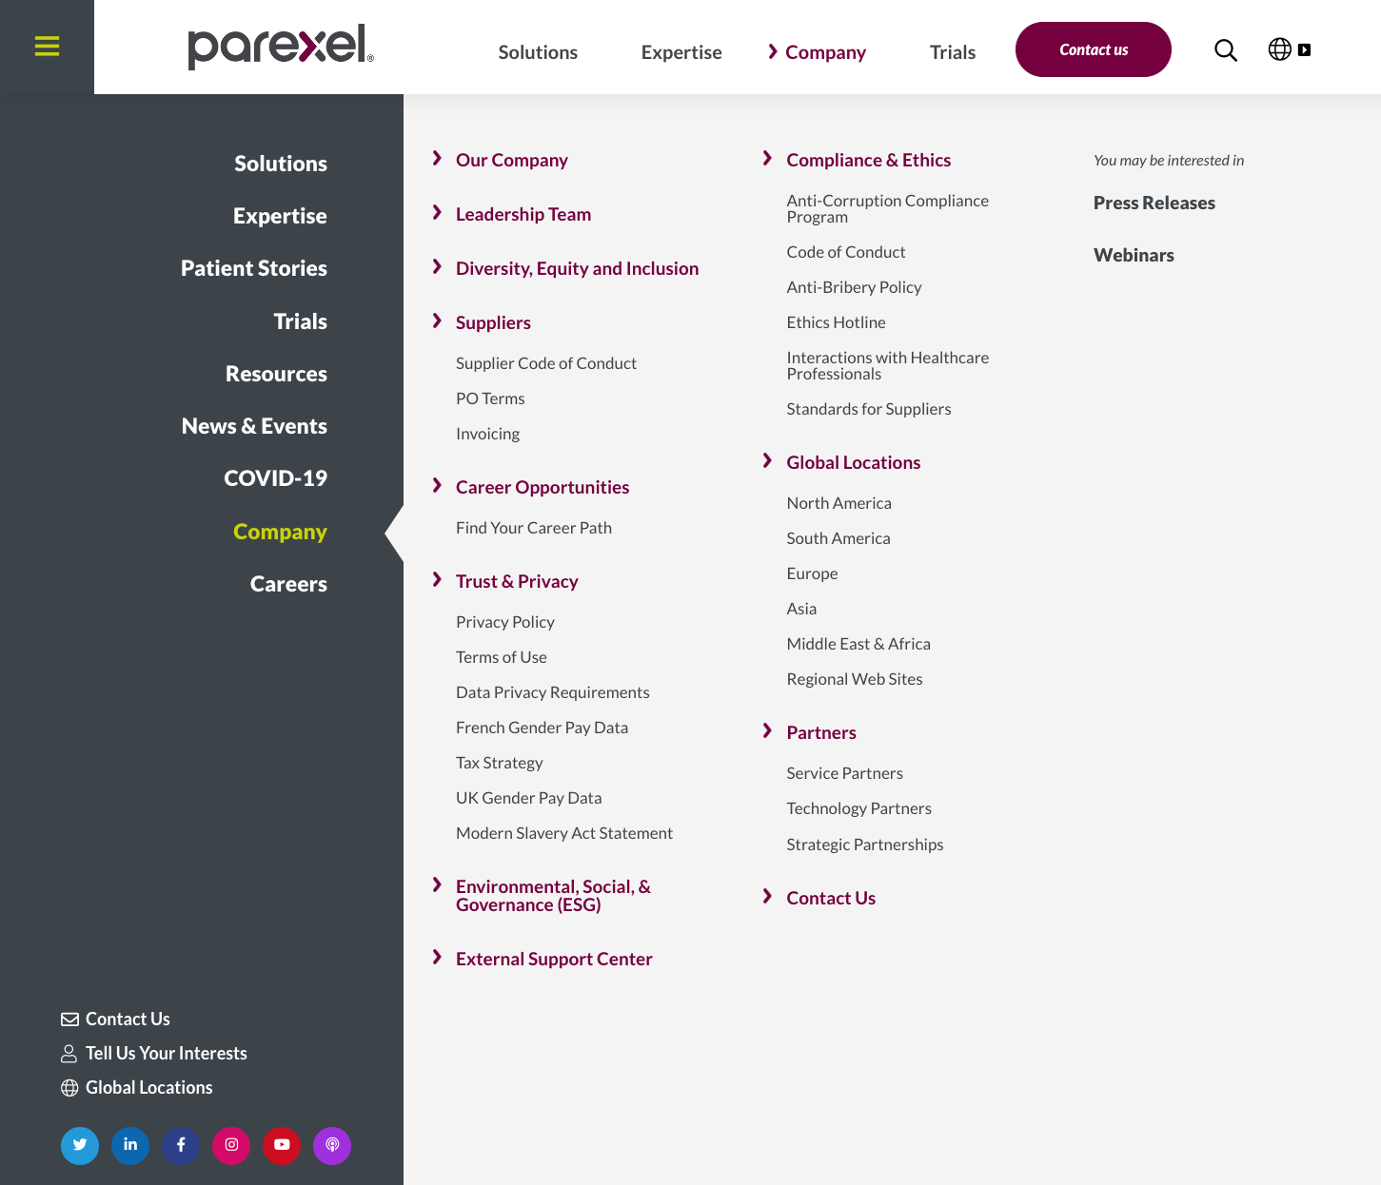
FORMER
HOMEPAGE
THE CHALLENGE
Parexel’s website was outdated and failing to tell their story. To better connect with new clients and potential hires, they wanted to be seen as an industry leader committed to changing patient lives, but that image was held back by a website with:
Internally facing language
A focus on services instead of people
Overly complex navigation and architecture
Underutilized patient stories and thought leadership
FORMER “MEGA” NAVIGATION
THE INSIGHT
In an industry that too often loses the emotional impact of its work by being too technical, we knew reimagining Parexel’s website with a relentless focus on audience, storytelling, and usability would turn their online presence from a weakness into a differentiator.
Notes:
Extract the story more, proof points, how yr solution unfolded, insights, analytics etc

Slide 3

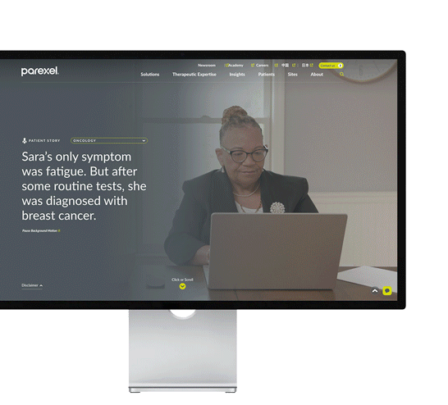
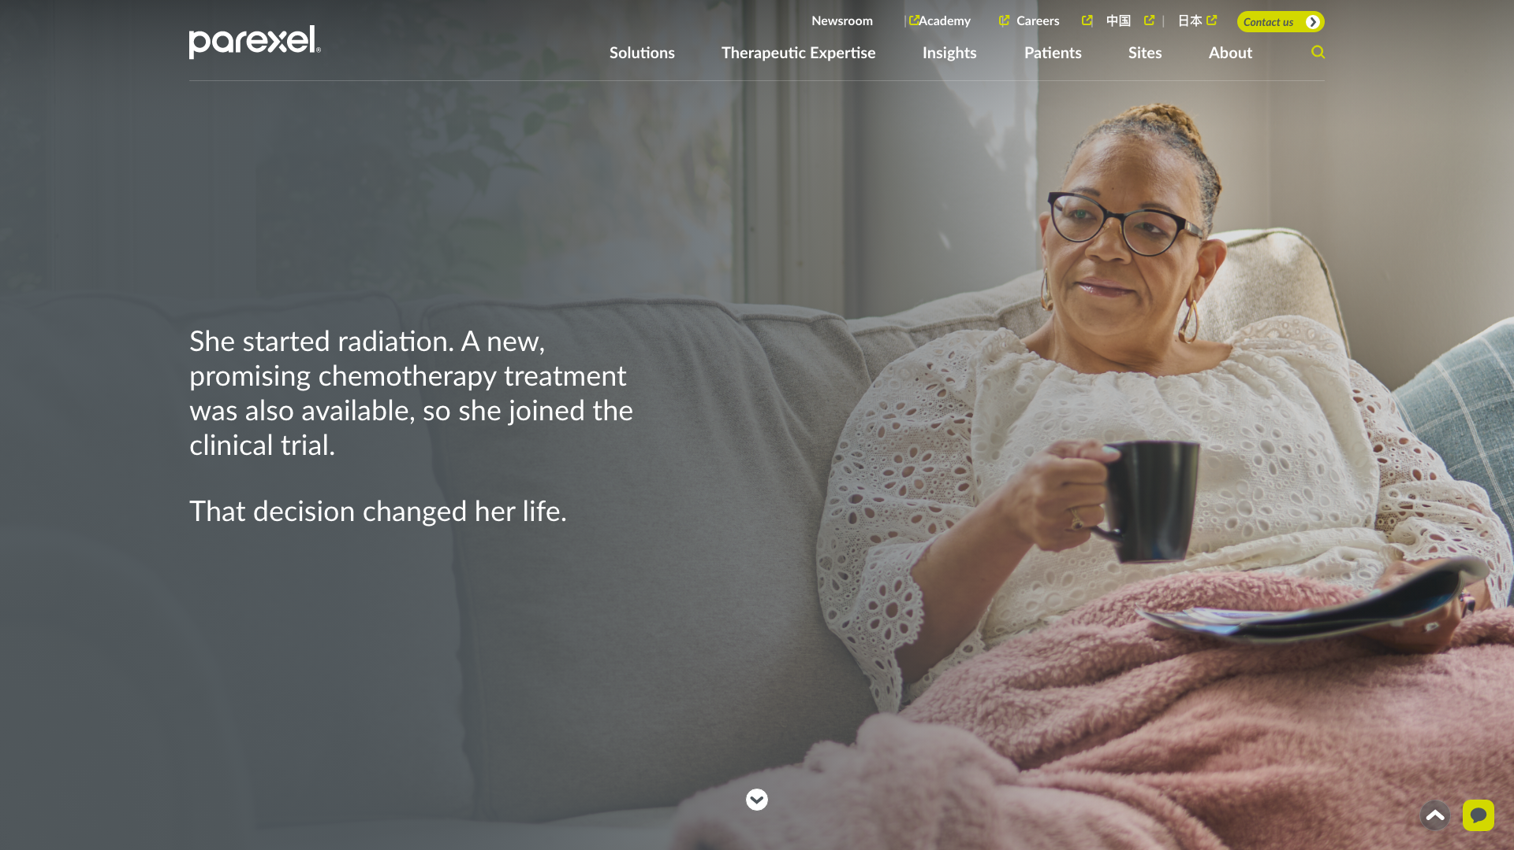
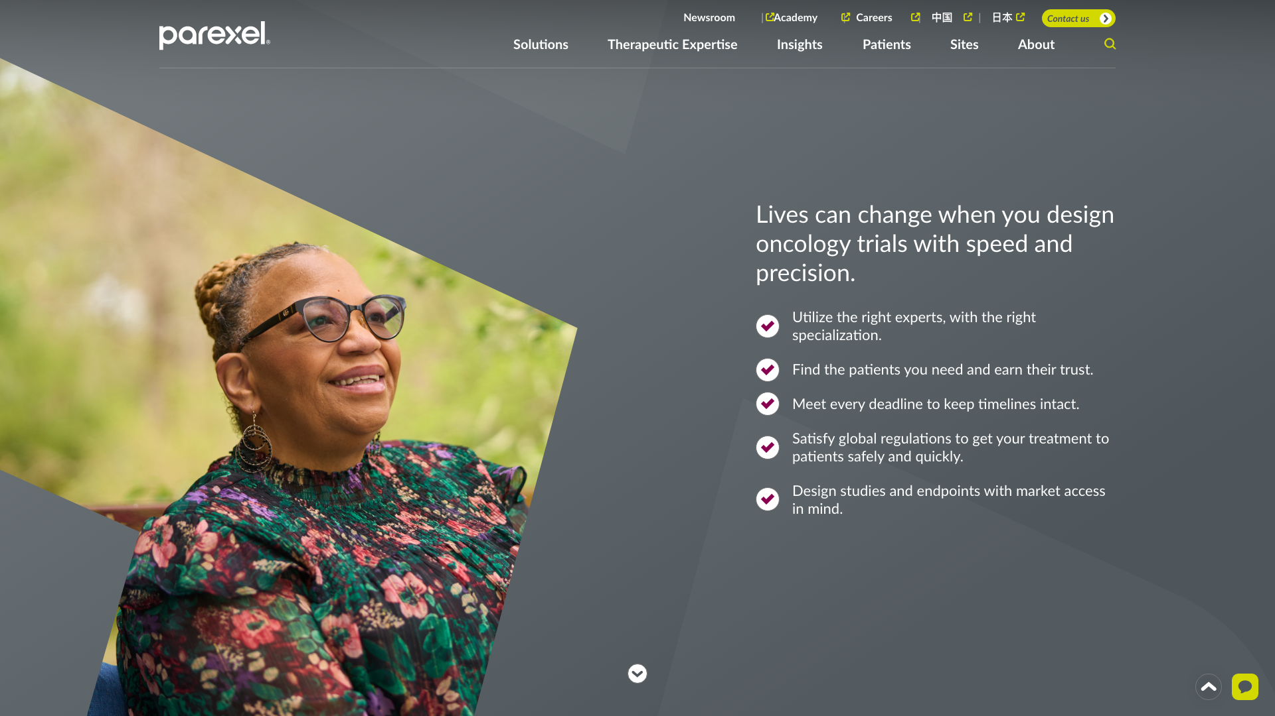
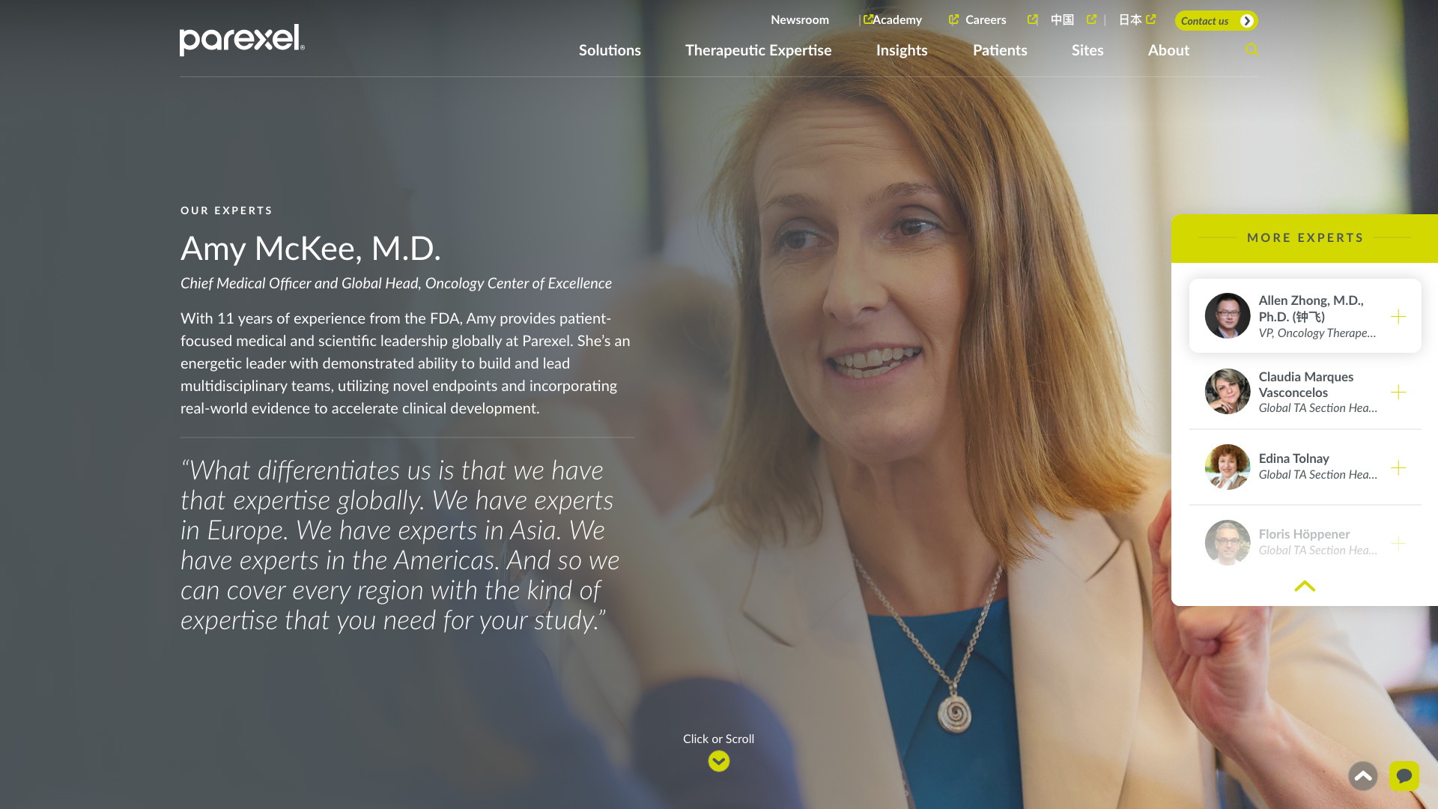
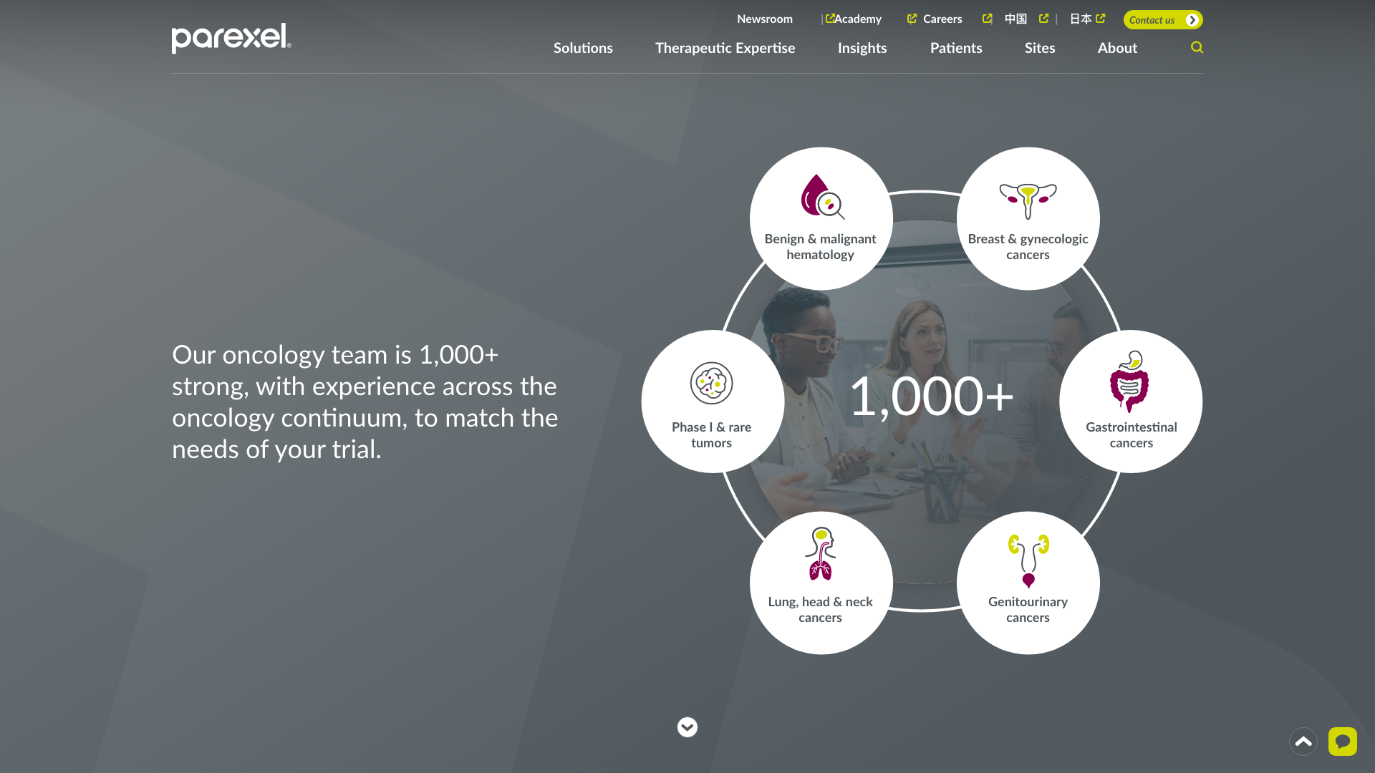
THE IDEA
Use interactive stories to portray Parexel as a company that changes patient lives, then engage visitors with approachable language, value-driven content, and an improved user experience to sell Parexel as a best-in-class partner and employer.

Slide 4

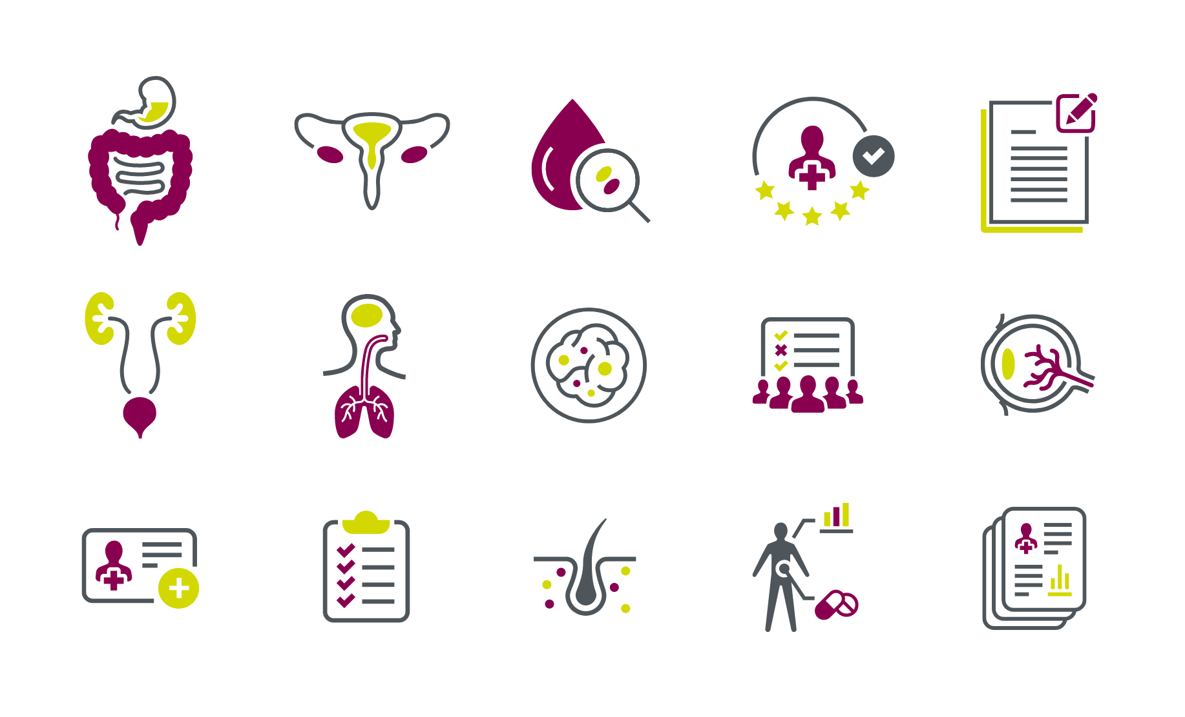

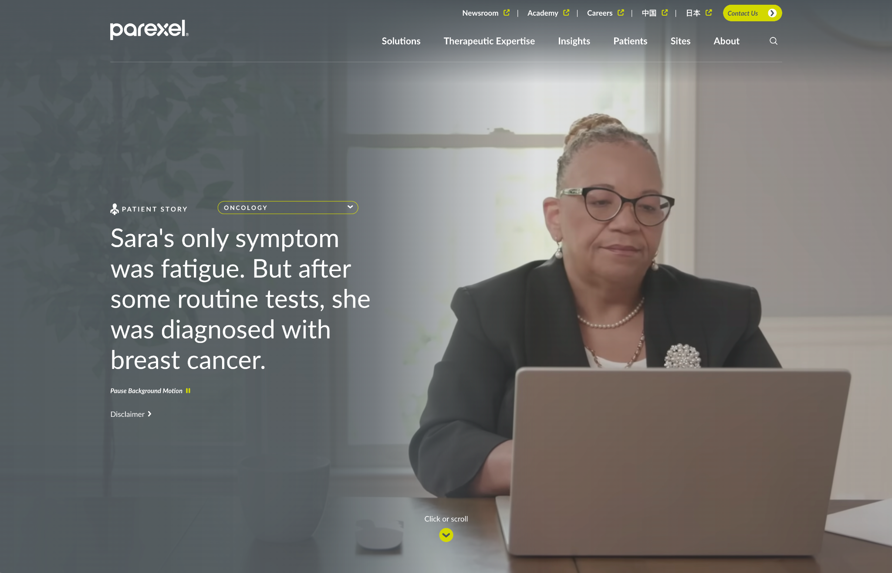
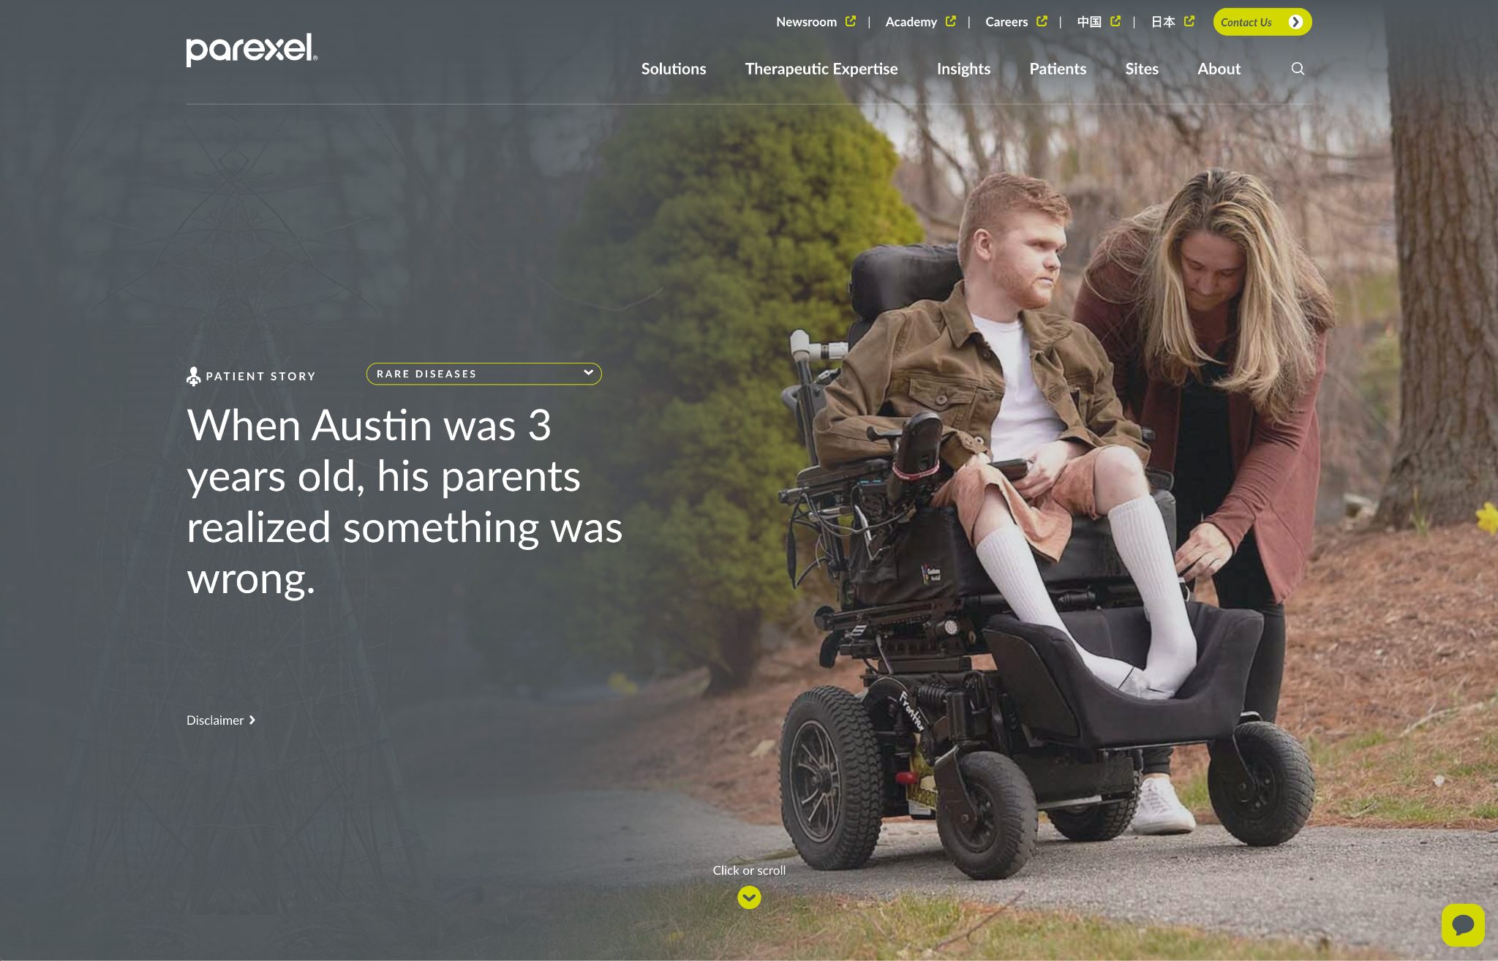
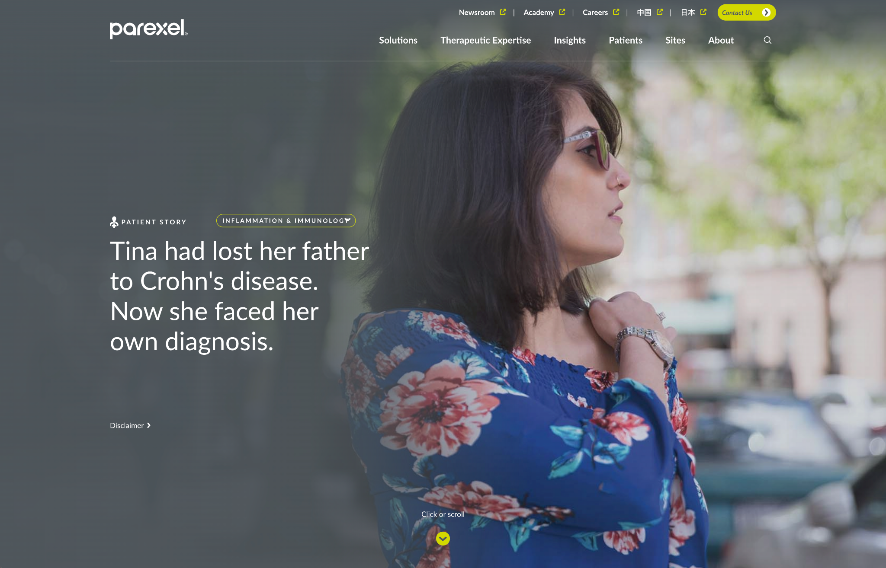
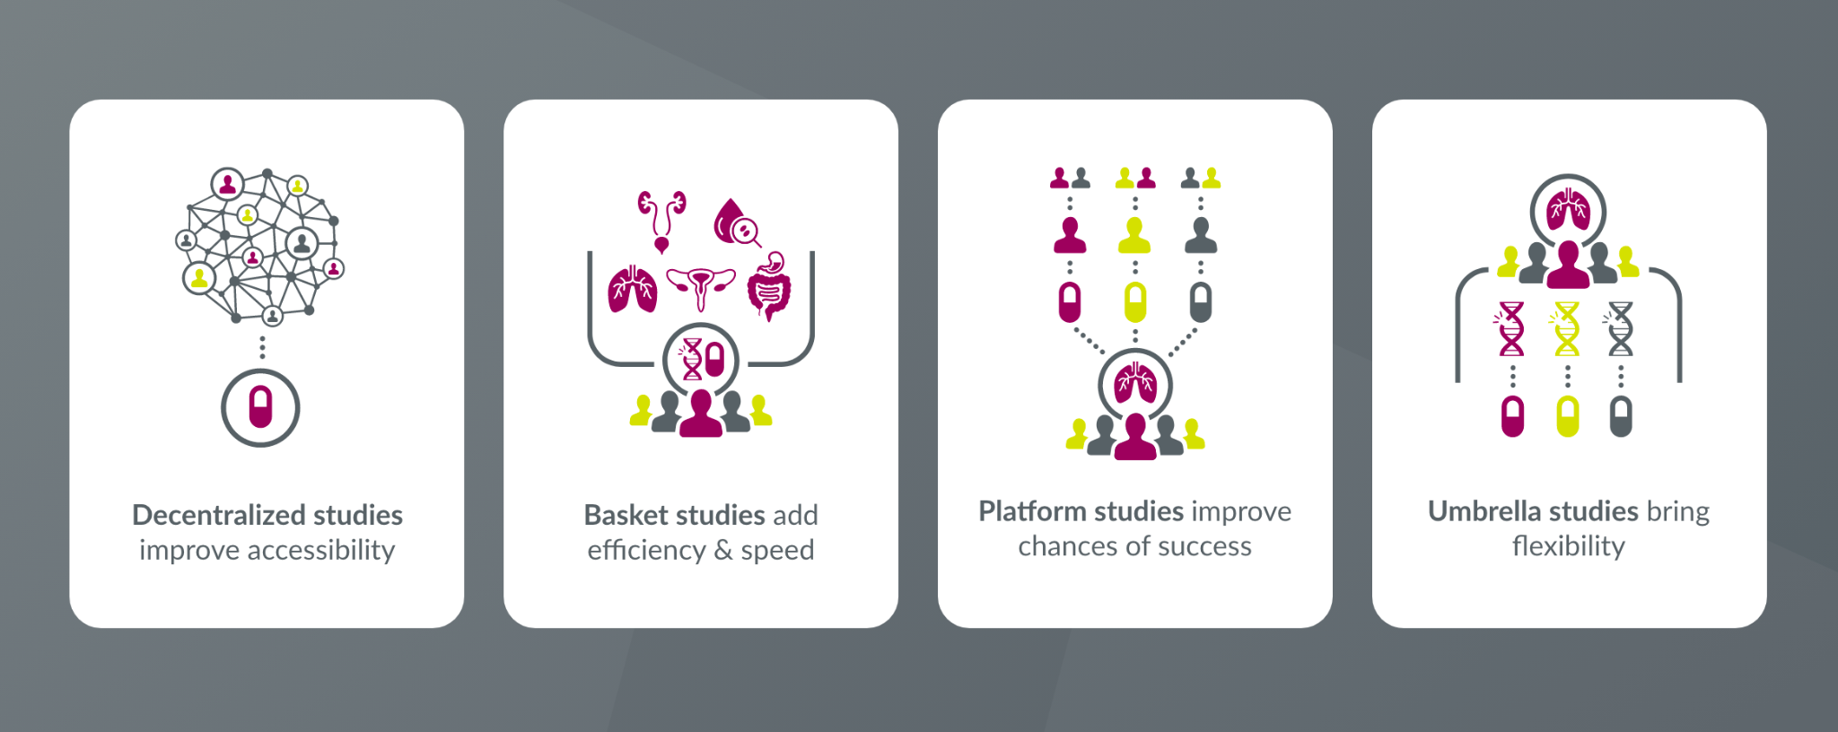
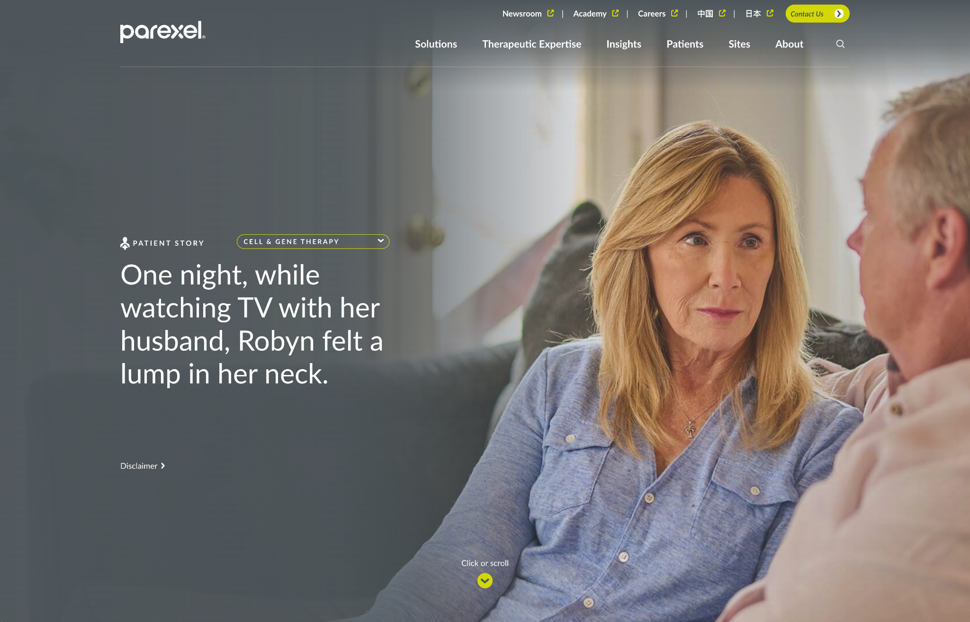
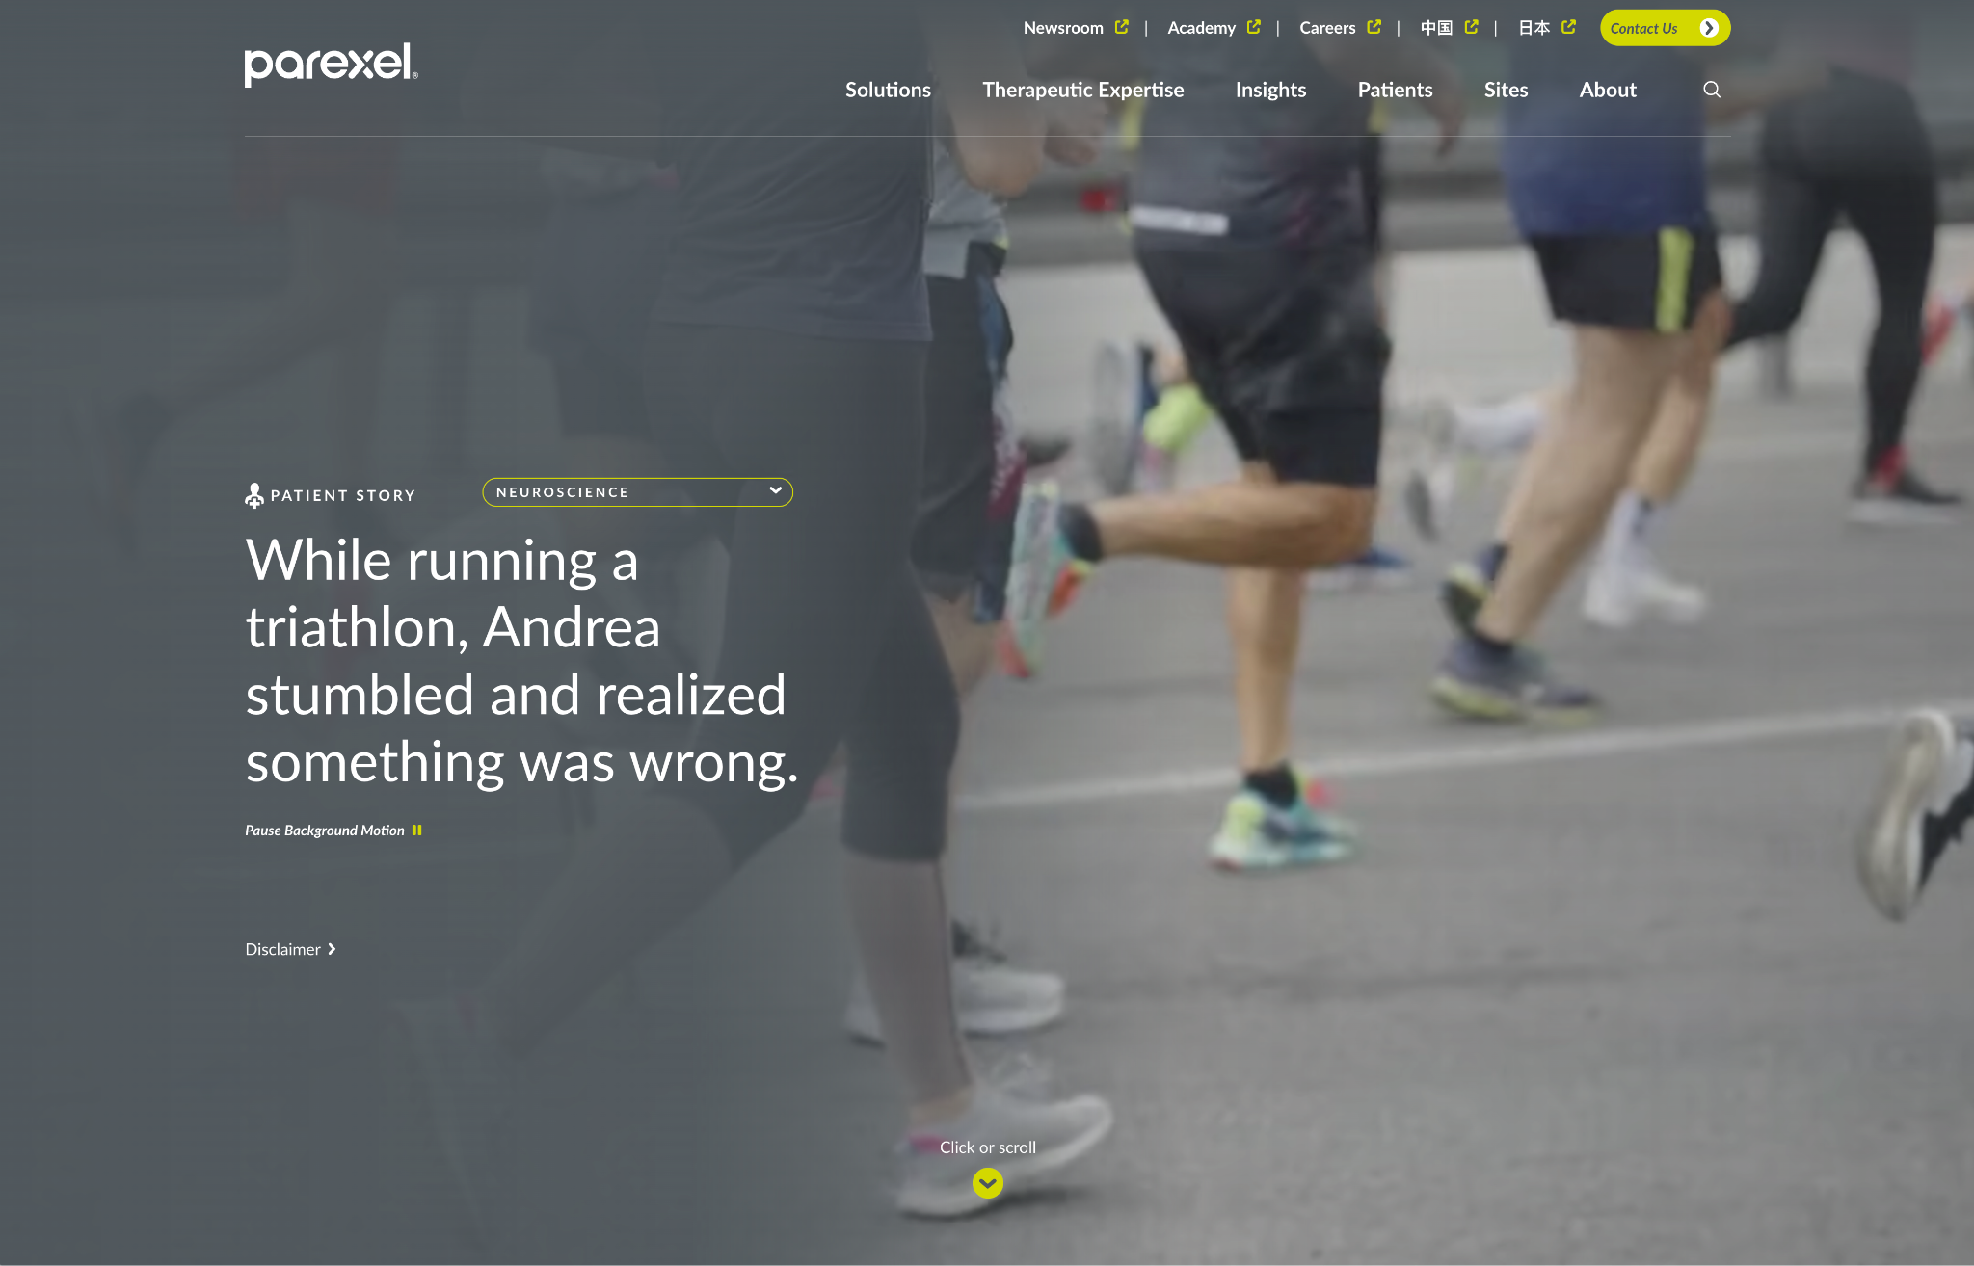

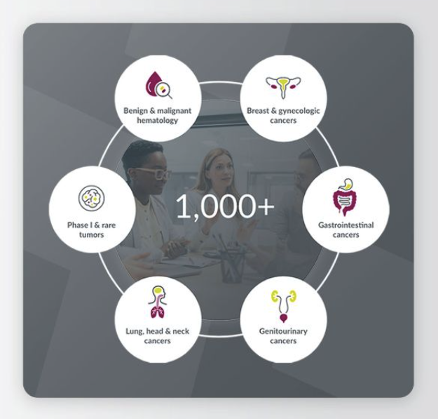
Oncology
Rare Diseases
Inflammation & Immunology
Cell & Gene Therapy
Success Story
Cell & Gene Therapy
Neuroscience
THE SOLUTION
Feature patient stories from Parexel’s five largest therapeutic areas on the homepage, and revitalize the rest of the site with approachable, benefit-focused copy, a simplified architecture optimized for search, a more engaging and intuitive Insights page, and a wide array of graphics, animations, and video.

Slide 5
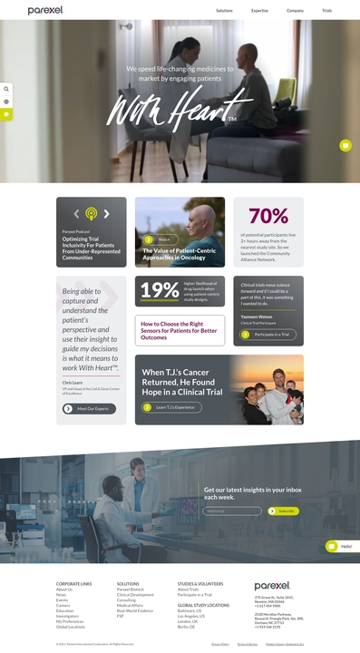
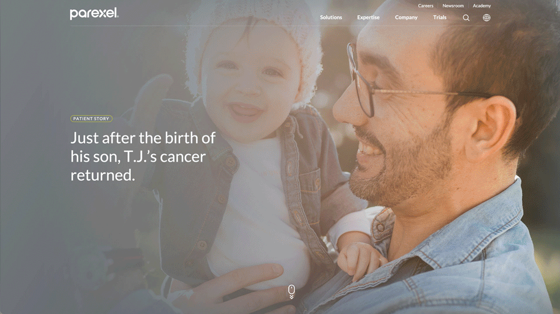
Explored multiple conceptual prototypes with stakeholders to hone in on the new vision

Slide 6
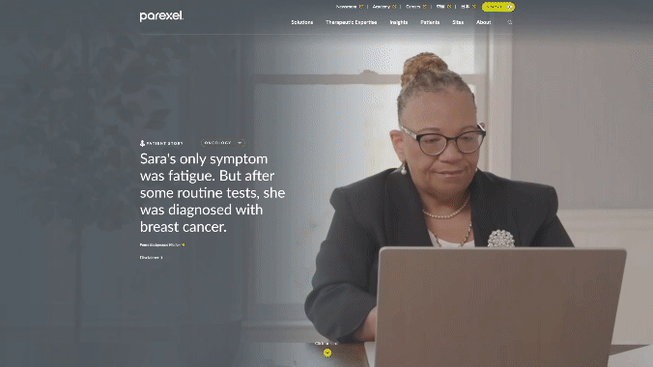
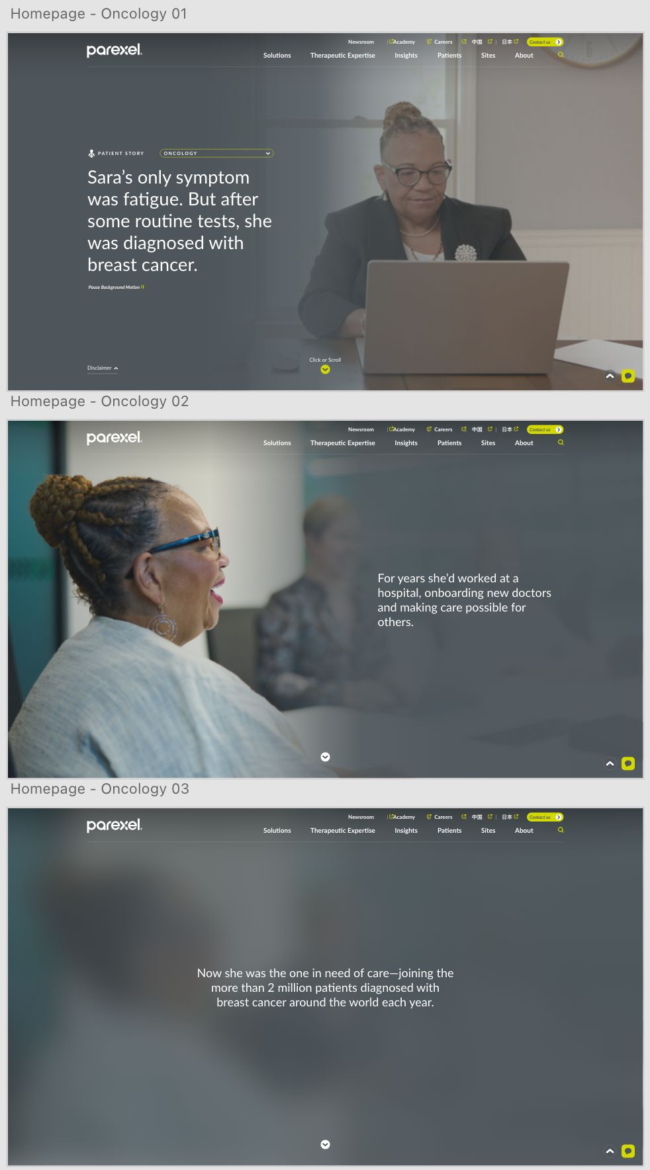
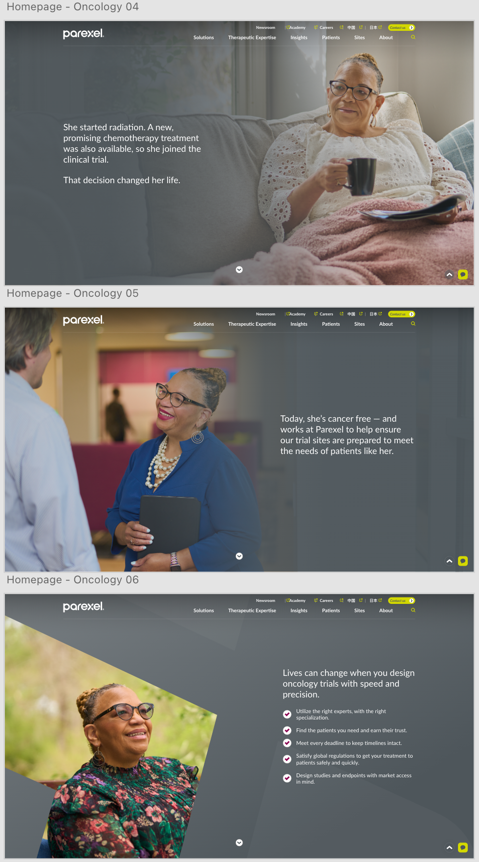
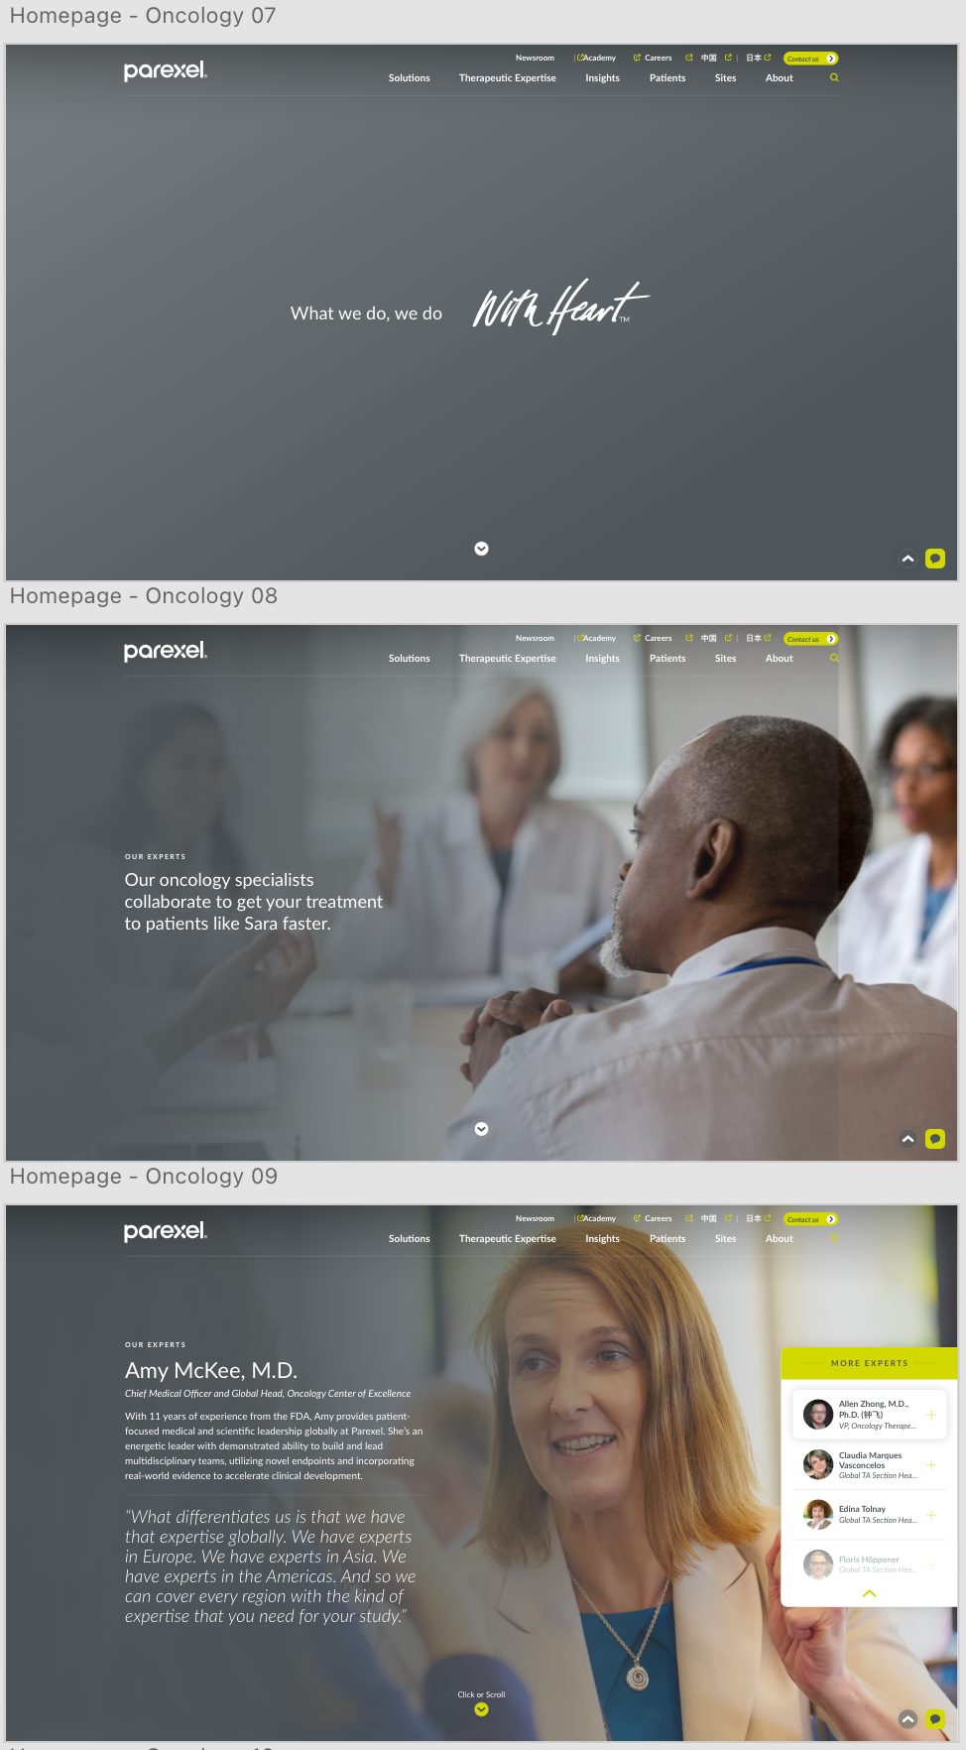
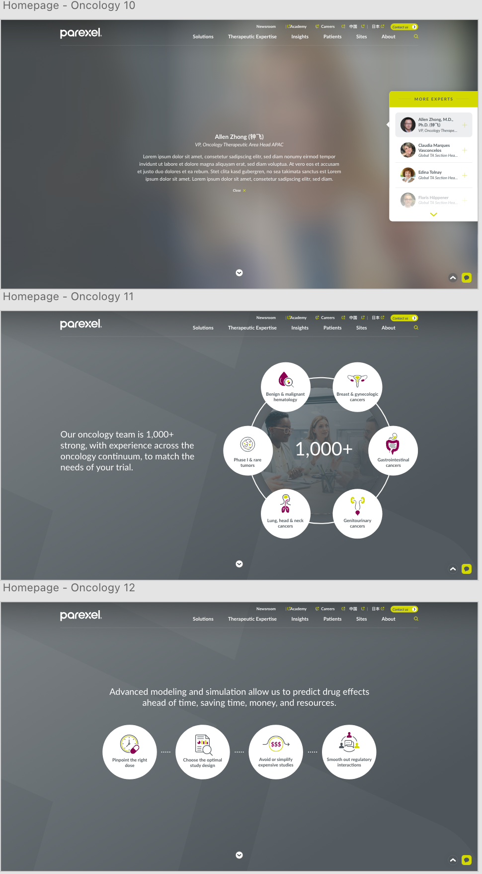
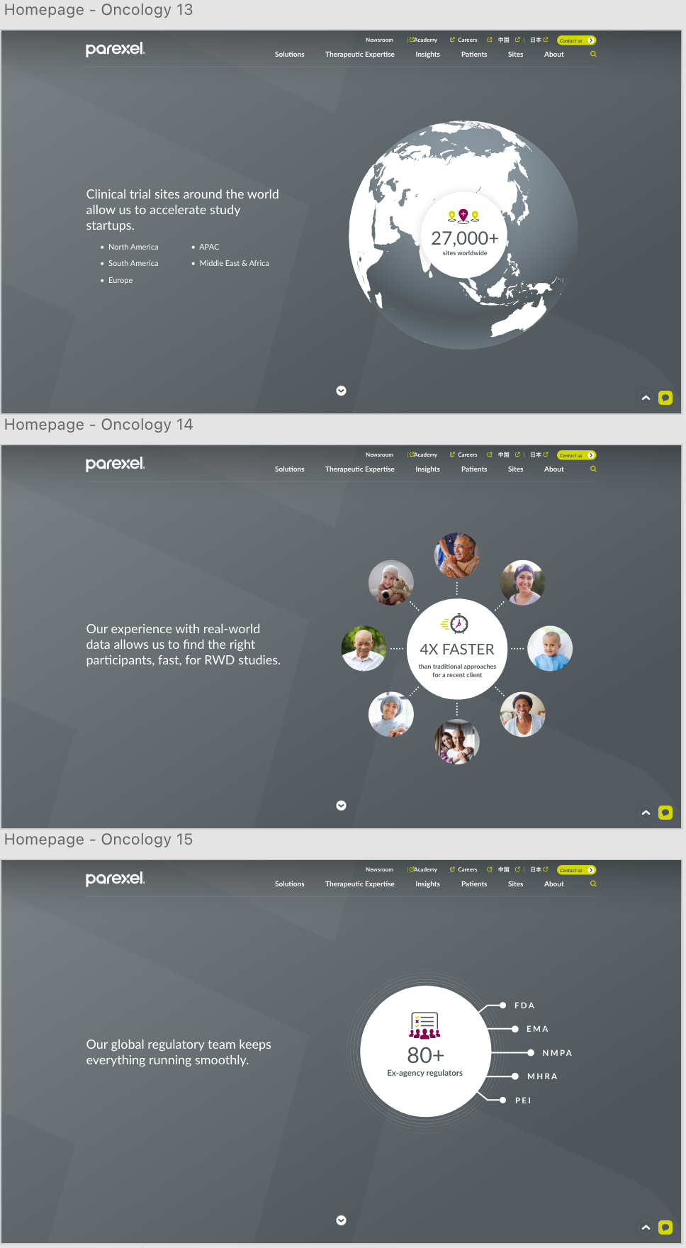
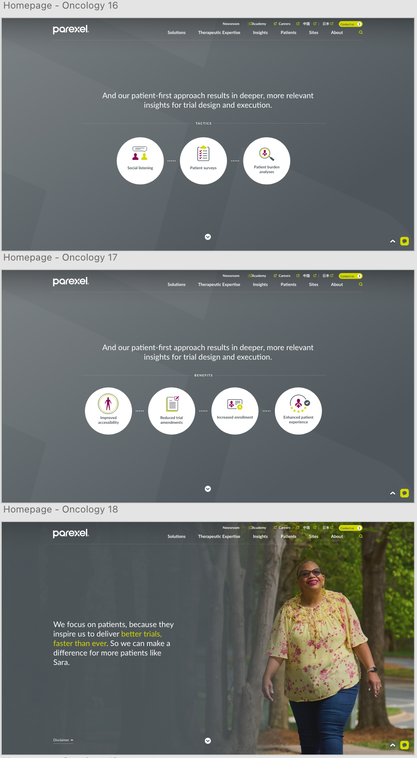
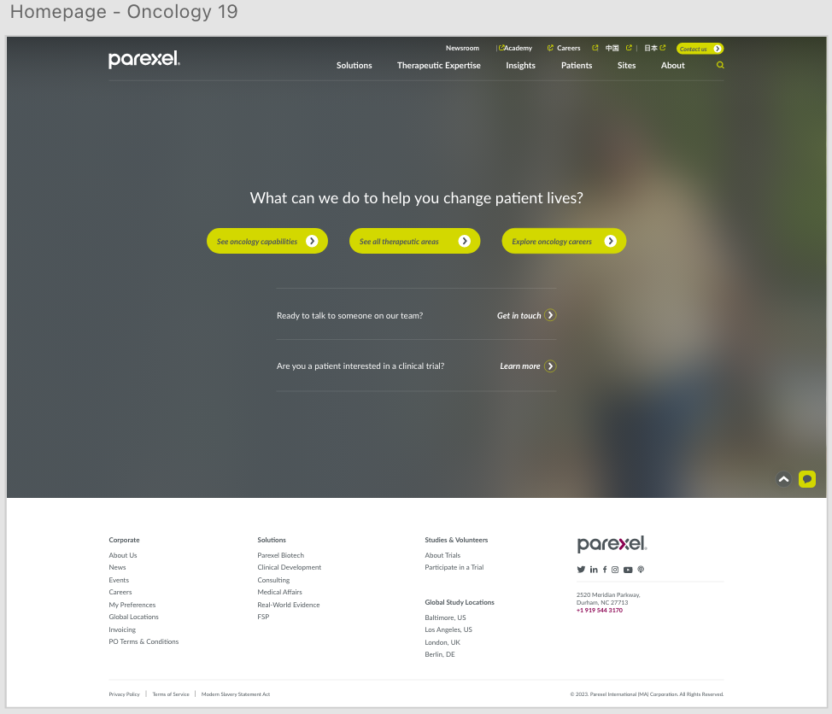
Created five patient stories that unfold as you scroll, with each highlighting one of their key therapeutic areas
Complete
Patient Story:

Slide 7
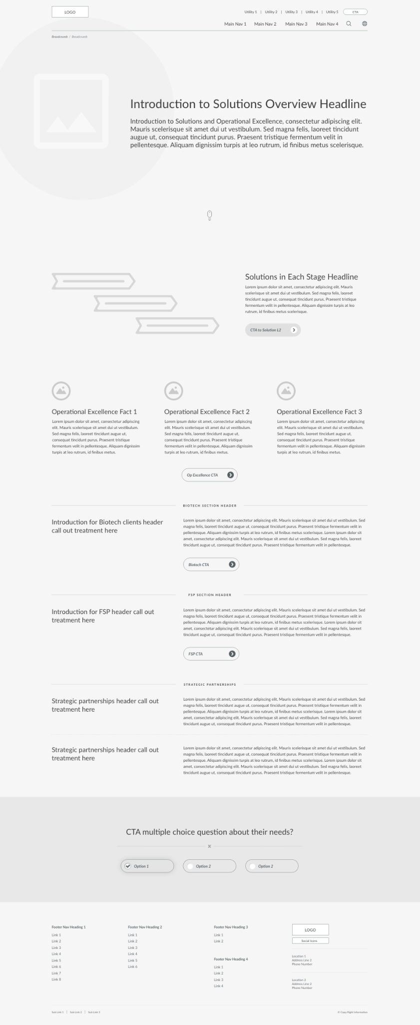
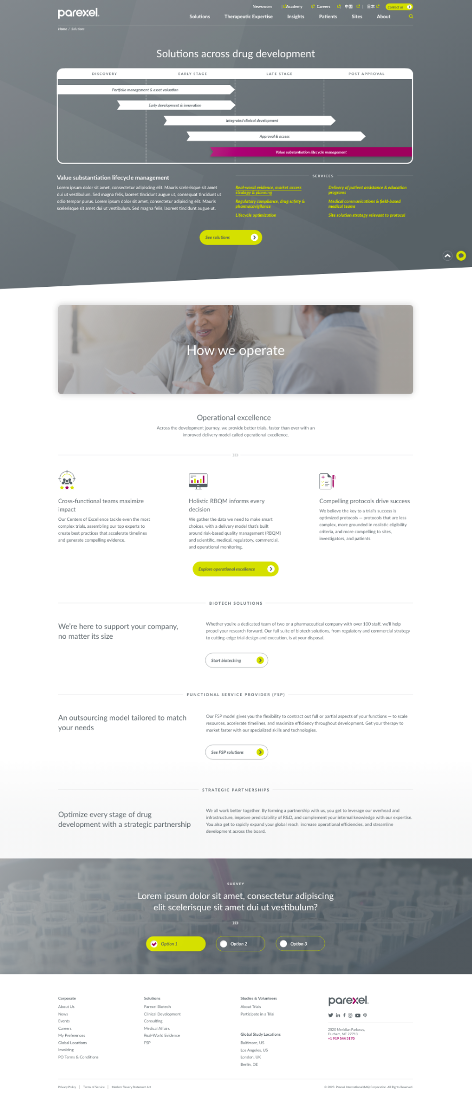
Underwent extensive UX exercises to develop clear, compelling ways to interact with the site

Slide 8
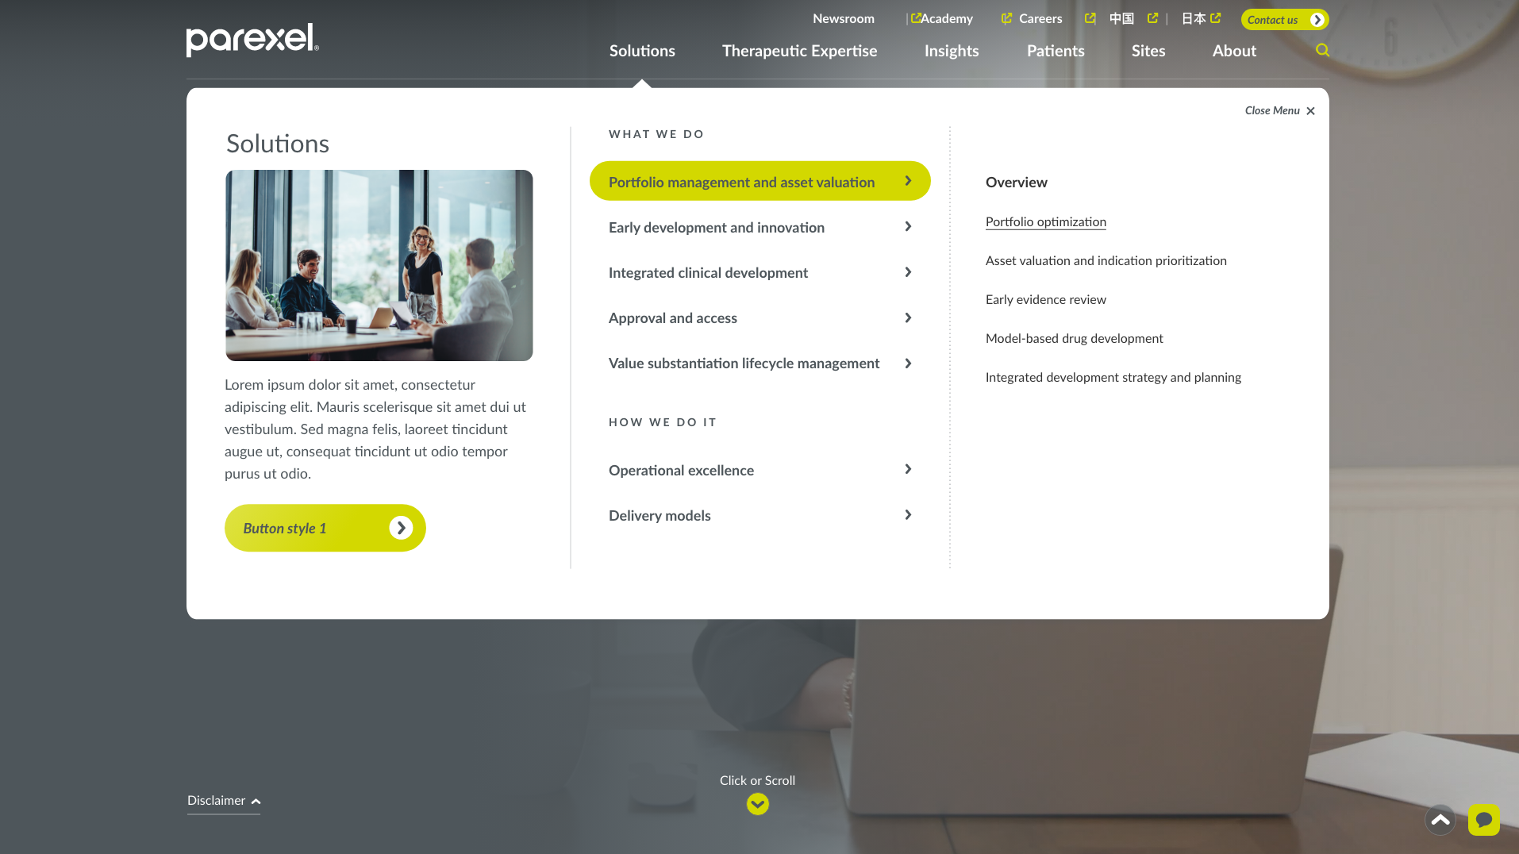
Re-architected the site with a simpler structure, streamlined navigation, and optimization for search

Slide 9
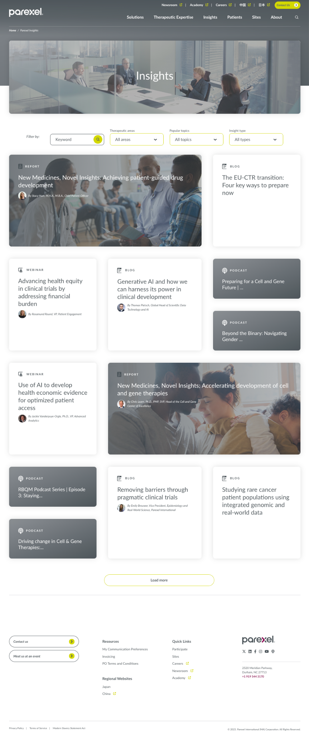
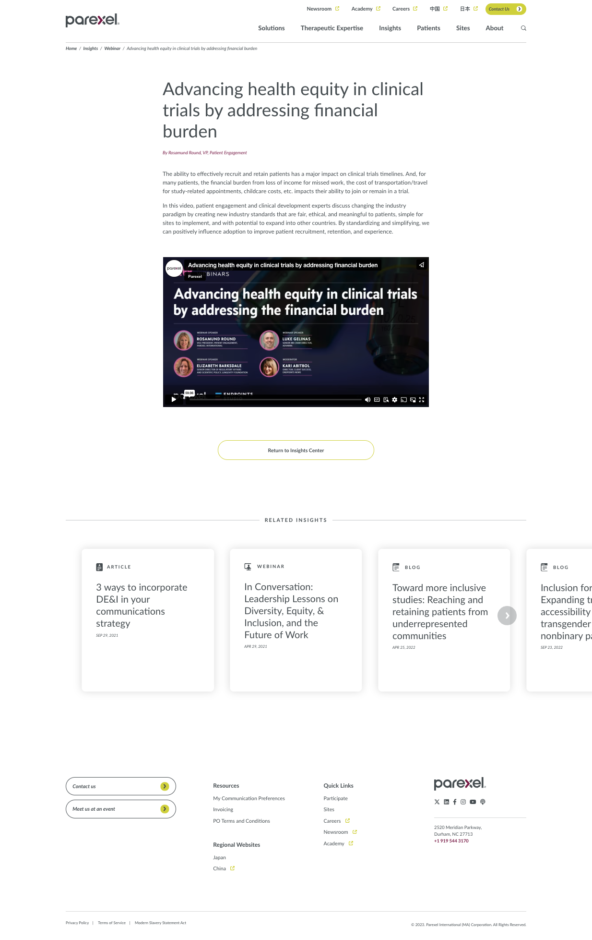
Developed a visually engaging, grid-based Insights page to better elevate their thought leadership

Slide 10

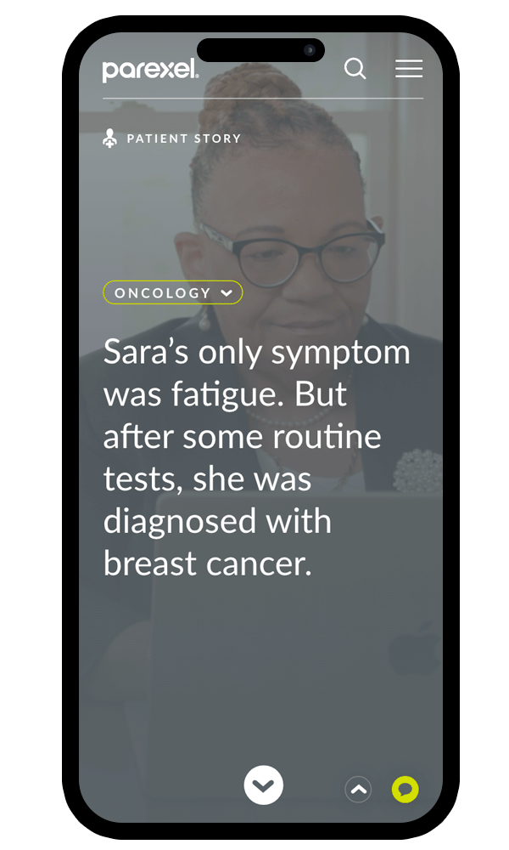
THE RESULTS
To inspire more people to choose Parexel, we created a website centered around telling their story and engaging visitors. The patient narratives, interactive content, and improved usability not only attracted more people, but kept them engaging for longer. Post-launch comparisons showed:
286% more traffic YoY (84% of which were new visitors)
81% longer time spent on site YoY
23% longer average engagement time on the Insights page
The new, search-optimized architecture also drove key performance metrics, including 110% more ranked keywords YoY — which gave them 37% more ranked keywords than a previously leading competitor.

